Slide 1
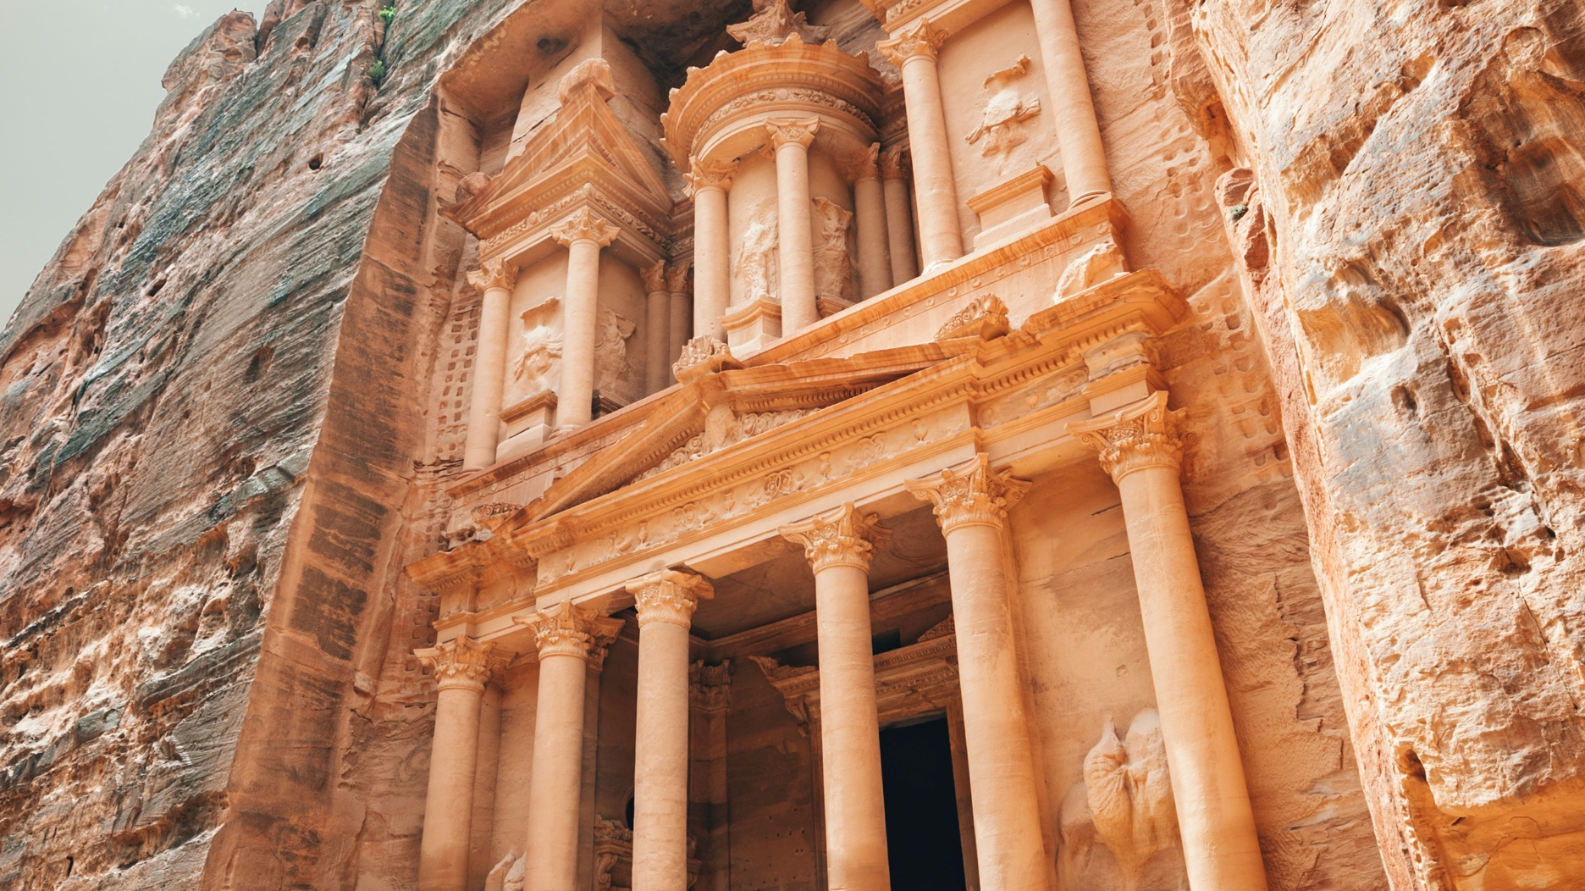
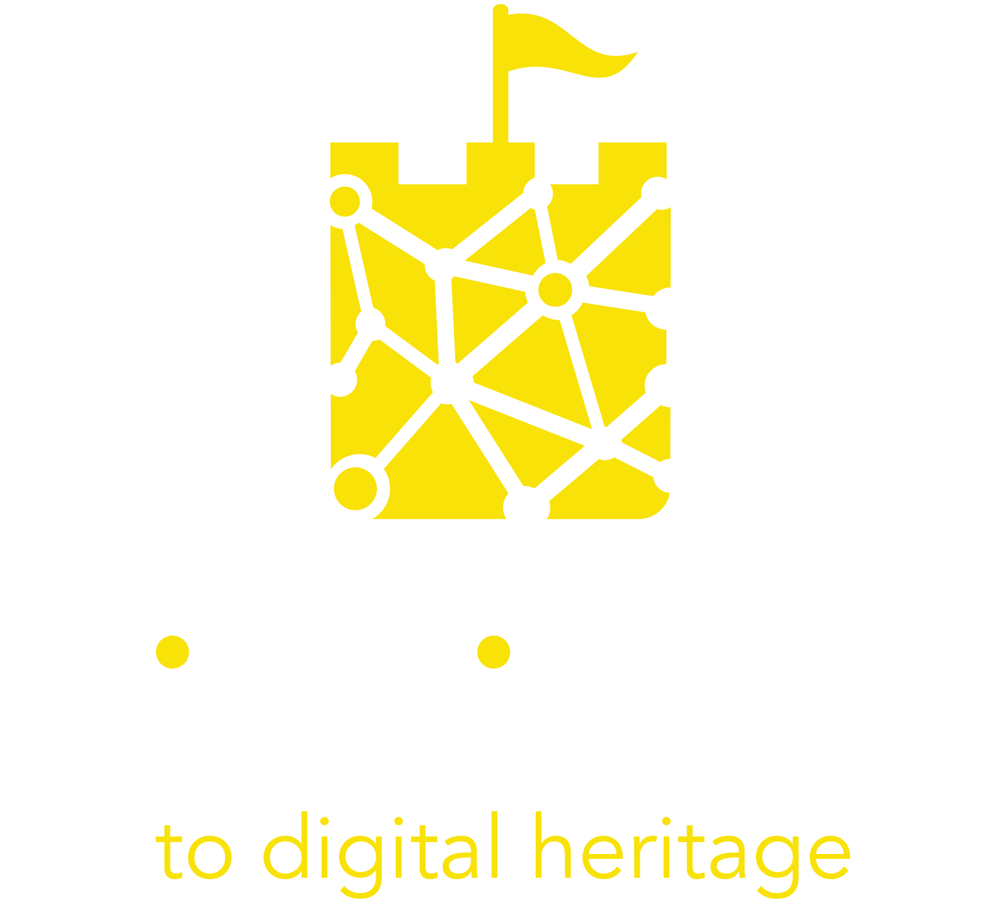
Module 7
Immersive Tourism Experience Canvas

Slide 2
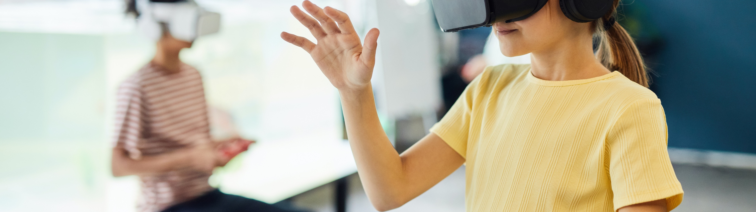
The Immersive Tourism Experience Canvas
The Immersive Tourism Experience Canvas is a strategic tool used for the visual development of the visitor experience. The aim is to easily define the main idea and the key activities of the experience offered. By using it you will be able to visualize your story in a simple, understandable way and to explore a new experience design model.
It is a one-page document that includes the basic elements of the immersive tourism experience design in a coherent way. It is designed to reflect what you have learned throughout this course.

Slide 3

The Immersive Tourism Experience Canvas is built up on 9 key elements:
Audiences
Cultural Heritage
Media
Data
Competition
Media Mix
Collaborations & synergies
Recognizing & overcoming the barriers
Sustainability
These elements are the main aspects that you should take into account when designing an Immersive Digital Tourism Experience.

Slide 4

Filling the canvas does not require long descriptions, but it calls for a reflection on the important points that should be taken into account when developing a digital cultural experience. It is more effective when it is used to brainstorm and to foster discussion within the working group. Finally, it can be useful to visually present the idea to others during the development phase.
LEARN MORE

Slide 5
Target audience
Cultural Heritage
Existing barriers
Demographics
Needs
Travel motivation
Macro-category of cultural visitors
Relationship with digital
About
Interpretation challenges
What feeling / meaning you aim to convey
Story to be told in one sentence
Inspiration
Vision & strategy
Skills
Resources
Confidence with the technology
Data
Core elements
Extended experience
Data generated
Data stored
Data usage
Unique value proposition
Storytelling
Wow moments
Technological elements
Interaction before the experience
Interactive features during the experience
Follow up activities after the experience
Sustainability
Collaborations & synergies
Media Mix
Social impact
Revenue model
Intellectual property rights
Social media and UGC (Facebook, Instagram, Tik tok, etc.)
Paid media (e.g. Advertising)
Owned media (e.g. Website)
Key partners on local / national level
(e.g. technical / content providers, local tourist providers)

