Slide 1
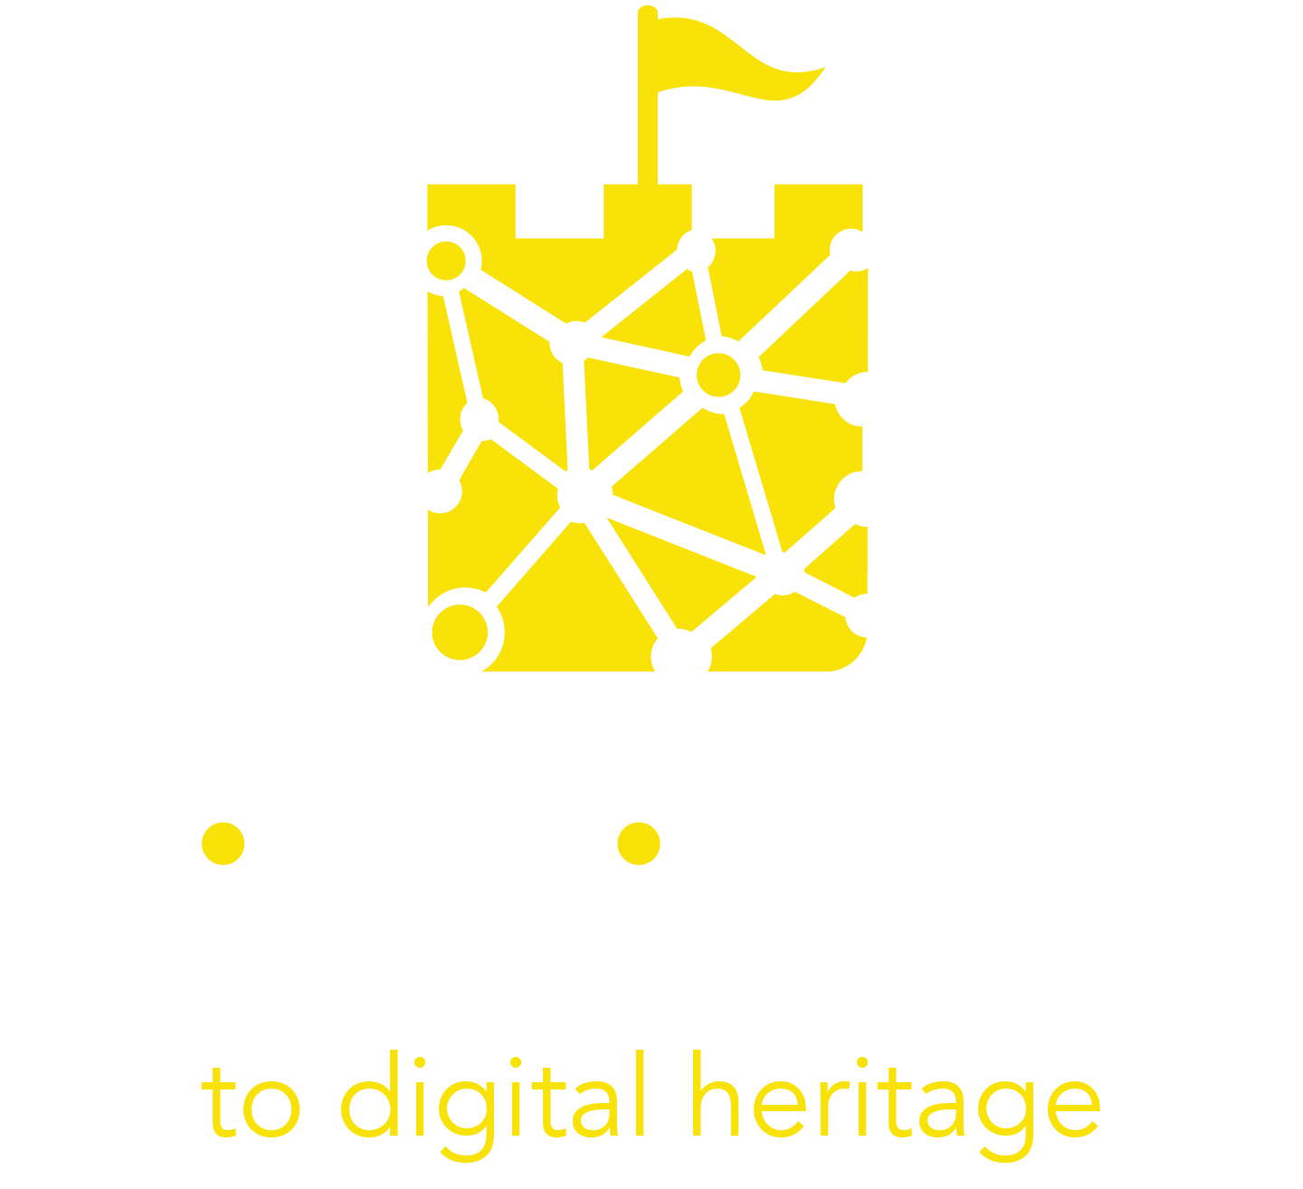
Module 5
Module 5
Digital Marketing for your Digital Cultural
Heritage Experience

Slide 2
Learning Objectives
When you complete this module you will be able to:
Differentiate between marketing and digital marketing
Explain and use the elements of digital storytelling as a key 21st-century marketing tool
Explain and use the user-generated content in your future marketing efforts
Evaluate best practice case studies of digital storytelling and user-generated content in practice
Recall 5 useful tools which can be used for the digital marketing of your digital cultural heritage experience

Slide 3
Contents
01
Digital Marketing for Digital Cultural Heritage
02
Spotlight on Digital Storytelling
03
Leveraging the potential of User Generated Content
04
Case Studies and Useful Tools

Slide 4
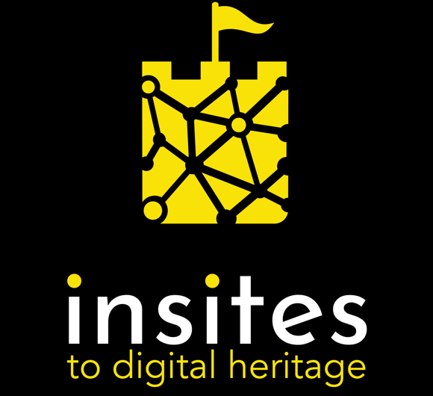
01. Digital Marketing for Digital Cultural Heritage

Slide 5
WHAT IS MARKETING?
Marketing is the action or business of promoting and selling products or services, including market research and advertising
Marketing is where your business puts the customer at the centre of all your activities

Slide 6
WHAT IS DIGITAL MARKETING?
Digital marketing is conducted via websites, search engines, blogs, social media, video, email and similar channels to reach customers.
In a nutshell, digital marketing refers to any marketing methods conducted through digital devices.

Slide 7
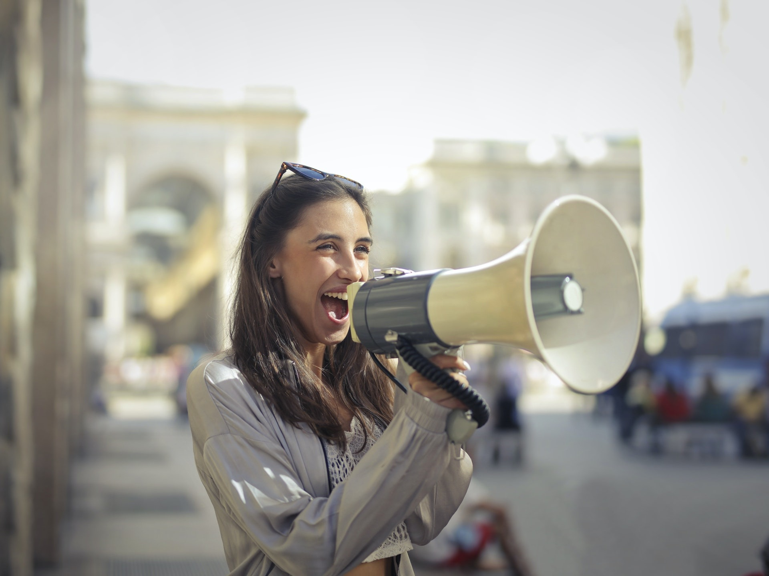
WHAT IS A MARKETING STRATEGY?
‘A Marketing Strategy is a business's overall game plan for reaching the right people and turning them into customers of the product or service that the business provides.
The marketing strategy of a company contains the company’s value proposition, key marketing messages, information on the target customer and other high-level elements’.
Source: Investopedia

Slide 8
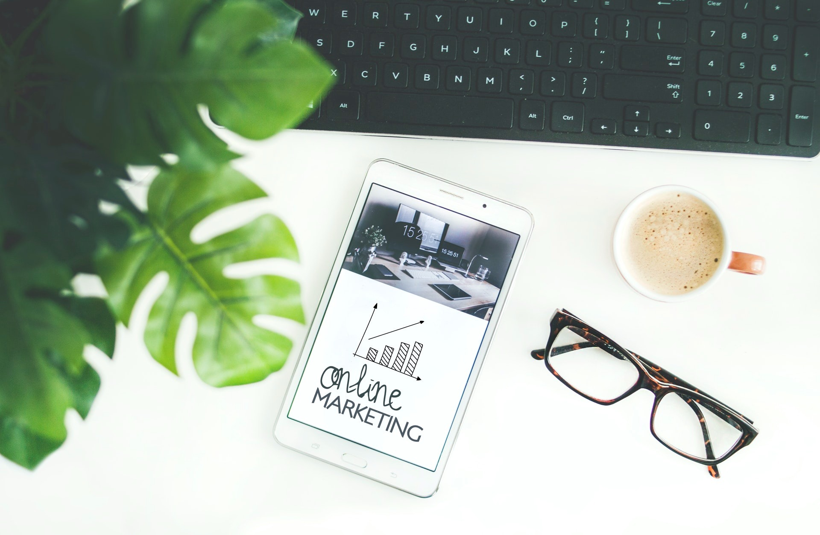
WHAT IS A DIGITAL MARKETING STRATEGY?
A digital marketing strategy is a set of planned actions performed online to reach specific
business goals. Digital marketing is of key
importance when we talk about digital cultural heritage.
Performing a regular digital marketing audit is a great way to assess what’s working and what you can improve on. Do this before you engage in any promotion actions for your new digital culture heritage initiative/activity.
Source: Investopedia

Slide 9
WHY IS DIGITAL MARKETING IMPORTANT TO DIGITAL CULTURAL HERITAGE?
To remain relevant and attract a younger generation, cultural heritage organizations need to move to and include digital marketing strategies. Cultural heritage has great advantages to leverage in digital marketing:
A long and rich history
A sense of nostalgia
A unique provenance
An expertise or very special savoir-faire
This gives cultural heritage organizations a head start in developing authenticity and trust with their audience - two traits that we are learning are very important in digital marketing.

Slide 10
SUGGESTED ACTIVITY?
Perform a Digital Marketing Audit
A digital marketing audit is a comprehensive check-up on every single part of your entire digital strategy.
At the end of the audit, you should be crystal clear about what is going right and wrong plus a highly actionable report that you hand to your marketing team or agency.
There are lots of great online resources which you can use to help you conduct a digital marketing audit.

Slide 11
02. Digital Marketing Techniques - Storytelling

Slide 12
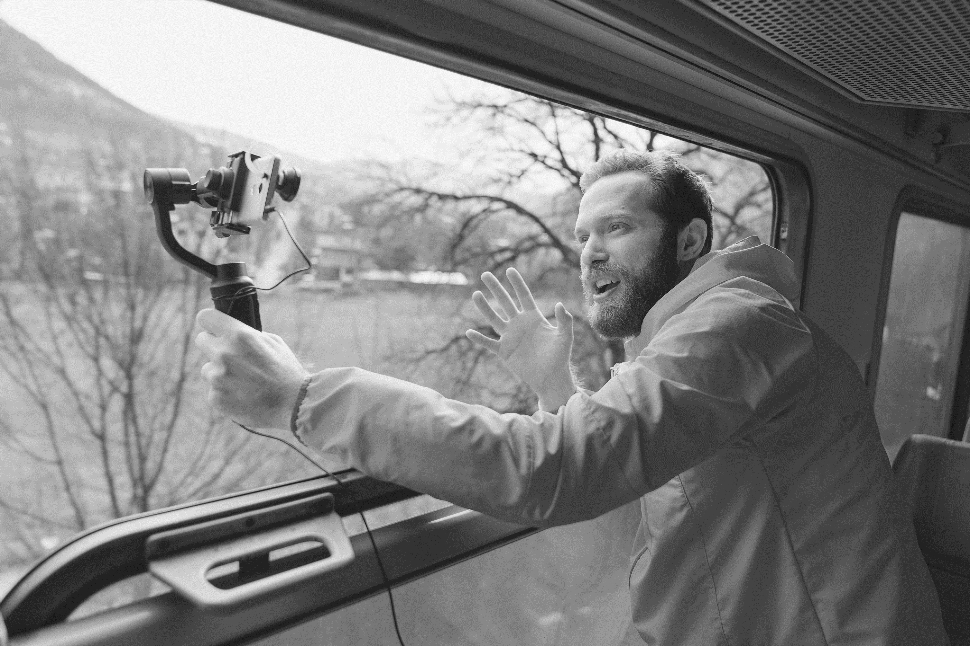
“Storytelling is the most powerful way to put ideas into the world today.”
Robert McKee

Slide 13
What is Storytelling and how does is relate to marketing?
Storytelling is the process of making a connection with the customer first, and selling a product second
Through skilful writing, however, a story is created that not only connects with customers; it establishes the company as a trusted resource
A customer makes an emotional connection with the story, and the message is considered genuine. Even though the customer is aware that the story is being used to ultimately sell something, they are still more inclined to purchase based on the connection they made through the story.
Storytelling is a really important element in this training course, please see Module 3 for more learning on this topic

Slide 14
What is digital storytelling? And why is it a powerful marketing technique?
Digital storytelling is a new method for organizations to attract viewers to their website using storytelling techniques and digital technology. Rather than tell their story using one method such as video or text, companies use these elements as well as images, recorded audio, animation and music.
Source: ifamemedia.com

Slide 15
Storytelling for Marketing
Storytelling in marketing is vital to the success of your brand because of the connection-­building power it contains. Brand storytelling is a specific type of content marketing that draws us in emotionally.

Slide 16
The types of stories you could tell…
Start with your Personal Story: Your history, how you got started, the choices you made, were other characters involved?
Your Passion Story: What you love and why you love what you do.
The Personality Story: How people might experience your brand, the customer experience or your approach to the work.
The Customer Story: What do you customers say about you?
Employee Story: How employees explain the systems, the ‘feel’ or culture of the business

Slide 17
For example..
The wAVE Project
The Cornwall Museum built immersive experiences with five small heritage venues enabling them to tell stories in new and different ways by leveraging user-centered design. In the long-term, these projects boosted the digital confidence of the teams in these museums changing the way they tell stories and what they could do in the future.
LEARN MORE
You can learn about this case study at this link.

Slide 18
Elements of Digital Storytelling
A beginning
Like a good movie screenplay, a good digital story should have an event that starts the story, problems that must be overcome and a strong ending.
There are some other key characteristics too. Let’s take a look…
middle
end

Slide 19
Elements of Digital Storytelling
Emotion
A story can be great in its technical adherence to storytelling rules, but it’s even better if it contains emotion. Emotion is what connects us as people (and consumers!). Emotional marketing is a form of marketing communication in which (a singular) emotion is leveraged to help an audience identify with- and buy a product. Emotions in marketing like anger, happiness or compassion give more meaning and depth to the experience of a brand or product.

Slide 20
Elements of Digital Storytelling
Authenticity
People can tell right away if a story is not adhering to the truth and values of the brand or their customers. When practiced correctly, authenticity in marketing helps you stand out in an otherwise loud market. Authenticity is a powerful tool for forging genuine connections with your audience and building trust. Remember, many consumers care about a brand’s values and the causes they support.

Slide 21
Elements of Digital Storytelling
Relatable
People must feel some sort of connection to the story, otherwise it will not resonate with them. How many times have you heard someone say, “I didn’t like that movie because there was nobody likeable in it?” That’s a perfect example of not making something relatable. In marketing, being relatable means really listening to prospects and customers and being truly interested in what they have to share about themselves.

Slide 22
SUGGESTED ACTIVITY?
Make your brand story by answering these questions
This exercise will help you to develop powerful marketing material which can be used to start PR campaign.
How, when and why did your business get started?
What is your own background? The background of the heritage asset you promote?
Who helped you get started? e.g. local historian, heritage group...
How do you source skills and ideas for your services?
What are your unique selling points? (what makes you different from others selling similar things)
What matters to you? Personally, professionally etc.
Are you conscious about protecting the environment?
How do you envision the future?

Slide 23
Digital Storytelling + social media
Social media and online platforms allow cultural sites and museums to communicate with visitors in real time, in a simple, free and interactive way.
Behind-the-scenes stories used in tandem with previews of events or temporary exhibitions, quizzes and interactive games are just some of the options that you can use to increase user engagement and consequently strengthen the brand of your cultural institution.

Slide 24
For example..
Rijksmuseum on TikTok
107.3K Followers
528.7K Likes
The National Museum of the Netherlands has deployed Tik Tok as a key marketing tool. They use it to create an extra layer of engagement for visitors before and after they visit. They are encouraged to take part in drawing challenges and more..
LEARN MORE
You can learn about more tools in our INSITES technology toolkit on our website

Slide 25
TOP TIP – For your Digital Storytelling efforts to be successful, you need to fish where the fish are and use the right bait!
Each social media network has a specific target audience. Digital Storytelling and marketing work best when you keep this in mind and create tailored content for each of these generations of users:
Millennials on Instagram
Gen Z on TikTok
Baby Boomers on Facebook.
Understanding and knowing your target users is again a key factor for successful communication. (This takes us back to Module 4 and our persona exercise again!)

Slide 26
Digital Storytelling + video
Videos are one of the most powerful ways to engage with an audience. In fact, two thirds of people prefer video over text while learning. Videos are entertaining and they manage to catch and keep the attention high much longer than textual contents.
Above all, younger generations are the most assiduous consumers of video contents: a marked majority of users aged between 18 and 29 say they use Snapchat (71%) and Instagram (73%) daily, with more than half reporting doing so several times a day.

Slide 27
Digital Storytelling + video
example..
King of the Vikings Waterford – Vox Pops
The term "vox pop" comes from the Latin phrase vox populi, meaning "voice of the people". Random subjects are asked to give their views on a particular topic and their responses are presented to the viewer/reader as a reflection of popular opinion. In this video, you can see the vox pop used for marketing purposes.
King of the Vikings VR - Vox Pops - YouTube

Slide 28
TOP TIP - Digital Storytelling in Action - Go Live with Virtual Video Live/Guided Tours
In recent years, we have witnessed the Coronavirus pandemic force everyone to stay home, which caused many cultural heritage sites to close their doors and go virtual. Many created and offered guided virtual tours instead of in-person tours.
BUT virtual tours are not just for pandemics. They are an important element in making cultural heritage travel more accessible especially for those who may not physically be able to travel. (If you hadn’t included this type of persona in your Module 4 work, we suggest you consider them now.)
Streaming free guided tours that tell powerful stories will strengthen the presence and brand of your heritage assets for a more inclusive and widespread dissemination of culture. Today, it is possible to organize live tours in a simple and almost completely free way, thanks to digital tools thanks to video conferencing tools and social networks.

Slide 29
3. Leveraging the potential of User Generated Content

Slide 30
What is User Generated Content?
UGC is an acronym for User Generated Content, a term that refers to contents published online autonomously and voluntarily by users. When people visit a museum, an art exhibition or make a cultural experience, they often wish to share their experience with friends and followers on their social media profiles. This content production, that consists mainly in publishing photos, videos and short reviews, often results in a quite remarkable image gain for the cultural organization.

Slide 31
Forms of User Generated Content
We define as UGC any content about a brand that a customer creates and shares online on their own initiative. This can be in the form of visual UGCs, such as pictures, selfies and videos or textual UGCs such as online reviews and testimonials published on third-party review sites (Google, TripAdvisor, etc).

Slide 32
User Generated Content and Digital Storytelling
UGCs play can play an essential role in promoting the museum’s brand image as closer to visitors and to their expectations. This is especially important when there is a digital cultural heritage and/or immersive tourism element.
UGC can lead to online conversations about your heritage asset. When you repost user generated content, its creator feels appreciated and rewarded, and these feelings contribute to the creation of a strong relationship based on trust and friendliness.
In this way, UGCs humanize brands and create more direct connections with present and future audiences. Harking back to what we learned about digital marketing, we can get a sense of how UGCs can bring emotion, authenticity and relatability to your marketing efforts.

Slide 33
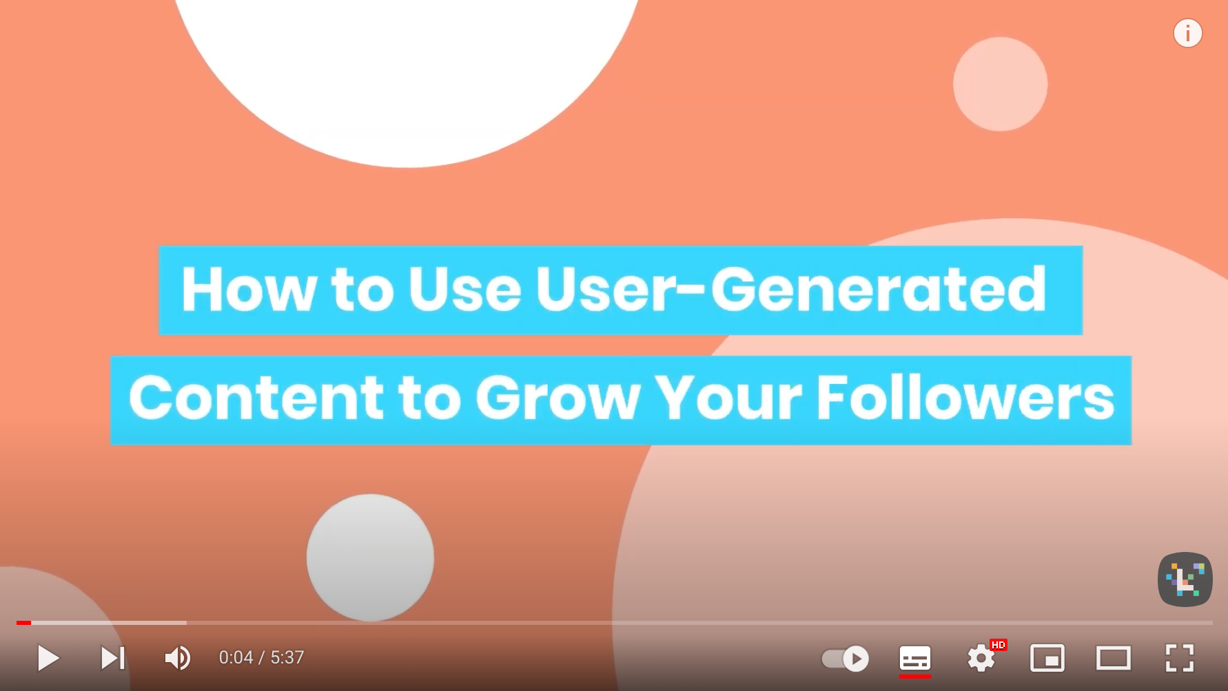
Watch this video and learn even more about UGC
Link: https://www.youtube.com/watch?v=mD_73JCEaNc&t=2s

Slide 34
04. Case Studies and Useful Tools

Slide 35
Case Study
The MET Museum
The MET Museum in New York organized online guided tours during the COVID19 pandemic.
They offered over 116 tours between July and December 2020 and reached over 2800 virtual visitors.
In this video, you can take an
Exhibition Tour—Making the Met, 1870–2020, Narrated by Steve Martin

Slide 36
Virtual Visits with the British Museum
Virtual visits with the British Museum are led by an expert who delivers a live workshop via Zoom.
Designed primarily for schools, the virtual visit includes live activities, interactive quizzes and thought-provoking questions your class will enhance their knowledge and understanding of the past.
You can learn about more tools in our INSITES technology toolkit on our website

Slide 37
Virtual Tours of Dubrovnik
The coronavirus outbreak in 2020/2021 put many vacation plans on hold, leading many tech-savvy heritage and tourism providers to innovate. For example, in the city of Dubrovnik, tour guides began to offer virtual live streamed tours.
ToursByLocals guides are now delivering virtual guided tours so you can meet a local and explore a new city, from your own home. They have built in a clever marketing trick/special offer “Redeem 100% of the value of your Live Virtual Tour (to a limit of $150 USD) when you book a future, in-person tour with the same guide!”
LEARN MORE

Slide 38
Case Study
Royal Palace of Caserta, Italy
Podcast
The Royal Palace of Caserta, in Italy, has launched a series of online podcasts available on Spotify
The Podcast tells the story of the palace and of those who have lived in it over the centuries. Two examples are the series dedicated to the"Stories of Women in the Construction of a Kingdom" and the TerraeMotus40 series that focuses on the Terrae Motus contemporary art collection of the Palace.
You can Audio stories | Royal Palace of Caserta (cultura.gov.it)
LEARN MORE

Slide 39
References
McIntyre (2020) Culture in Lockdown. Part 1: We can do digital, can we do strategy? https://www.culturehive.co.uk/resources/culture-in-lockdown-part-1-we-can-do-digital-can-we-do-strategy/
Abrams (2019), Personas and designing the ideal museum experience, accessible at: https://cutt.ly/DQnUvg1
Prensky (2001), Digital Natives, Digital Immigrants, accessible at: https://cutt.ly/0nJdZAP
Global Web Index (2019) Audience Report, accessible at: https://cutt.ly/7QnKH16
McGarry (2021), Attracting Millennials to Museums: Your Complete Marketing Guide, accessible at: https://cutt.ly/LnJdLqp
Lu (2021), How Heritage Organizations Can Find Their Way Into Digital Storytelling, accessible at: https://jingculturecommerce.com/heritage-digital-digital-storytelling-takeaways/
Revelx, Persona Canvas, accessible at: https://cutt.ly/SQnJZ2c
Nielsen Norman Group (2018), Empathy Mapping: The First Step in Design Thinking, accessible at: https://cutt.ly/EQnKSNX
Chen (2021), How The V&A’s New Digital Platform Centers Access and Audience, accessible at: https://cutt.ly/snJdFZa
Coates (2019), Modern museums in the internet generation - memes and millennials, accessible at: https://cutt.ly/RnJdJve
Abrams (2019), Personas and designing the ideal museum experience, accessible at: https://cutt.ly/TQnUmbq
Culture Connect, Practicum Vol. 1: Empathy Maps https://cultureconnectme.com/practicum-vo-1-empathy-maps/

Slide 40
Next Steps – Module 6
Our next module covers the topics of working in
partnership with other cultural heritage custodians

