Slide 1
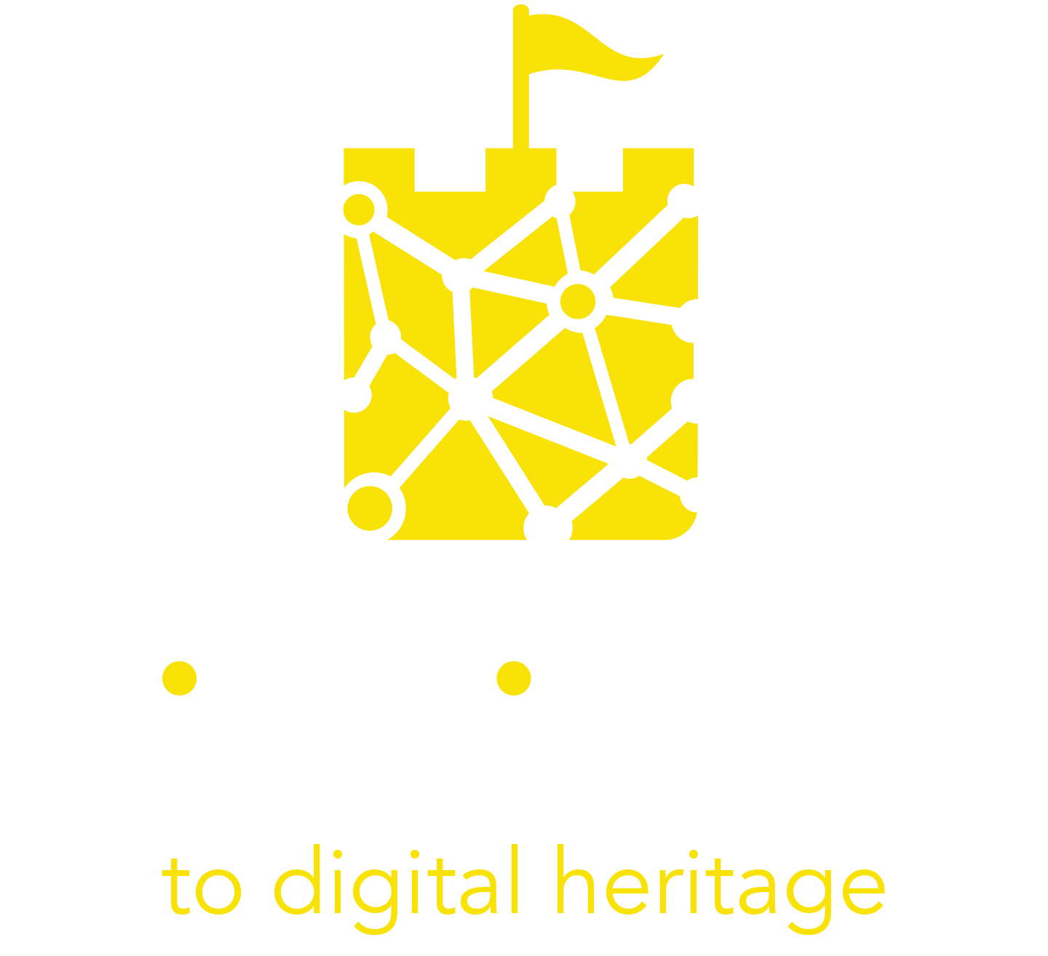
Module 4
Understanding Immersive Tourism Audiences

Slide 2
Contents
01
Understanding cultural audiences
02
Digital natives and digital immigrants
03
Focusing on your target audience
04
Case studies and useful tools

Slide 3
Learning Objectives
When you complete this module you will be able to:
Differentiate between different cultural and tourism audiences, based on their behaviours and needs ​
Explain the main motivations for visiting a cultural institution ​
Describe digital natives and key strategies for reaching them ​
Build a customer persona
Create an empathy map
Explore your visitor journey

Slide 4
“The organisations best placed to succeed are those that are unequivocally Vision-led and relentlessly Audience-focused.
It’s the secret sauce for success”
Andrew McIntyre

Slide 5
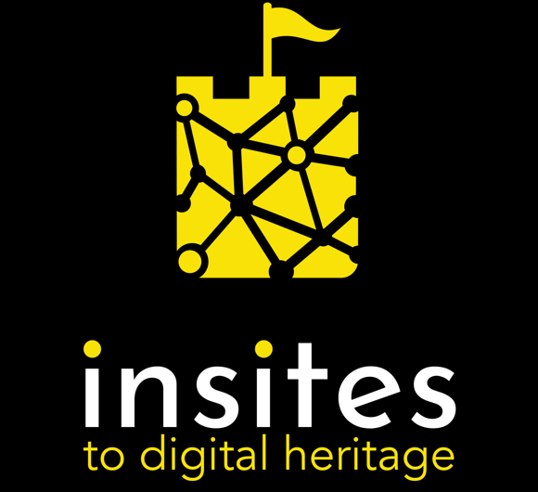
01 Understanding Cultural Audiences

Slide 6
Introduction
Cultural heritage organizations and businesses are brands that survive as long as they fulfil the various needs and desires of their customers To get into this mindset think of every visitor as a customer and every visit to a cultural heritage site or event as a service that your customer buys into to satisfy a need.
To understand what visitors are looking for in a cultural and tourism experience, and to respond with an interesting offer, you need to identify and aim at specific target audiences. When you can visualize and describe who your visitor is, and understand their journey, you can tailor a specific and meaningful experience for them. This module will take you through some steps and tools to gain this understanding.

Slide 7
“Give them something they might not even realise they are missing”
Chris Murray

Slide 8
Who are cultural audiences?
Cultural audiences are made up of people interested in cultural heritage, arts & creativity. This broad category contains visitors with different needs & characteristics. Understanding the differences is essential to designing experiences that will build a strong and lasting relationship with them.
A visitor is both an individual and part of a social group, which is called a "market segment“ in marketing terminology.
Segmentation is simply the process of dividing and organising the population into meaningful and manageable groups – or segments - so you can tailor your offer to their preferences.
Segmentation made simple
Photo by San Fermin Pamplona from Pexels

Slide 9
Macro-categories of cultural visitors
In 2009, John H Falk published his book Identity and the Museum Visitor Experience. One of the key takeaways is that what people learned or remembered from their visit to a site was based on their reason for going there in the first place. He identified five macro-categories of cultural visitors and described their “Identities”:
Explorers
Facilitators
Professional/hobbyists
Experience Seekers
Rechargers
Each of these personas has a distinct objective with a specific need to be met when visiting your site. If you want someone to come back, leave visitors feeling that their individual objectives and expectations were met for that visit.

Slide 10
Macro-categories of cultural visitors
Explorers
This type of visitor is driven by curiosity and the desire to learn something new through experiences. They aren’t looking for specific objects, they just enjoy the experience of visiting. As a result they want to find something new each time they visit. They particularly appreciate digital and interactive tools that can enhance their visit & make their experience unique.
Facilitators
Facilitators are driven by the desire to share knowledge & experience with other people, they are generally teachers & parents interested in providing a good group experience. They like exhibits that appeal to a broad group and a frictionless experience. Impress them with a “reward” for bringing other people to the museum - even as simple as a ”thank you for visiting” note.

Slide 11
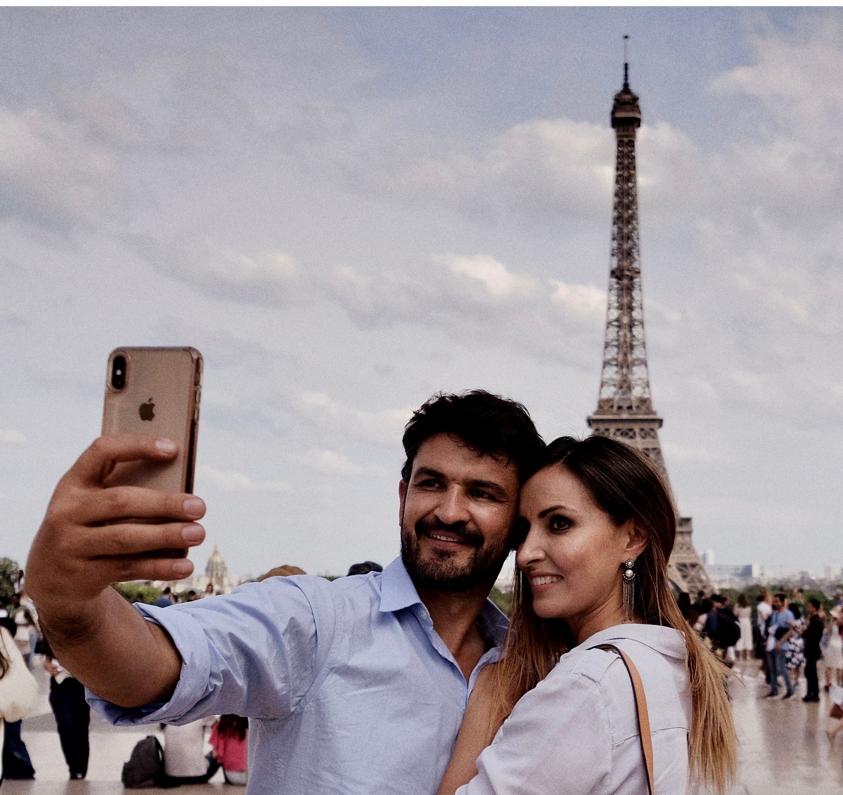
Macro-categories of cultural visitors
Professional/Hobbyists
These are expert visitors whose work or hobby makes them interested in exploring specific elements of a site. They are motivated by the desire for deeper knowledge of their subject, so they appreciate tours and workshops with experts. Impress them with interactive experiences that give them new insights and answer their questions.
Experience seekers
Experience seekers collect destinations they want to add to their checklist. They are generally tourists that want to experience something they heard about so they can say “I did that”. They are attracted by the most eye-catching things that they can photograph and share on their social media profiles. They like to have a clear map of where the “must-sees” are.

Slide 12
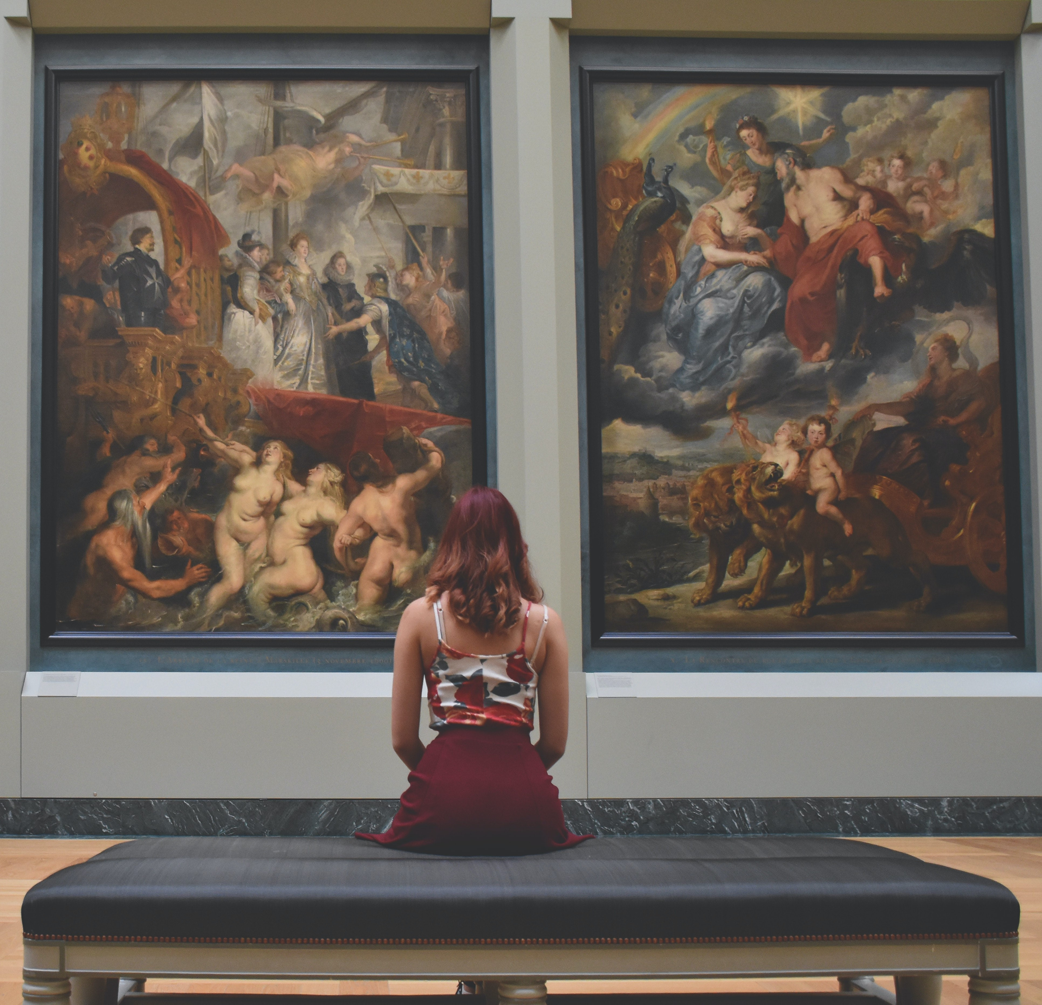
Macro-categories of cultural visitors
Rechargers
This category visit for a restorative experience, where they can take a break from everyday life and contemplate. They particularly enjoy the quiet and less-crowded spots of museums where they can stop for a moment, and feel inspired by what they see. Rechargers want to know the least busy times to plan their visit.
Segmenting your intended audiences by their main motivation for visiting your site, you can design a new experience that they can relate to much more easily.
You can also make sure there are no barriers for them.

Slide 13
02 Digital Natives and Digital Immigrants

Slide 14
Digital Natives & Digital Immigrants
If motivations are essential to create the right offer for your visitors, another important factor to take into account is their age profile.
Your audience’s approach to digital culture differs greatly based on the generation they belong to.
To understand this generational difference, you can break down your audiences into Digital Natives or Digital Immigrants, according to the definition created by Professor Prensky
Reaching these two groups requires different strategies.
Photo by Andrea Piacquadio from Pexels

Slide 15
Digital Natives & Digital Immigrants
“Digital Natives” are people born from the late 1990s who have grown up in an environment where digital technology was present from the very beginning of their lives. These younger people are very familiar with technological and digital language and applications. They already key into a thriving and interactive pop culture & they expect to be engaged through new & interactive approaches when they experience cultural heritage.
“Digital Immigrants” are people who were born before the spread of digital technologies & had to learn the digital language later in their lives. Although most have become familiar with the digital world to some degree, they often keep a foot in the past by merging new technologies with old habits. Digital immigrants can be passionate adopters of immersive digital heritage products, but they require more investment in encouragement and support.

Slide 16
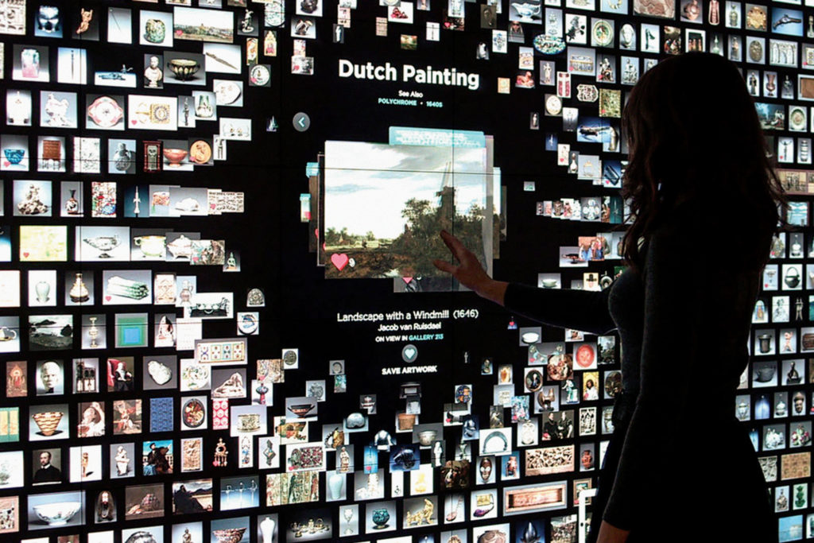
Reaching Digital Natives
“We’re not competing with other museums. We’re competing with Netflix,”
Jane Alexander Cleveland Museum of Art
Case study - The Cleveland Museum of art created the ArtLens Gallery, an experiential gallery that puts the viewer into conversation with masterpieces of art, encouraging engagement on a personal, emotional level.
It allows Digital Natives to explore on-view works in the permanent collection both at the museum and from home.
For more details: https://www.clevelandart.org/artlens-gallery

Slide 17
Reaching Digital Natives
Digital Natives have many ways of keying into cultural content. They are used to receiving information very rapidly, dealing with parallel processes and adopting multi-tasking as their lifestyle, or even mindstyle.
Digitization is not an add on for heritage businesses, it has become an essential tool for engaging Digital Natives before, during and after the visit. here’s how:

Slide 18
Engaging Digital Natives
Before
Communicate with fun and engaging social media content
According to the Global Web Index, Millennials own on average 9.3 social media accounts. Use these channels to reach them directly without investing large amounts of money.
When talking to Digital Natives it is important to find the right tone of voice to speak to them, creating engaging online contents and making the visitor experience worth sharing.
When we use the language that young people are using, it makes it more relatable to them. — Abby Bird
Click to find out how the Black Country Living Museum used Tik Tok to build a new Gen z audience

Slide 19
During
Design Engaging Immersive Experiences
Younger generations are particularly attracted by immersive experiences that make them feel they are active spectators. Digital technologies – such as virtual and augmented reality - are very powerful for this group, because they make visitors feel like they are part of an exhibition and can create new interactions through Edutainment, an approach that mixes educational contents with entertaining activities.
Photo by Ali Pazani from Pexels

Slide 20
After
Create a community
New technologies create long-lasting connections with your audiences. Learning the language of social media & investing in content creation will create supportive online communities. Communities like these are part of the everyday life of Digital Natives. Harnessing their potential allows you to gather more in-depth feedback, to broaden your audience and to create returning and loyal visitors who are your ambassadors in their communities.
Learn more about digital communication in Insites Module 5
Photo by Tracy Le Blanc from Pexels

Slide 21
03 Understanding The Target Audience For Your Experience

Slide 22
Listening to your audiences
In a busy, noisy world it is easy for cultural organizations to lose focus. Innovating is a lot easier if you have analysed what visitors think of your organization by collecting their feedback.
Ad hoc surveys, online comment monitoring, sentiment analysis, crowdsourcing, customer care. Any touchpoint between your organization and your audience is a possible source of information to improve your understanding of the visitor experience.
Keep listening!
How Nuneaton Museum used audience insights to boost their digital communications
Photo by Ann H from Pexels

Slide 23
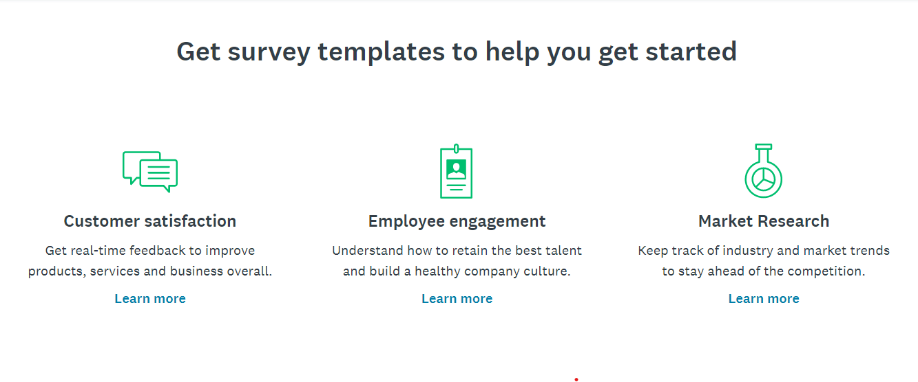
Low or no cost ideas to gather feedback
Feedback walls - these work well when you prompt feedback by asking a well-planned question and change it regularly
Set up a stall at another event or venue where your customers might be and ask them some simple questions to generate a conversation
Organise a focus group or discussion with your target audience - go to a venue where they already congregate (with the venue's permission!) and be ready with your questions, e.g. talk to parents and carers at a soft play centre, go to a teachers' network meeting, go to a knit and natter group, talk to a youth theatre group.
Use an online survey service such as https://www.surveymonkey.com or https://www.quicktapsurvey.com and send a questionnaire to your database or distribute through a partner
Free Pdf - Understanding Your Audiences

Slide 24
Tools for understanding your digital audience
How do you find out about the individuals that make up your social media audience?
You’ll find answers in your social media analytics.
Here’s a guide to 5 free analytical tools covering the some of the top digital media platforms:
Free analytical tools to boost your understanding of your digital audience
Photo by PhotoMIX Company from Pexels

Slide 25
Your ideal customer - Positioning your organisation
Identifying your ideal customer is the first step towards a coherent and successful development strategy for your digital experience. Not every customer is right for you, so focus on just one or two main targets. For example, if you want to focus on children and create edutainment activities for them, you are not closing your doors to all other possible targets, but you are talking clearly to schools and families & positioning yourself in their minds as a place that will meet their needs.
Talking to everyone means talking to no one
That’s why every type of organisation delivering services, cultural organisations and businesses included, should
identify & aim at precise market niches when developing
a digital product. We have some useful tools and exercises
to help you do that.
The first one is Creating a Customer Persona.
Photo by Pressmaster

Slide 26
What is a customer persona?
Personas are fictional profiles you create that represent your target customer. You create them by observing and defining key characteristics of several real people based on your feedback and research (demographics, lifestyles, personality traits, beliefs, thoughts, behaviours, interests, skills, motivations and goals).
The goal is to design a product, in our case the cultural heritage experience, that attracts the ideal customer
By asking a range of questions, you can define your fictional customer who embodies your target. This will deepen your knowledge of your audience.
Personas and designing for the ideal museum experience
Photo by DS stories from Pexels

Slide 27
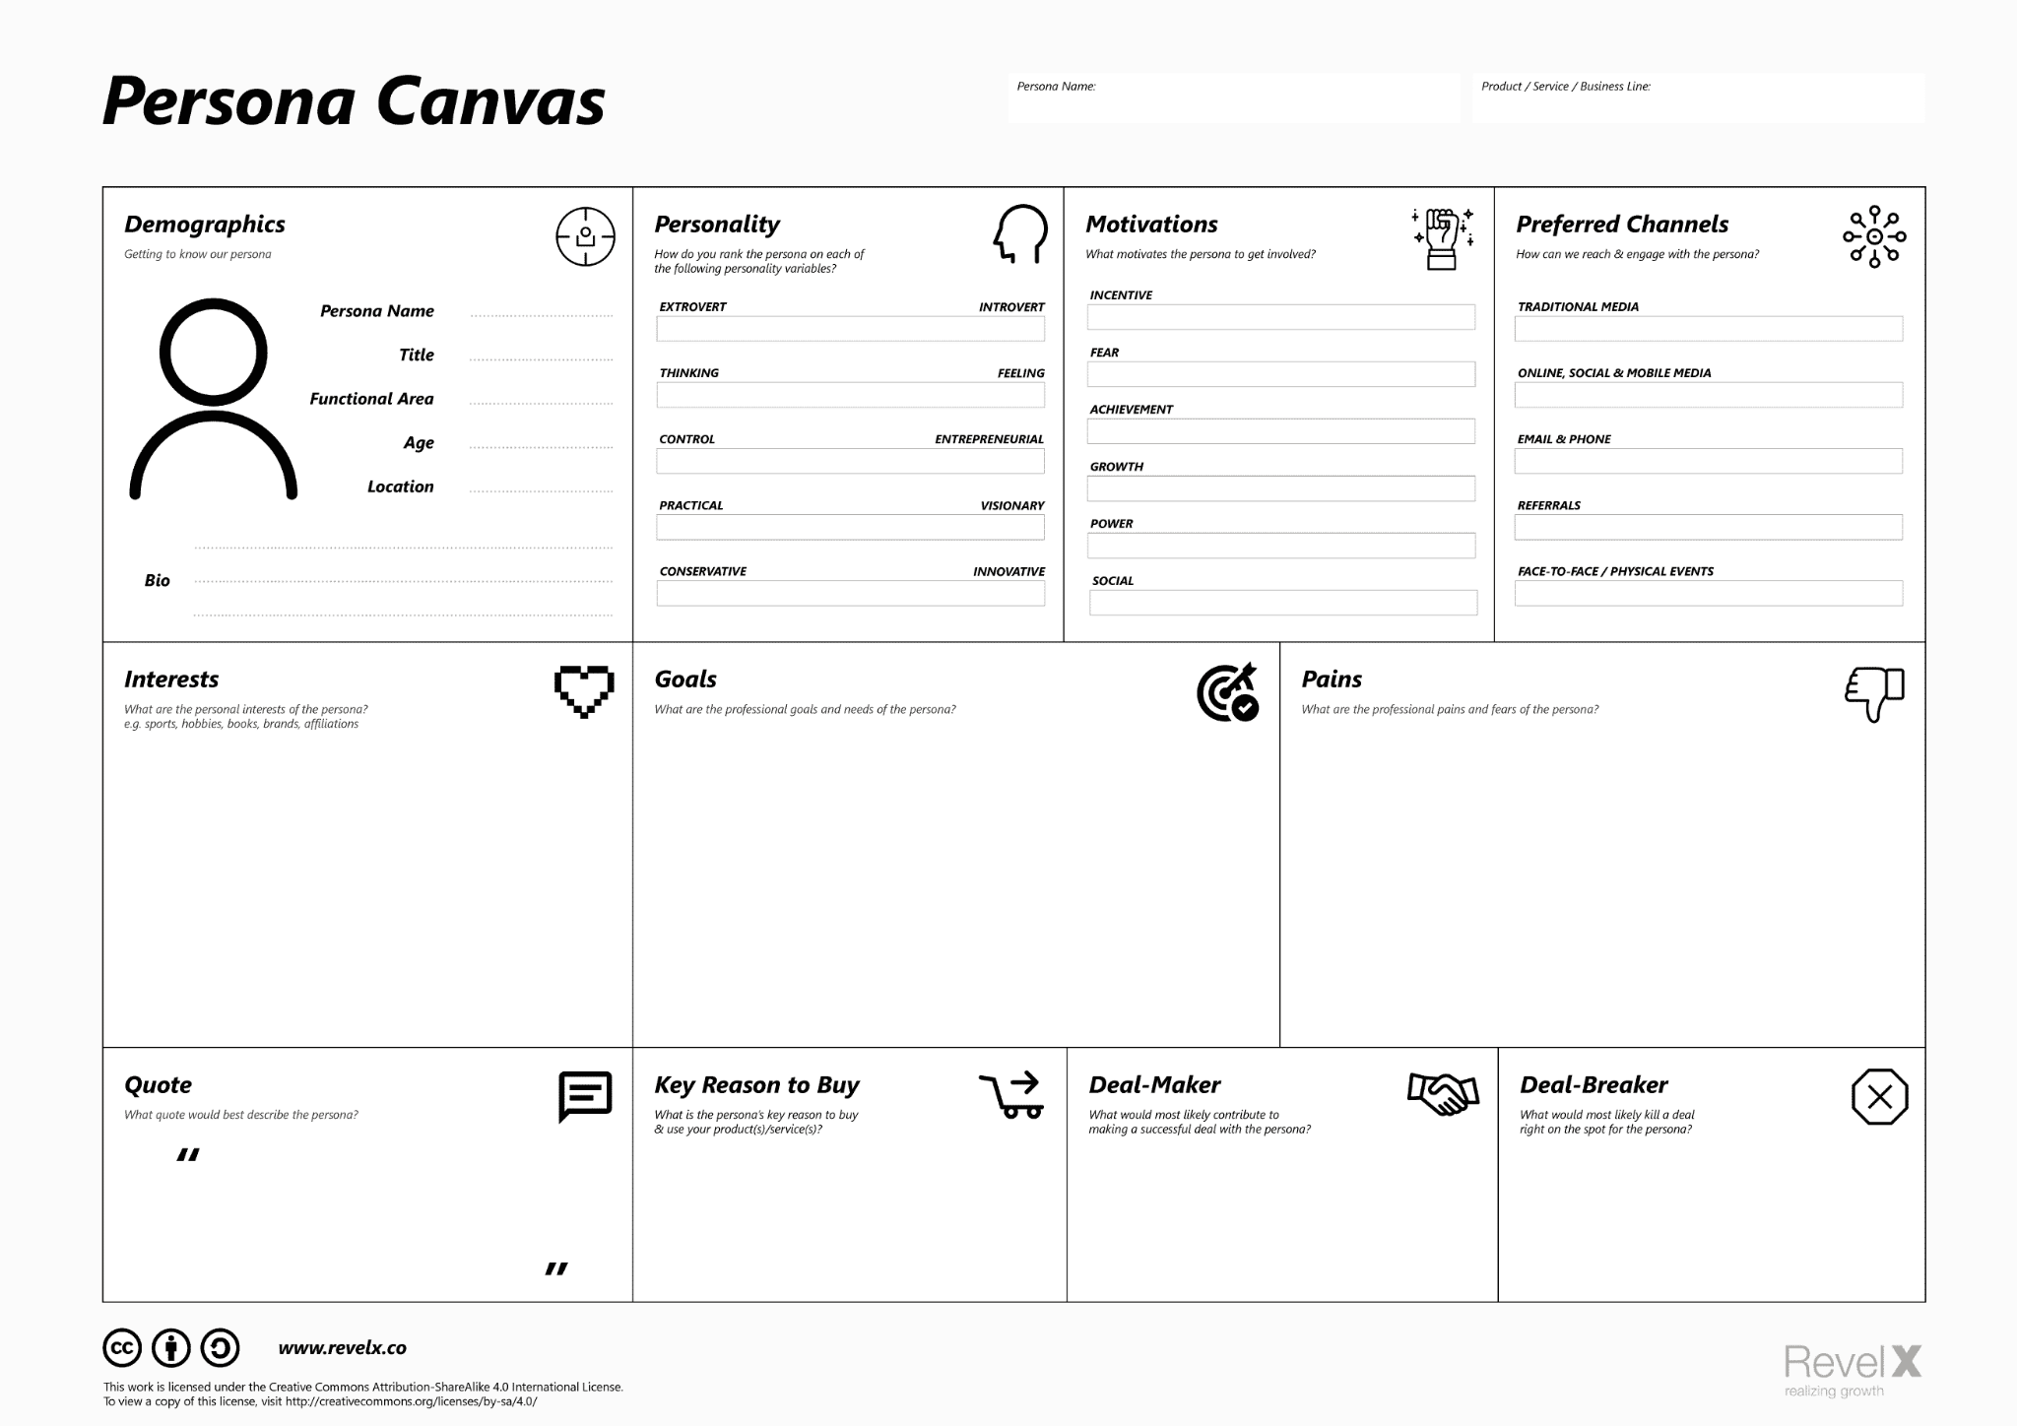
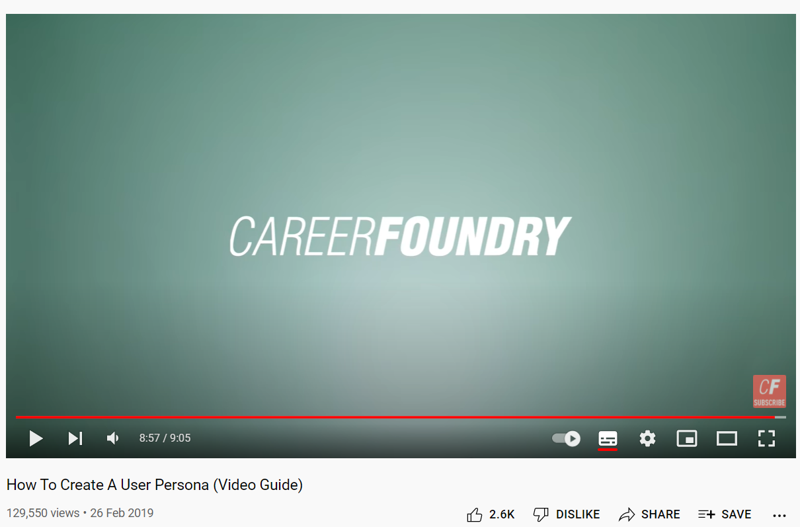
Exercise 1 – Creating a Customer Persona
Try mapping your thoughts with a flip chart/white board or download the canvas
Persona Canvas free download
Learn more from this video guide: Creating a Customer Persona

Slide 28
The empathy map
“If you want to design moments of wonder for visitors then you have to see the world through their eyes.” Culture Connect
Personas are not the only tool for understanding your user. An empathy map is a simple, easy-to-digest, visual tool that captures knowledge about a user’s behaviours and attitudes. It can explore the social context that deeply influences the way your visitor thinks, feels, acts and behaves.
By using this map, you can uncover what your target is likely to say about your services, how they might react to your messages and how you can describe the persona you are aiming at.
Photo by Samuel Theo Manat Silitonga from Pexels

Slide 29
Uncovering motivations
One of the main objectives of the empathise stage is to identify visitor needs & behaviours that are hidden, or unspoken. It is important to distinguish between what people say they would do in a certain situation, and what they actually do. In reality, users have habits or desires that they’re not aware of, so it’s important to observe them in action.
Empathetic research & design is not concerned with facts about the user, such as their age or location. It focuses on their feelings towards a product and their motivations in certain situations - Why do they behave in a certain way? Why do they click here rather than there when presented with a particular screen or page? These are the insights you discover during the empathise phase, and they’ll help you to create experiences that are memorable for your audience.
Empathy Mapping: a guide to getting into a users head
Photo by SHVETS production from Pexels

Slide 30
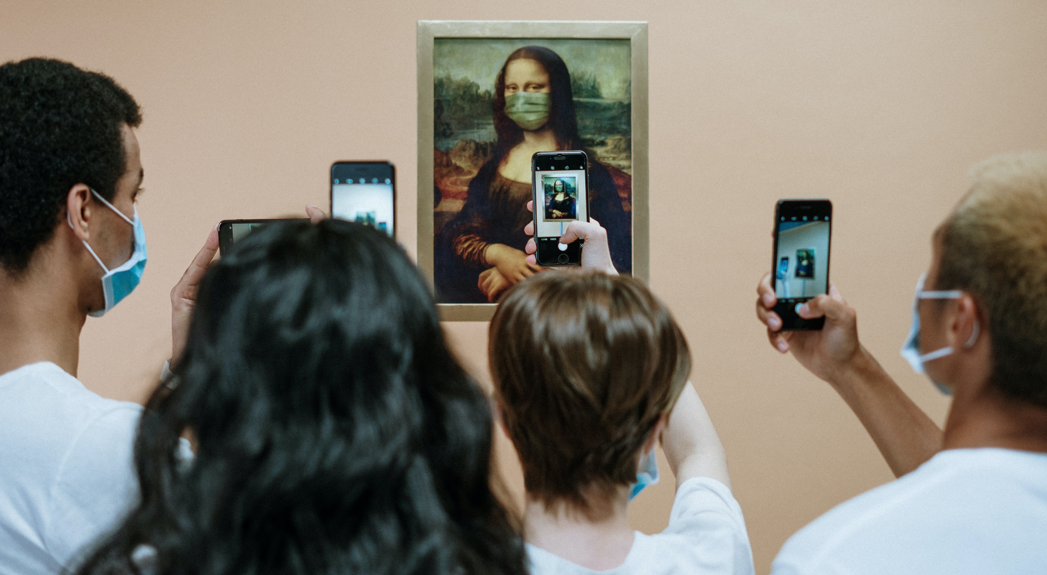
The empathy map invites you to ask four questions:
1. What does your visitor say about you?
Not only what the customer says about your organization and your cultural site, but also how they talk about your services.
2. What does your visitor think about you?
People often have thoughts that they are not fully articulating. Try to uncover and empathise with unspoken attitudes and behaviours.
3. What does your visitor do?
Observing your visitor’s behaviours during a visit
and how they interact with their surroundings
can reveal those unspoken thoughts
4. How does your visitor feel?
Your visitor is a human with a range of feelings
driving their behaviour. If you can focus on
these feelings before, during and after a visit you have a chance to influence these drives in a positive way.
Photo by Cottonbro

Slide 31
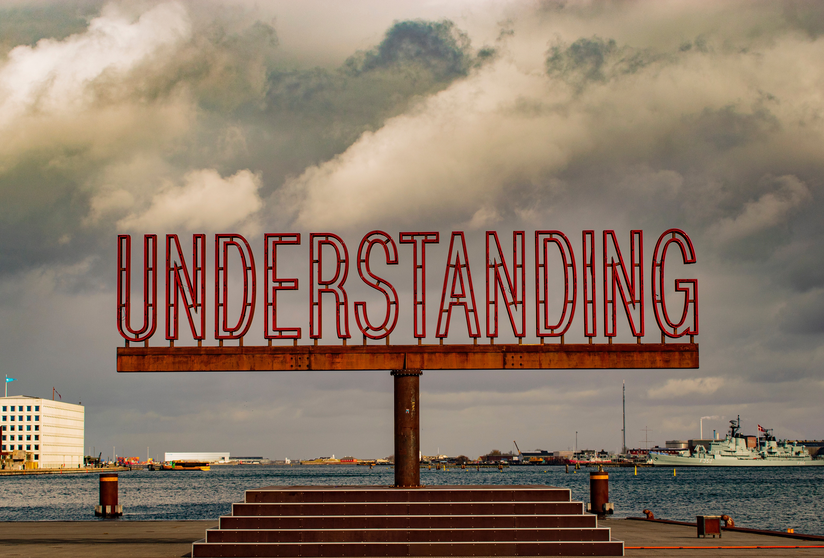
Advantages of the empathy interview
Being on the receiving end of empathy is to feel heard. To feel heard is to feel valued. An empathy interview with your target audience is about active listening and active hearing.
They focus on the emotional and subconscious
They bring insights on how users behave in given environments & situations.
They reveal solutions, unmet needs and challenges you might be overlooking
They allow visitors to speak about what is important to them
They dig deeper, beyond the ordinary questions.
Spontaneous questions can come out of observing body language and reactions
Photo by Zuzana Ruttkayova: pexels.com
They make the subject feel at ease so they can speak from the heart

Slide 32
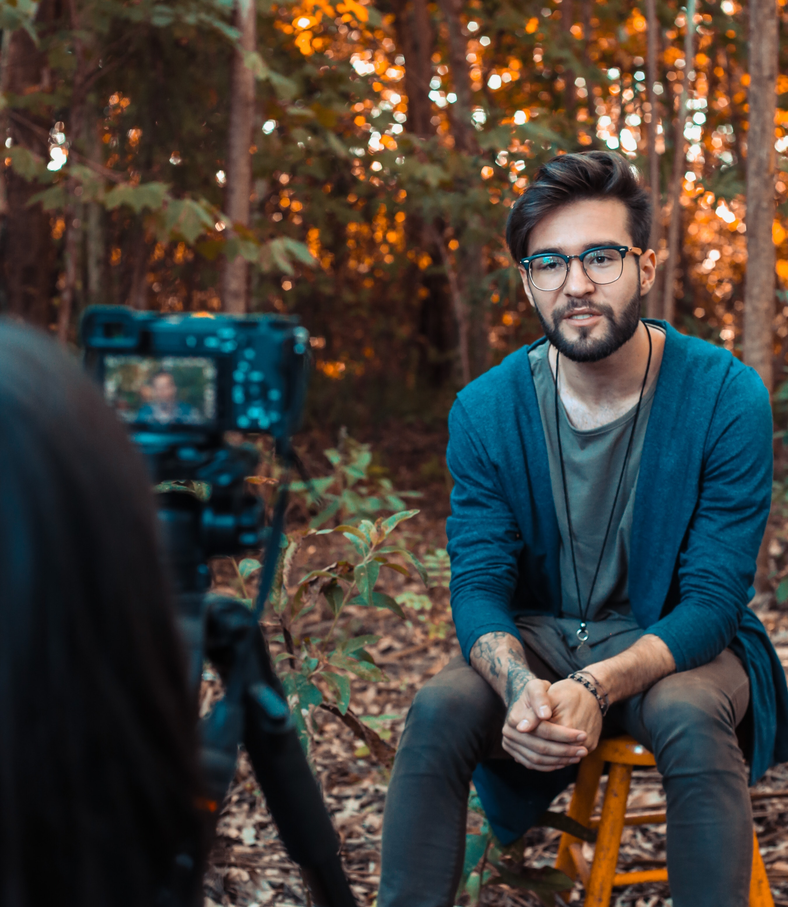
Tips for effective interviewing
1. Introduce yourself.
2. Introduce your project.
3. Shift your focus to the interviewee (ask their name, where they come from).
4. Build rapport.
5. Ask about specific instances or occurrences (“Tell me about the last time..”)
6. Keep questions to fewer than ten words.
7. Ask one question at a time.
8. Encourage stories.
Photo by Rodrigo Souza from Pexels

Slide 33
Tips for effective interviewing
9. Look for inconsistencies and contradictions; what people say & what they do can be very different.
10. Observe non-verbal cues, hands, facial expressions
11. Ask neutral questions like “What do you think about...?”
12. Explore emotions like “Why do you feel...?” “What do you feel about...?” “And what were you feeling then?”
13. Question statements.
14. If you get stuck, ask “why?” Constantly asking why digs deeper into emotion and motivation.
15. “Can you say more about that?”
Photo by Olya Kobruseva from Pexels

Slide 34
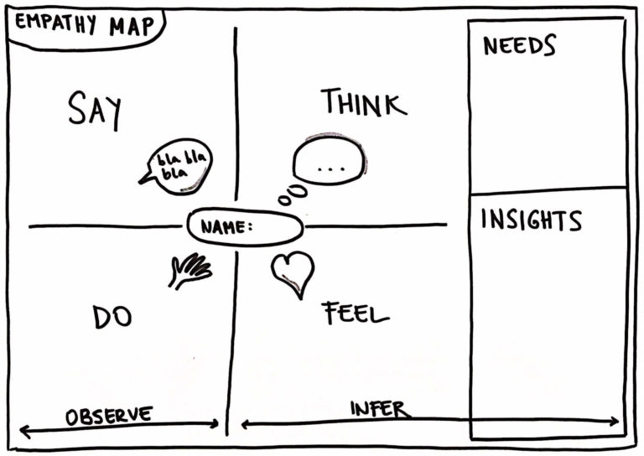
Exercise 2 - Using the empathy map to focus on your visitor experience
Exercise 2 – Using the empathy map to focus on your visitor experience
Fill in your map digitally or use paper & sticky-notes.
Base it on interviews, observations and other sources of gaining empathy
This short guide will walk you through the process
Empathy Mapping guide
Learn more from this short YouTube tutorial on
How to empathy map
Source: https://www.innovationtraining.org/empathy-map-template-training/
SAY – What key messages are target customers giving? How are they talking about your service?
THINK – What thoughts or beliefs might influence your visitors’ behavior?
FEEL – What nonverbal cues do your customers give that indicate their emotions?
DO – What actions and behaviour have you observed?

Slide 35
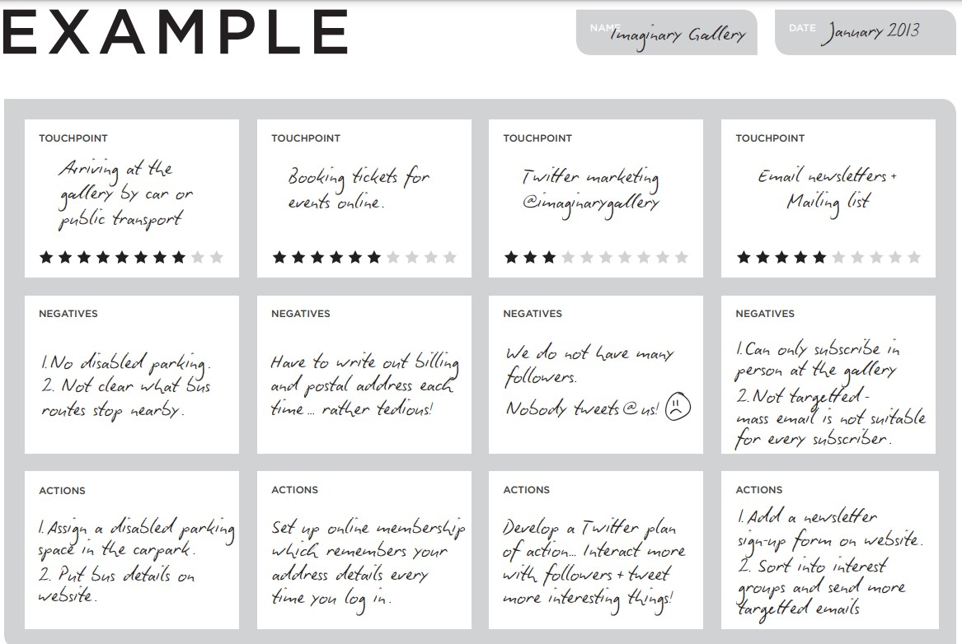
Exploring your customer journey
Once you have visualised your visitor persona and empathised with their experience, the next step is to explore their path through your site, what marketers call the “customer journey”. Following the customer journey allows you to imagine and define the ideal path that your visitor will experience, from the first moment they get in touch with you until after the visit.
Start by identifying all the touchpoints for a particular visitor, where the visitor interacts with the site (either directly or indirectly). This could include a guidebook, website, highway signs, admission desk, parking lot, tour, restaurant, gift shop, and exit gate. These touchpoints are arranged from start to finish, and then evaluated individually. This becomes the start of a plan to improve the visitor experience.

Slide 36
Expert Tips
“A great customer journey map must represent the experience as your customer sees it, not the way you think they see it. That means it will often include aspects out of your direct control, such as social media influences, web searches, and steps your customers take before you even enter the picture”
Top 10 requirements of the Customer Journey Map from customer experience consultants Heart of the Customer

Slide 37
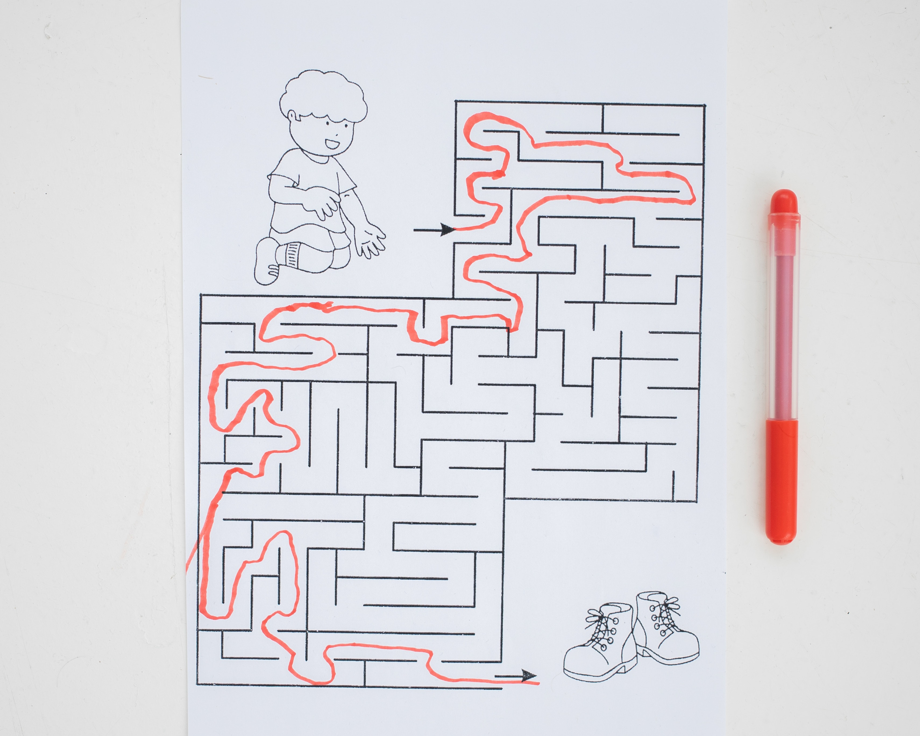
Exploring your customer journey
In the next slides we are going to map a customer journey, with models easily applied to
different types of cultural heritage sites or
experiences.
There are 5 phases of the typical visitor journey:
1. Awareness
A visitor’s experience of the site starts long before
the visit. During this stage, the potential visitor gets
in touch for the first time. It is a crucial step,
a good first impression really matters.
2. Consideration
The customer has been thinking about the visit
and they are considering it as a possible way to satisfy one of their needs.
Photo by Monstera

Slide 38
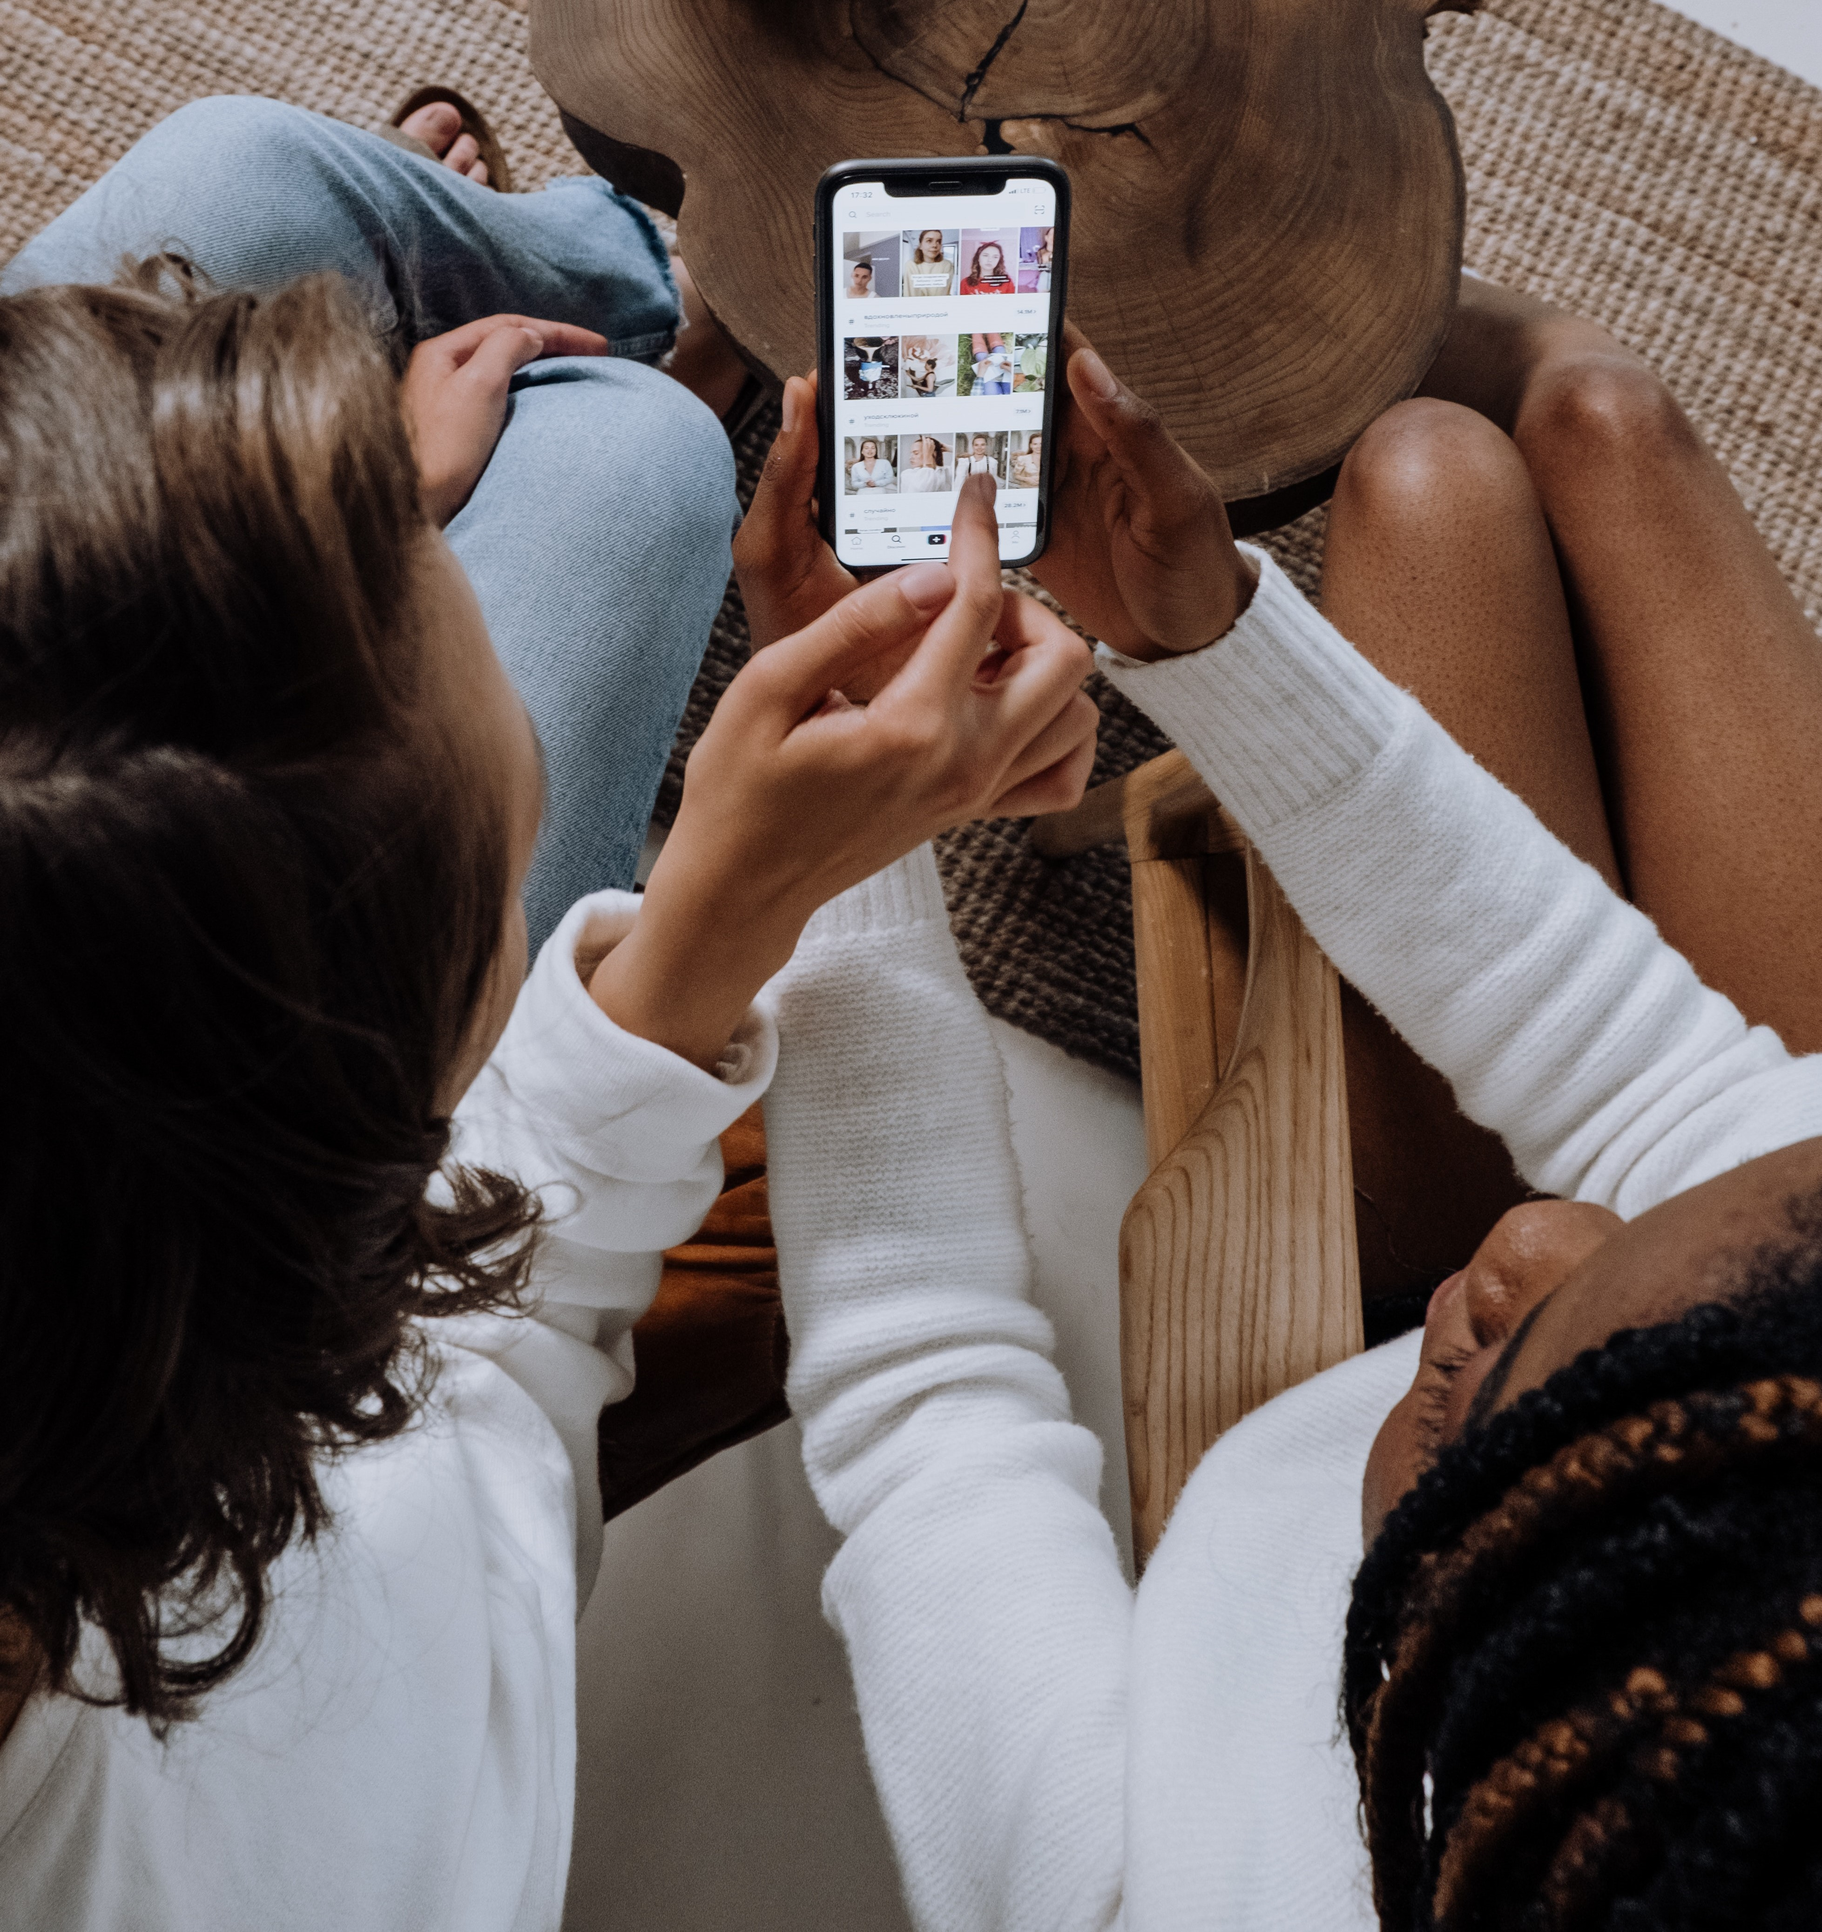
Exploring your customer journey
3. Purchase
The visitor has considered your offer and chosen to visit you. They have reached the point where they realize that you are offering the ideal product to satisfy their needs.
4. Retention
If the visit has satisfied their expectations, they will talk positively about it with their friends, family and colleagues. During this stage you need to have a way to retain and engage the visitor in order to hold a place in their mind.
5. Advocacy
Once the visitor understands that you share their
interests, and values they will become a real
ambassador and advocate, spreading positive
messages to their networks with no advertising spend
required.
Photo by cottonbro: https://www.pexels.com/photo/people-using-a-smartphone-5081918/

Slide 39
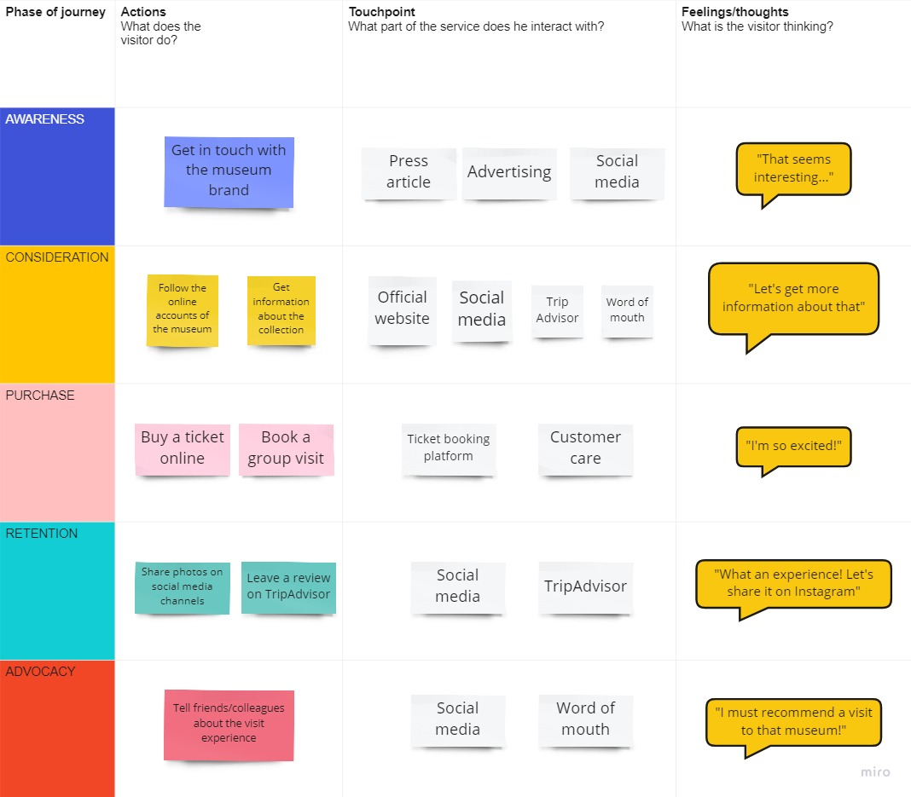
Exercise 3 – Mapping the Customer Journey
Exercise 2 – Using the empathy map to focus on your visitor experience
There are lots of different customer journey maps out there – start your own with post its
Free pdf - Journey Mapping for Arts Organisations

Slide 40
The empathy map, customer persona and customer journey map are all about making it easier for you to experiment, find the right digital tool and design an exciting new experience for the visitor group that is important to you.
These tools are also the basis for tapping into the digital potential for communicating & marketing to new audiences & we will spotlight your marketing & communications strategy in module 5.
Photo by Polina Zimmerman from Pexels

Slide 41
04 Case Studies and Resources

Slide 42
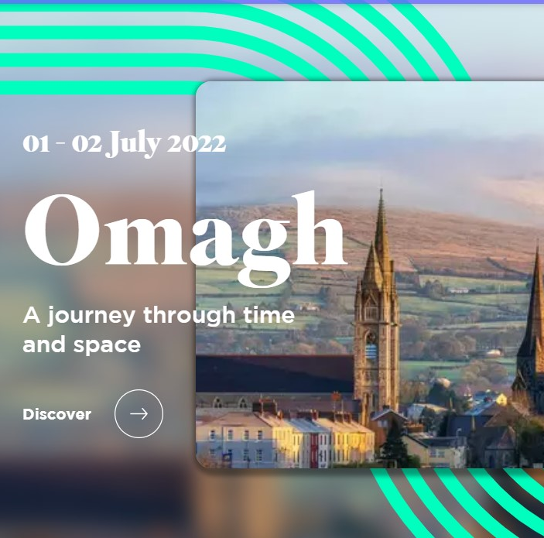
Get Inspired…
StoryTrails, UK
Local libraries and communities in the UK are collaborating with a new digital project that allows people to experience their town in a different way through Augmented Reality (AR) and Virtual Reality (VR). Visitors can use this technology to travel back in time and bring to life untold histories. Town squares, libraries, streets and cinemas will be transformed into virtual portals in 15 towns and cities across the UK, starting in the small town of Omagh, Northern Ireland.
They can fly through virtual 3D maps to immerse themselves in the place. Guided by a mobile AR app visitors can also take an interactive tour of the town with stories from archive footage and recordings creating a window into the past.
Find out more about StoryTrails
If you want to find out more about low-cost ways of creating AR experiences, take a look at the Insites Digital Toolkit on the website: Insites

Slide 43
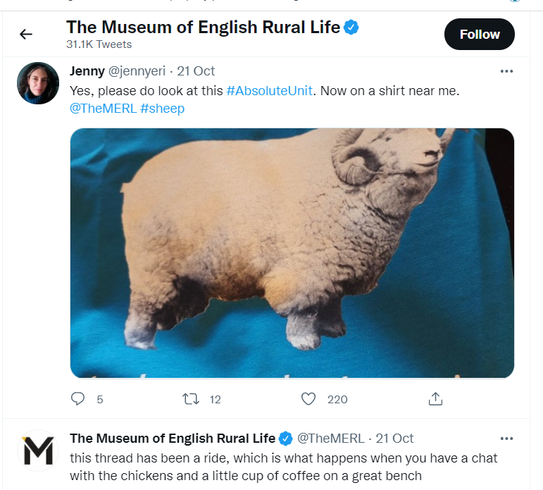
Get Inspired…
The Museum of English Rural Life, UK
The Museum of English Rural Life is a small organisation with a big voice. Following the phenomenon of internet memes, very popular among Millennials and Digital Natives, the museum decided to adopt an ironic and irreverent tone of voice for their social media communication. In 2018, one of their Twitter posts went viral. A picture of a sheep was accompanied by a piece of copy that was highly unusual for the cultural heritage sector: “Look at this absolute unit”. As the museum had invested in understanding its audience, it hit the right note. The post created amusement and affection, turning a new audience into ambassadors for the museum. Storytelling is the most powerful communication tool the cultural heritage sector has. Telling a story is not only about selling a product or a service, it is fundamentally about building a real and trusting relationship with the customer. Find out more about digital storytelling in Insites module 5
Find the MERL on Twitter

Slide 44
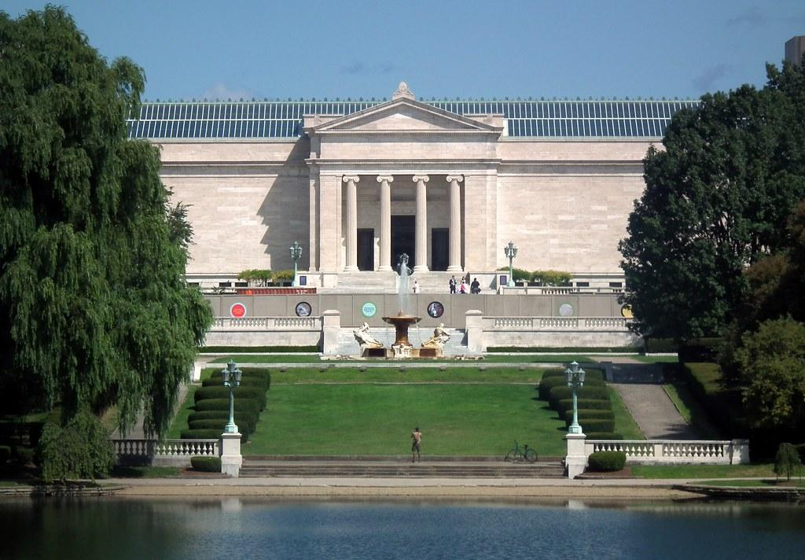
Get Inspired…
The Cleveland Museum of Art, USA
The Cleveland Museum of Art has reached out to its audience by designing a new app called ArtLens. This app allows the visitor to plan and experience the visit before arriving, taking their planned tour with them on their smartphone when they do visit. The app not only helps them navigate, it maintains a connection with the visitor afterwards by allowing them to dip into their tour or create a new one. They can also engage playfully by matching their photos to museum exhibits. As Jane Alexander, the museum’s chief digital officer, explains they are targeting an audience which is not the standard cultural heritage visitor.
“We’re not competing with other museums. We’re competing with Netflix,”
Catching the attention of the customer in a noisy world is the key for success, today more than ever.
Dip into ArtLens at the Cleveland Museum of Art

Slide 45
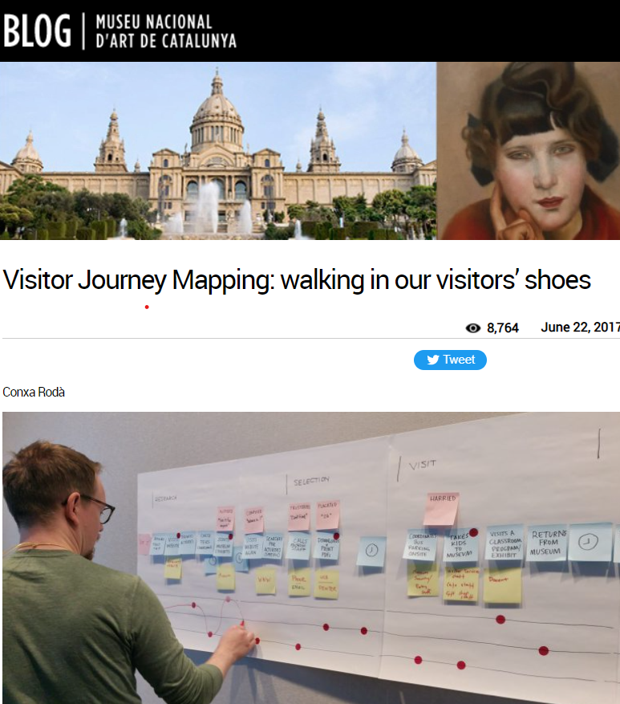
Resources
Museu Nacional d’Art de Catalunya
https://www.youtube.com/watch?v=7gvclNFzGPk
Museum blog - Visitor Journey Mapping
Audience of the future - The Immersive Journey Report

Slide 46
Free tools for understanding your audience
Shows you which keywords perform the best for Search Engine Optimization (SEO). SEO means to adapt and optimize your online communication by using keywords which Google responds to by putting your website on the top of the Search Engine Result Page.
It allows to monitor your website performance and analyze your audience. By putting a string into your website URL, you will be able to know everything about visitors’ behavior on your site, such as how many website pages do they go through and much more.
Gives you a deeper knowledge about preferences, lifestyle and behaviors of your target audience. You can find out how the user lives the online experience, how they behave while scrolling through the feed.

Slide 47
References
Abrams (2019), Personas and designing the ideal museum experience, accessible at: https://cutt.ly/DQnUvg1
Chen (2021), How The V&A’s New Digital Platform Centers Access and Audience, accessible at: https://cutt.ly/snJdFZa
Coates (2019), Modern museums in the internet generation - memes and millennials, accessible at: https://cutt.ly/RnJdJve
Culture Connect, Practicum Vol. 1: Empathy Maps https://cultureconnectme.com/practicum-vo-1-empathy-maps/
McGarry (2021), Attracting Millennials to Museums: Your Complete Marketing Guide, accessible at: https://cutt.ly/LnJdLqp
McIntyre (2020) Culture in Lockdown. Part 1: We can do digital, can we do strategy? https://www.culturehive.co.uk/resources/culture-in-lockdown-part-1-we-can-do-digital-can-we-do-strategy/
Nielsen Norman Group (2018), Empathy Mapping: The First Step in Design Thinking, accessible at: https://cutt.ly/EQnKSNX
Prensky (2001), Digital Natives, Digital Immigrants, accessible at: https://cutt.ly/0nJdZAP
Global Web Index (2019) Audience Report, accessible at: https://cutt.ly/7QnKH16
Revelx, Persona Canvas, accessible at: https://cutt.ly/SQnJZ2c
Tincher (2020) https://heartofthecustomer.com/customer-experience-journey-map-the-top-10-requirements/

Slide 48
Next Steps
Find out more about developing and communicating with your audience in module 5

