Slide 1
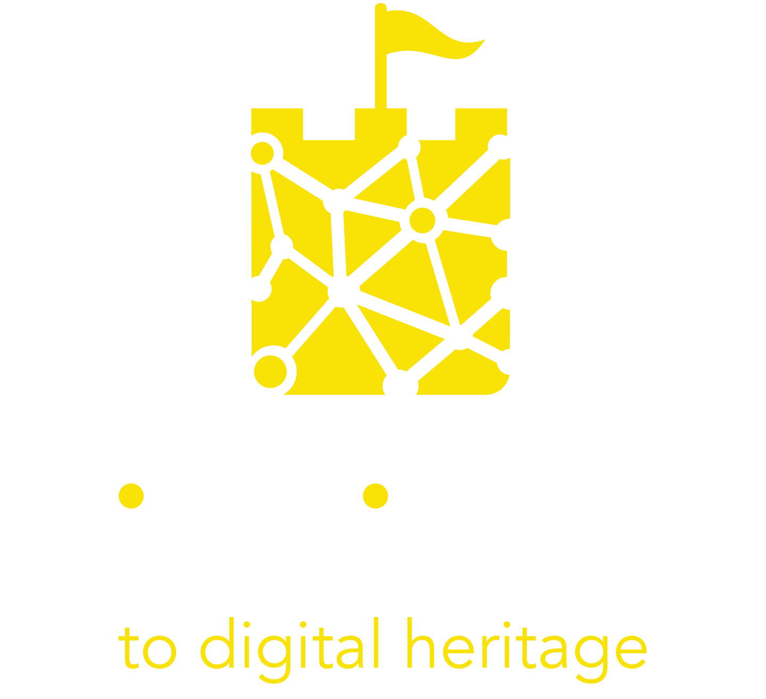
Module 3
Introduction to Immersive Tourism Experiences Design

Slide 2
TABLE OF CONTENTS
01
What are Immersive Tourism Experiences (ITE)
02
The building blocks for ITE
03
Designing a valuable cultural ITE
04
Transforming a Tourism Experience into an ITE
05
Case studies of successful ITEs

Slide 3
“A mind that is stretched by a new experience can never go back to its old dimensions”.
Oliver Wendell Holmes

Slide 4
Learning Objectives
​When you complete this module you will be able to: ​
Define experiential and cultural tourism​
Describe the building blocks for designing successful immersive tourism experiences ​
Evaluate the main technological tools and approaches for digitization (e.g. AR, VR, holographic projections, etc.)
Explain what makes an immersive experience stand out​
Understand and apply the fundamentals of the experience design process​

Slide 5
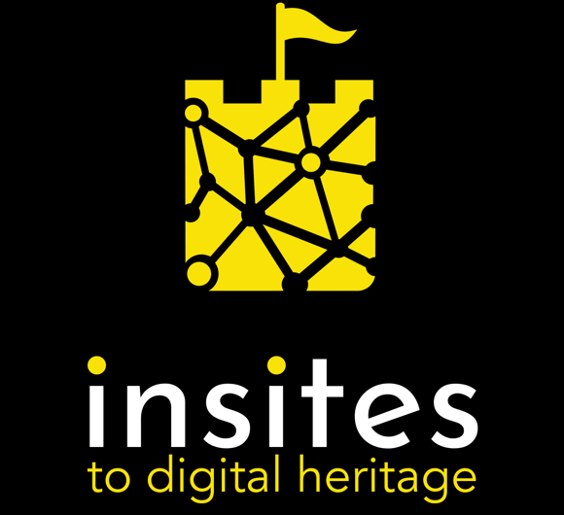
1. What are Immersive Tourism Experiences?

Slide 6
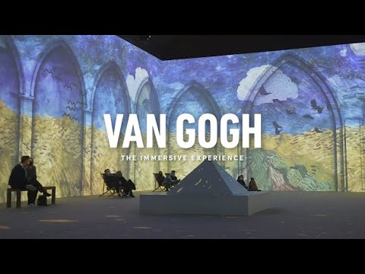
Modern travellers are nowadays seeking more immersive and enriching cultural experiences.
Immersive Tourism Experiences (ITE) are those experiences in which the visitor is immersed, physically and figuratively, in the cultural heritage they are visiting.
In the video on the right you can see an example of an immersive experience where visitors don't just observe the artworks but they actually “enter” into them.
*click on the picture to watch the video

Slide 7
Five (but not limited to) senses
Immersive means engaging all our senses
A rich experience of the world around us involves a number of emotions, perceptions and senses. Similarly, an Immersive Tourism Experience should engage us beyond just passively viewing a flat image.
We can link feelings to the visual Van Gogh Alive – creating the emotional impact that is the most important element of an immersive story using for example:
Hearing - Soundcloud Immersive Audio Story
touch - Native American Voices Exhibition)
taste and smell - Combining Smell and Paintings
*click to watch the video on senses
“Good design looks great, yes — but why shouldn’t it also feel great, smell great and sound great? ”
Jinsop Lee

Slide 8
Five (but not limited to) senses
Immersive means engaging all our senses
The more senses an experience involves and the more realistic a representation they transmit, the more realistic your immersive experience will be.
Immersive Tourism Experiences can:
imitate the world around us to engage our senses - Immersed in Nature
exaggerate, create worlds that do not exist (anymore/yet), amplify some aspects (senses) over others Starry Night Stereo VR Experience - click and move around the video

Slide 9
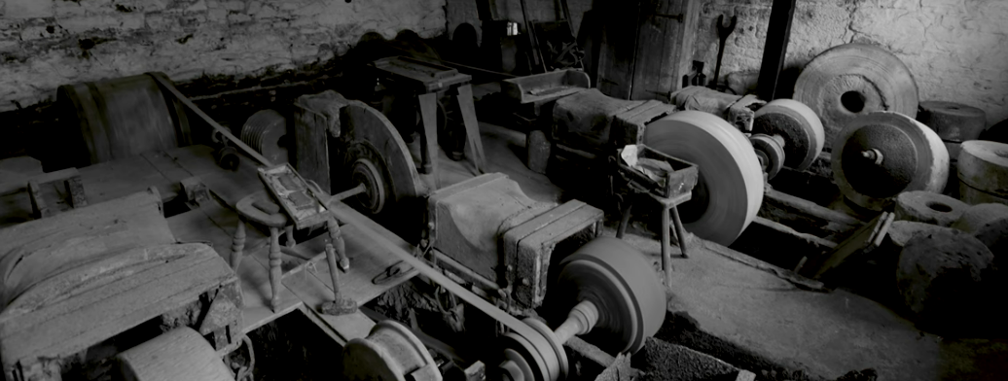
Sound Maps
In this example of engaging senses a city sound map combines the photographs and sounds together to provide a richer and deeper experience of the location.
Using less obvious combinations, the sound of nature while looking at industrial heritage for example, can raise the relationship between industrial heritage and natural heritage. Pleasant sounds would speak of potential harmony, while noise would signal the conflict between the two.
*click on the picture
to watch and listen

Slide 10
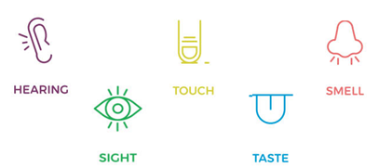
Exercise: explore the senses and technologies
Which of the five senses can different technologies affect?
Sketch (or write) some technologies you are
familiar with and connect them with the senses
on the right.
Can you think of any other senses the human body
can or can‘t have?
Watch a short video here More than 5 senses
Read the article here 🕮 about more than 5 senses
Can you connect them with any known technologies that can affect them?
How do different senses connect with each other? Can you replace any of the senses with another?

Slide 11
2. The building blocks for Immersive Tourism Experiences

Slide 12
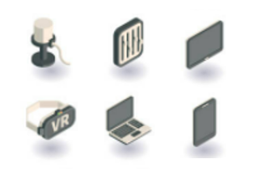
Key Building blocks for an Immersive Experience
Get to know the technological and non-technological building blocks and combine them to design perfect experiences for your visitors
technological solutions such as digital devices, (touch) screens, sound speakers or headphones, sensors, smart phone apps, VR headsets and others. We will talk about these in more detail in the next slides.
non-technological solutions such as theming, guest role, storytelling*, design focus on architectural elements of exhibition space (shape and brightness of a room, furniture and other objects in it, etc.) *Storytelling is the key non-technological building block which will be explored in greater detail in later slides.

Slide 13
Technological building blocks
New forms of media adaptable for cultural heritage are constantly emerging:
computer animations,
computer games,
human–computer interfaces,
interactive computer installations,
websites,
and virtual worlds.
With the right knowledge and skills these “new media“ offer you more interactivity and customization than ever before.
AR, VR, MR explained
In the following slides, we will show you some of the most common new media based on:
mobile apps,
interactive screens,
extended reality holograms
These can blend and re-combine to create new ways of presenting and interacting with digital cultural heritage artefacts. Chinese museums roll out VR, AR exhibitions)

Slide 14
Web & mobile apps
Mobile Web apps provide information in a readable, action-oriented format. Their advantage is that they require only a web browser to be installed and are not limited to the underlying platform for deployment.
Mobile native apps can offer much more powerful technical features and options when delivering information, graphic content and real life interaction on the go but require a full installation on a mobile phone.
Read the article on designing mobile apps for cultural heritage promotion here 🕮
*click on the picture for a video on Web & native apps

Slide 15
Web & mobile apps
With apps, you can:
provide additional information to enhance your site such as photos, videos, maps and games
Allow you to create a richer interaction in remote or diverse locations through a smart phone
enable interaction where physical interventions need to be minimal.
Mobile web apps can be one of the lower cost options for creating an immersive experience.
*click on the picture for a video about a museum app

Slide 16
Augmented Reality (AR) mobile and web apps
AR app is a software application that adds layers of digital information (digital layers) on top of a screen showing the physical world.
Find an introduction to AR here: What is AR?
Compare different AR solutions: Mobile v Web AR
AR can really help visitors understand heritage sites with physical remains, with images overlaid onto the site to show how they looked at the time they were in full use.
Read an article on use of AR in museums here 🕮
*click on a picture for a video on AR use example

Slide 17
Augmented Reality (AR) mobile and web apps
With augmented reality, you can:
bring exhibitions to life,
provide play-and-learn experience,
renovate the place,
let the visitors see how it was before.
Here’s a short video about using GoFind to explore a city through historical images: GoFind
*click on a picture to see AR bring exhibit to life

Slide 18
Virtual reality (VR)
Today's latest game engines and virtual reality devices make it possible to recreate ancient worlds and build experiences with a new aim in mind, not just to see the buildings in an ancient town, but feel as if you were back then.
VR is made possible by using headsets that have become a more realistic tool as prices have dropped
VR technology can be used for:
visualizing simulated worlds,
visual interaction with rare objects,
offering tours,
playing games …
Click the link to find out: What is Virtual Reality?
Read more about VR on Wikipedia here 🕮 🕮
*click on a picture for an example of an interactive VR

Slide 19
VR game
VR game is a video game played on virtual reality (VR) hardware that offers enhanced interaction.
Most VR games are based on three types of immersions:
Narrative immersion: user is invested in a story
Tactical immersion: performing tactile operations that involve skill
Strategic immersion: performing tactile operations that involve mental challenge
*click on a picture to see example 1 of a VR game

Slide 20
VR game
VR games are appropriate for involving visitors in cultural heritage stories, especially when material remnants are scarce, hard to reach or otherwise inaccessible in person.
With VR game, you can:
provide play-and-learn experience,
tell a story (make the visitor a protagonist),
simulate interaction with objects or places,
*click on a picture to see example 2 of a VR game

Slide 21
Virtual tours
Virtual tours offer a panoramic 360° view or video simulation of a place. These can be one of the lower cost options for creating an immersive experience.
They can be viewed, through a browser, an app or through a set of VR glasses.
They may also use models in place of real-life video and images and are able to offer some level of interactivity.
Read more about virtual tours on Wikipedia 🕮
*click on a picture for virtual tours in Louvre museum

Slide 22
Virtual tours
Types of virtual tours:
Online virtual tours are usually a collection of panoramic images of an existing place that are played in sequence to view like a moving video with added sound and text effects.
VR virtual tour is a simulation of an existing location, usually composed of a sequence of videos or still images. It may also use other multimedia elements such as sound effects, music, narration, and text.
*click on a picture to try a virtual tour of Anne Frank house

Slide 23
Virtual tours
Virtual tours can:
bring remote or inaccessible locations to users,
show how it was before,
be used for travel or vacation-related research.
Watch a video about making a tour of an Iberian town here: Reconstructing a 2,200 year old Iberian Town
Read more about a design methodology for immersive 360° cultural heritage video tours 🕮
*click on a picture for a virtual tour of Machu Picchu

Slide 24
Interactive object recognition (OR) tables
An interactive object recognition table is a touchscreen table, with which can users interact by putting objects directly onto it. The touchscreen recognizes the objects and responds by showing information associated with them.
Interactive object recognition (OR) tables can structure complex information from diverse formats and showcase it in easy-to-interact ways.
*click on a picture for a OR table demonstration

Slide 25
Interactive object recognition (OR) tables
OR tables can integrate high-resolution images, videos and graphics, so users can:
intuitively move through different content,
observe the presented material through different perspectives,
zoom in and focus on details of his interest,
Be immersed in interactive games.
*click on a picture for OR table use in Air Museum

Slide 26
Interactive screens and walls
Interactive screens and walls are physical wall surfaces that are mapped with a digital display, by using digital screens, or for a cheaper option, using a projector and can be interacted with - to explore content displayed on it.
See an example of a wildlife interactive exhibition here: Interactive Exhibition
With the integration of different sensors, such as cameras and face recognition IA, the interaction with screens is not limited only to the touch.
*click on a picture to watch a touchless interaction example

Slide 27
Interactive screens and walls
Interactive displays are highly customizable
They can be used for:
animating objects,
playing games,
delivering virtual exhibitions of unavailable exabits,
displaying interactive maps.
*click on a picture for an example of object animation

Slide 28
Holographic projection
Holographic projection is a very powerful immersive tool that can really animate an object and give visitors a much deeper understanding of what they are looking at.
Holograms are best used in applications where you want to tell a story of an:
object
building
animal - Hologram Circus
character
collection - The DaVinci Museum Hologram
*click on a picture for a video with castle holograms

Slide 29
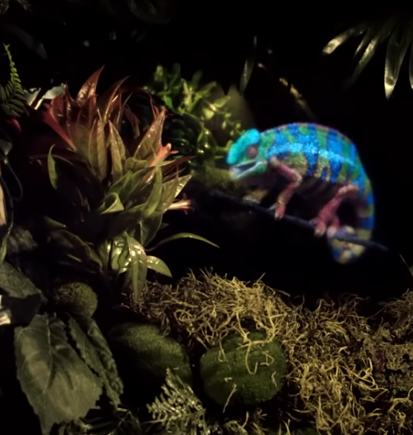
Holographic projection
Holographic projectors create an image that has three-dimensional qualities but is still flat.
Read more about holography here 🕮
Many “holograms” currently on the market are still technically 3D images shown on a 2D surface.
Watch 10 examples of the latest hologram technologies here: 10 Most Advanced Holograms
Watch how to make a basic holographic projector at home - 2D here: Build a 2D Hologram Projector
3D here: Make a 3D Holographic Projector With Resin
*click on a picture to see video presenting advanced hologram

Slide 30
Immersion rooms
An immersion room is a virtual reality room that is a self-contained space, customized with embedded or portable technology that delivers or enhances a highly immersive multimedia experience.
Its goal is to fill the user's visual field, giving the sensation of physical presence.
See an example of an immersion room Immersed in Van Gogh
It is best used to convey an atmosphere or a feeling through a group experience. Immersion rooms with VR head sets bring users into the same simulation.

Slide 31
Choosing affordable technology for your story
These technologies come at different costs, but keep in mind that the hardware is not the only expense one should take into account. A major part of expenses are teams of professionals that develop the content for a chosen medium and maintain the product!
Also, the content itself (different for each specific case) is usually what dictates the necessary minimal level of quality which has its price. Keep in mind that the visitors expect quality at every point of the experience!
What is the take away?
Get acquainted with what the technologies have to offer – research further.
Select the ones that can add an additional dimension to your story – look for case studies that match your project.
Look around for various technology and service providers – check their references.
Do not hesitate to ask tech companies and digital experts for advice!

Slide 32
Exercise: Mix and match
Watch the video Digital Innovation - Slovenia
Now choose your favourite cultural heritage site close to you. (It can also be a smaller part of exhibit or an object.)
Which of the new technologies presented could you use to enhance the visitors experience of that site? (You can use more than one.)
Find three providers of this technology in your country (or local area) and experts who can offer you appropriate knowledge and services. Check their references.
Now think of your least favourite or least interesting cultural heritage site near you. Why is did you choose this site? Which qualities is this site missing? Can you think of a use of any technology presented that could make your least favourite site more interesting to you?

Slide 33
3. Designing a valuable cultural immersive experience

Slide 34
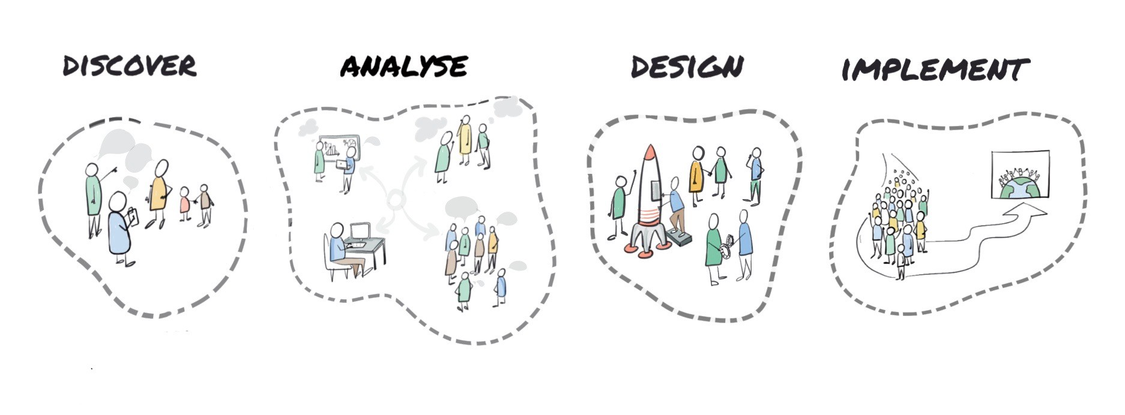
Steps of the Immersive Experience Design Path
We hope you can see that there are a lot of exciting digital tools out there than can transform your organisation and business. But before trying to embed a new technology in your tourist experience, you need to do some basic development work to avoid wasting your investment of time and money. Analyse your business, the uniqueness of your offer and the needs of your target audience first to make the right choice.
Image credits: Dianne Dredge on Medium

Slide 35
The Design Path
Consider the needs of your heritage organization. “Experience Design”, offers you a strategic approach that allows you to improve the competitiveness of the tourist offer of your destination.
Consider the ever-changing needs of travellers. The fundamental demand of good Experience Design is that it is "user centred", that it always puts the final user at the centre of the entire design process.
(learn more about categories of cultural visitors in module 4 and about developing and marketing immersive tourism in module 5)

Slide 36
Cultural Immersive Experience Design
PROBLEMS The starting point is an analysis of one or more problems or needs your visitor experiences.
TRAVEL MOTIVATION Understand what drives travellers' choices by conducting surveys and analysing travel data, both online and offline. Ask yourself why do visitors choose your site and why do they prefer your destination over all the others available?
(more on collecting feedback in module 4)
FEARS Understand what possible fears or obstacles the visitor has that may be holding them back. Are there reasons why your experience might not be suitable for some travellers?

Slide 37
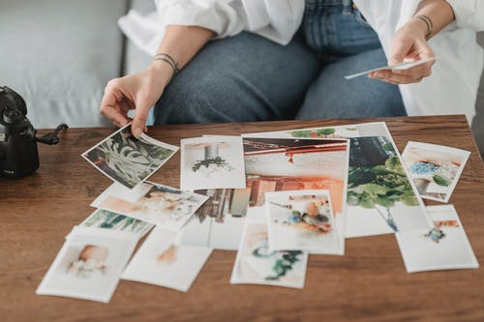
Cultural Immersive Experience Design
SOLUTIONS Depend very much on the type of cultural heritage you want to promote and the assets or opportunities you have in your organization.
ALTERNATIVES AND COMPETITIVE ADVANTAGES What are your strengths? Why would a traveller choose you over others. Are there similar experiences around you? Is there anyone already offering the same experience, and if so, what competitive advantages can you offer to the traveller?
UNIQUE VALUE PROPOSITION Find the essence of your experience, that thing that only you have and that really makes the difference to your traveller.

Slide 38
UNIQUE SELLING PROPOSITION
The USP refers to the unique benefit that enables you to stand out from competitors, the thing the visitor can’t find elsewhere.
You have to identify that unique value of your experiences for your audiences. Then think about which of the presented digital technologies could complement or emphasize it.
It’s your superpower! Being aware of your USP will help you define the ideal “customer journey“.
Find tools and tips for understanding your customer better in Insites module 4

Slide 39
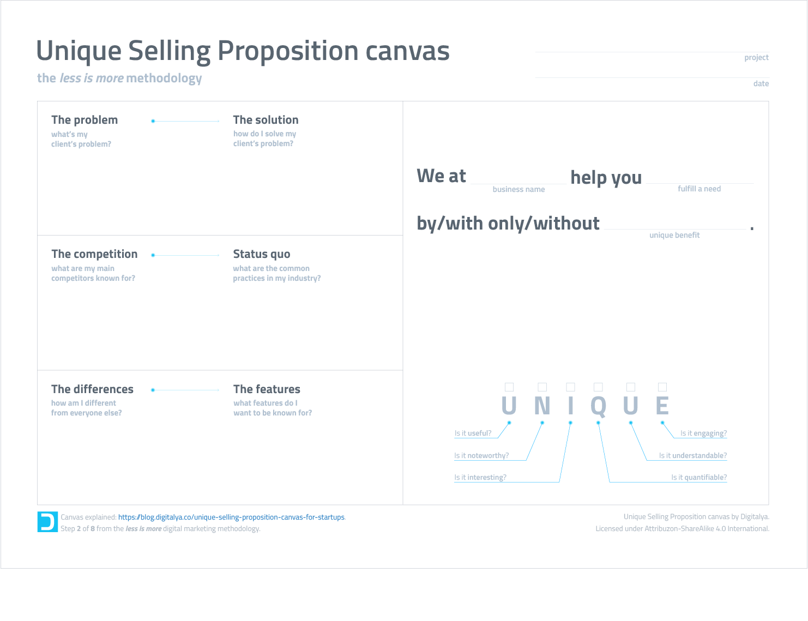
Fill in the canvas below to identify your uniqueness!
Click to download USP canvas

Slide 40
KNOWING YOUR TARGET
Your experience is not for just anyone. Using your USP statement you can identify the exact audience you want to target with your immersive experience and design for their needs, desires and interests.
Does the experience appeal to an adult audience or is it for children?
Does it require being active?
Can people with disabilities participate?
Read more about how audiences behave around immersive content here 🕮

Slide 41
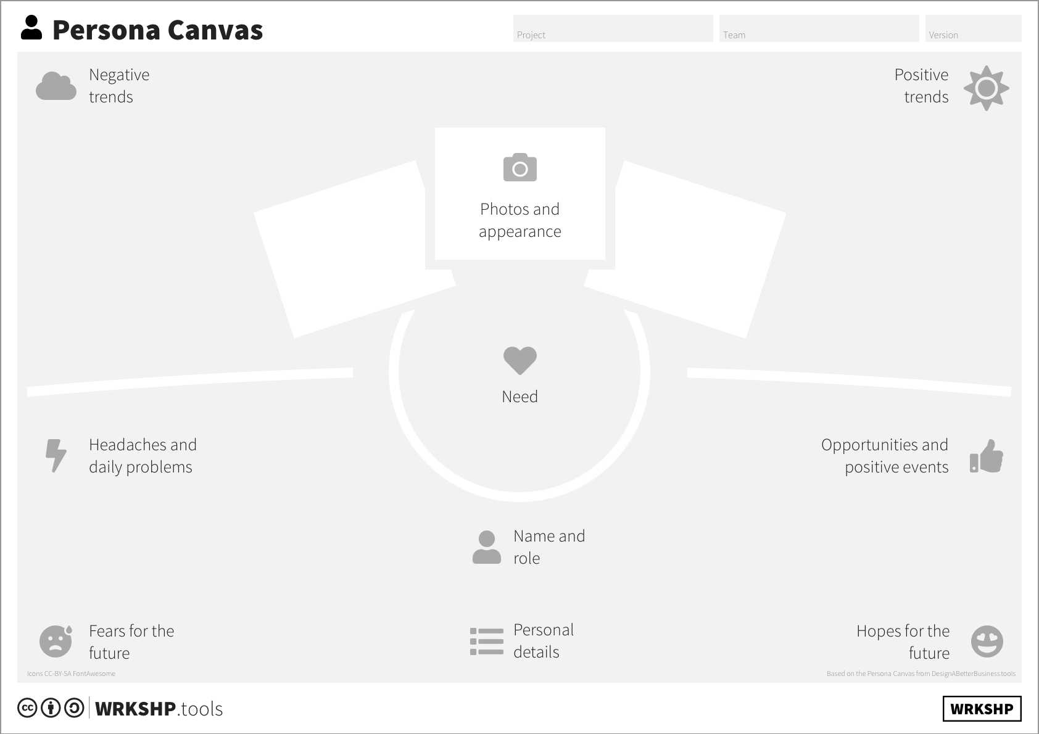
Fill to outline the target personas for your experience.
Click to download Persona canvas

Slide 42
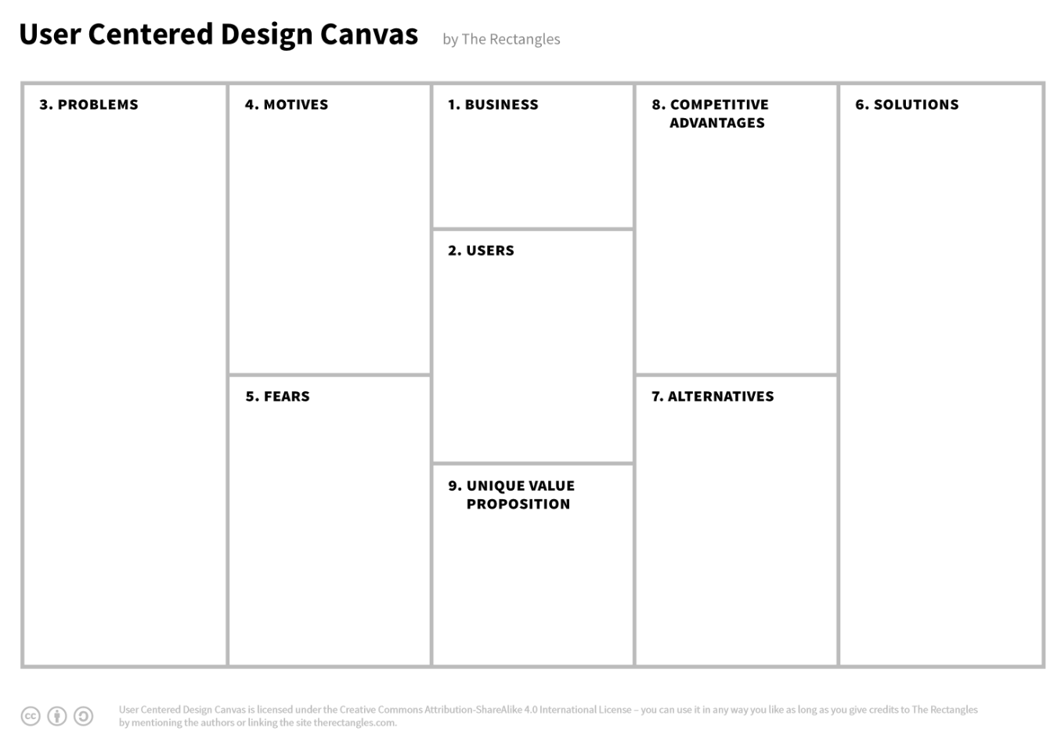
Now let‘s try to design an immersive visitor-centric experience!
Fill in the canvas below following the numbering of fundamental design steps!
Click to download User Centered Design Canvas

Slide 43
4. Transforming a Tourism Experience into an Immersive Tourism Experience

Slide 44
The role of technology
In the second chapter of this module we showed you that different technologies offer you many different features:
organizing and presenting a broad range of information and different materials,
enabling customization,
visualizing the unseen or hard to be seen (in place or in time),
arousing multiple senses to enhance emotions,
adding interactive and playful moments.

Slide 45
Technology is not just an add-on
When designing an immersive experience the digital component needs to be carefully crafted into a Tourism Experience not to alter it for the worse.
Digital should supplement analogue only where the latter needs an upgrade or fails to address an important challenge
Technology without content and concept is just a gadget. Interesting for beginners, but a real waste of precious time and resources
Technology cannot substitute for a human interaction and spontaneous moments - let’s not expect that of it

Slide 46
Non-technological elements
As the designer of an immersive experience, you should be aware of the two most important non-technological approaches that can assist in effective attention to the immersion of a guest. Read an article on more keys to immersion here 🕮)
Storytelling and getting to WOW!
By focusing on these two key factors, you can:
Give the visitor a purpose! They can be active participants in the themes, stories, events and situations that unfold in those spaces.
Go beyond the typical expectations of the service industry and build relationships with your guests. They are not simply consumers in immersive spaces.

Slide 47
EXPERIENCE STORYTELLING
There is no real experience without a story to tell and/or listen to. If you want to make your digital experience really immersive, you need to tell that story in a way that really grips your audience.
Key ingredients for storytelling are:
structure
emotion
empathy
facts
Unforgettable storytelling has to inspire and keep the visitor engaged before, during and even after the experience!
*click on a picture to watch 5 best TED talks on storytelling

Slide 48
EXPERIENCE STORYTELLING
Is storytelling possible only through spoken or written words?
Storytelling should engage all our senses!
Storytellers have always tried to use different approaches to stimulate imagination and have been for this purpose evolving and adapting various technologies of their time.
Read more about engaging the senses here 🕮
Now, in the world of digital technologies, storytelling can take many different forms, but the best examples still engage people on a personal and emotional level.
*click on a picture for 7 examples of digital storytelling

Slide 49
EXPERIENCE STORYTELLING
There are some storytelling tips to be followed for the cultural heritage sector:
be personal,
be informal but expert,
tell hidden stories,
illustrate your points,
signpost your journey,
be specific,
be evocative.
For some in-depth reading on this subject also look here 🕮
Storytelling is also covered in Insites Module 5

Slide 50
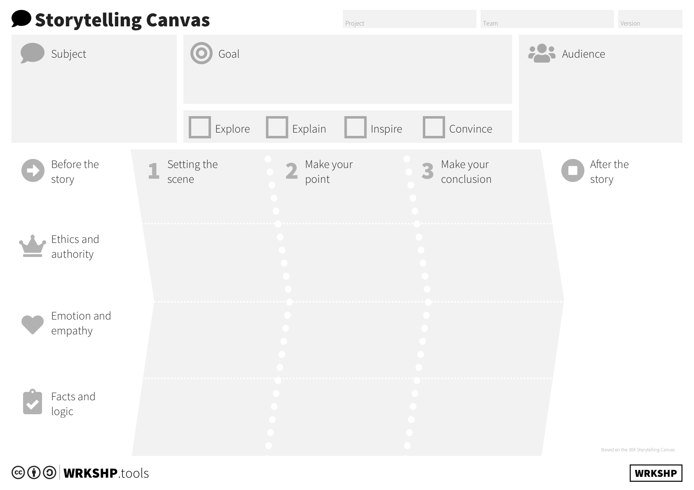
Fill the canvas below to define your story. Remember: people love dreams!
Click to download Storytelling Canvas

Slide 51
WOW MOMENTS
A tourism experience is made up of a series of moments. So called "wow moments" are those that the visitor will carry in their heart for a lifetime, and they are the ones they will tell their friends and family about.
It can be a sunset aperitif, a hands-on experience, a chat with a local ...
For getting to wow it is important that:
you know the moments in which your visitor's heart will leap
you stitch the rest of the experience around those moments
*click on a picture to watch TEDx talk “Getting to Wow!”

Slide 52
10 Tips for creating unforgettable experiences
Start with the uniqueness of your assets: what is a unique thing that visitors can't find elsewhere?
Create a story: your site should tell an inspiring story.
The visitor is protagonist: design experiences that exceed their expectations.
Stimulate the 5 senses: design experiences that generate strong emotions.

Slide 53
10 Tips for creating unforgettable experiences
Give exclusivity: make the visitor feel special and part of an exclusive adventure
Give authenticity: stay true to local history and tradition.
Create surprise: create unexpected emotions in the visitor.
Create unforgettable moments: create moments in the mind to share with family and friends.

Slide 54
Wrapping up the take aways of the full ITE design path.
There are a lot of examples of digital technologies that can meet your needs and target your desired audience.
Take care to seamlessly weave the technologies with the story that you want to convey and to add the wow moments into the whole experience to make it more engaging and adventurous.
In the following slides, we will take a look at a final practical example that guides you through some of the design steps of turning a Tourism Experience into an Immersive Tourism Experience.

Slide 55
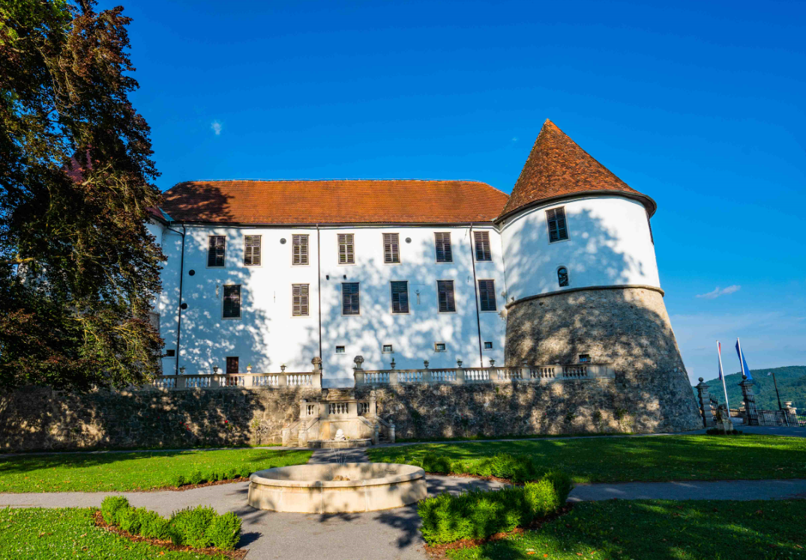
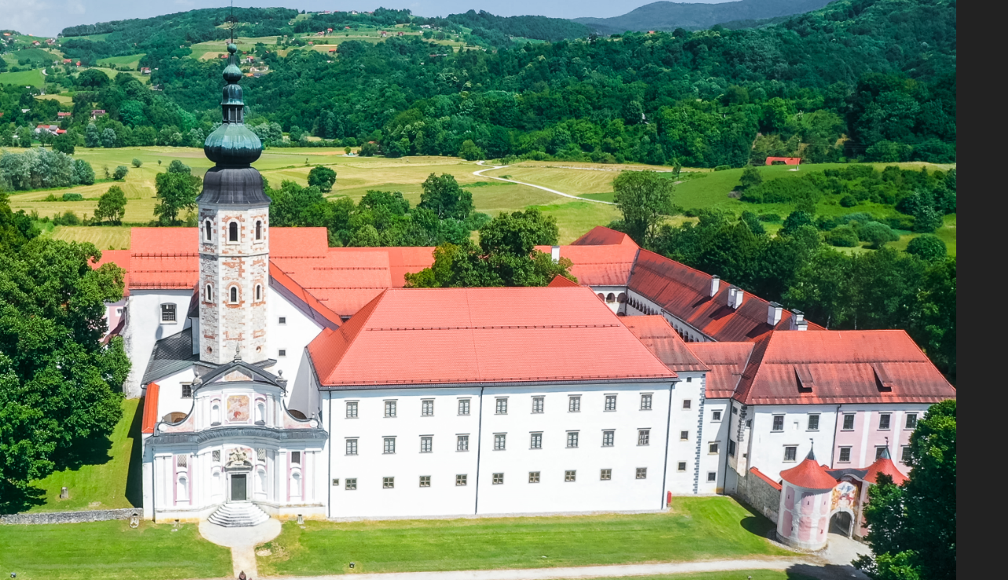
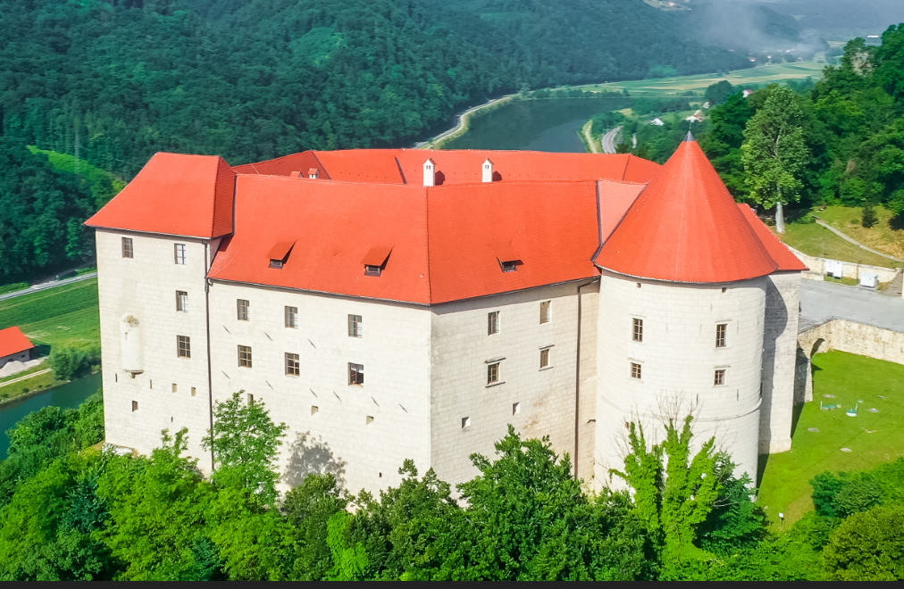
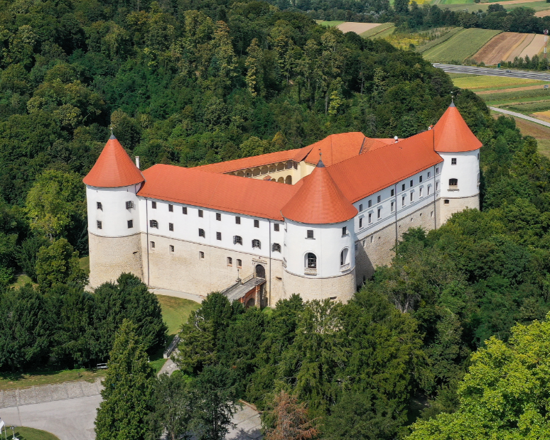
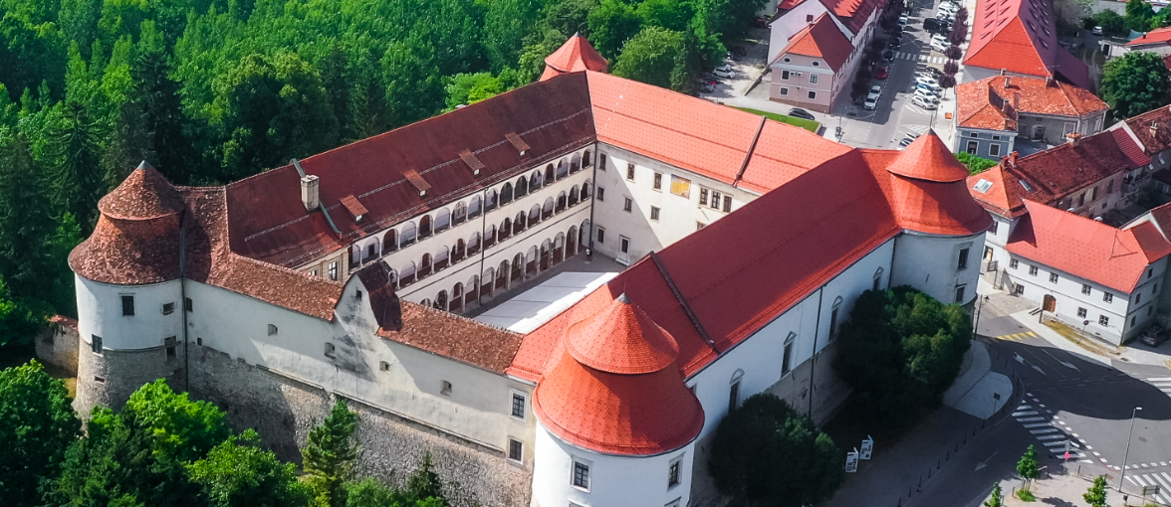
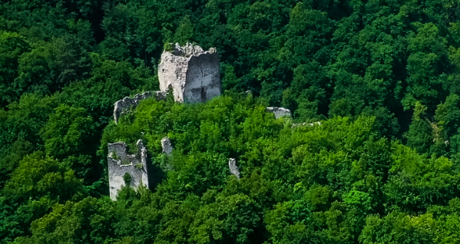
Design Case Study - Posavje region, Slovenia
This Immersive Tourism Experience was designed for a regional development agency RRA Posavje from Posavje region in Slovenia, which is well-known for many castles. The Royal Seven
The main focus of the project was a promotion of these castles which are:
old, majestic and unique (from Middle Ages to Baroque),
mystical, with hidden paths and interesting historical facts, full of stories of its owners,
very diverse, full of art and public sculptures.

Slide 56
Considering the needs and possibilities of the organisation
The identified needs of the investor were:
preserving seven castles for future generations by digitising them.
educating the visitors about cultural heritage interactively, and immersing them in the historical story and the peculiarities of the sites
improving the castles’ promotion which was restricted to a website, without engaging and attractive digital materials nor channels of communication.
redirecting tourists from the busiest locations to less congested points of the region by motivating them to plan a half day trip to any of the remote castles scattered across the region.
The project managers had the chance to collaborate with castles, museums, local tourist organisations and tourist providers. The ITE was developed by professionals from a Slovenian technological company. The project was co-financed with funds from the EU and Republic of Slovenia.

Slide 57
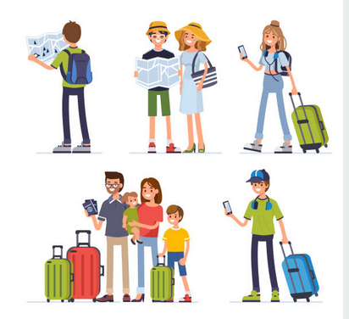
Choosing the target audience
The target audience that they identified was:
the “general public”, outside of regular museum and gallery visitors
digital natives,
digital immigrants.
They especially wanted to engage families with young children to get to know castles and spend an afternoon or more at one or more of the castles.

Slide 58
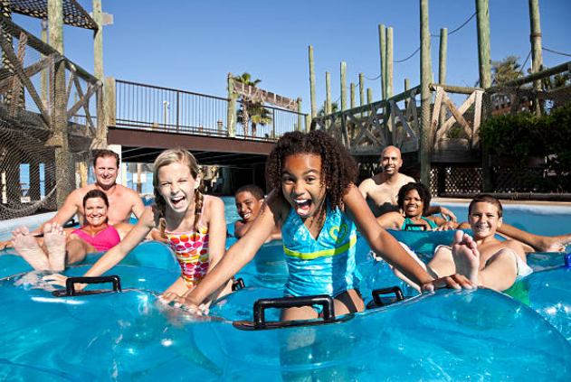
Knowing the target audience
It was important to know the target audience‘s habits and interests.
The chosen target group does not think of museums and galleries as their primary interest. The families usually look for fun and engaging afternoon trip ideas, often outside and/or without a lot of advance planning.
The location for the ITE was chosen in a way to reach the target group in their environment – they decided to work in the local spa resort with the most overnight stays in the region.

Slide 59
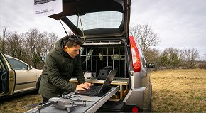
Creating the ITE content
Content of 4 different types has been made!
High-quality digitization of the castles exterior which was done in three steps:
using flying drones equipped with cameras many high-quality pictures of each castle were taken from many angles preserving visual state of the heritage in detail,
pictures from 3D scanning were then merged together into a 3D model making it feel even more realistic, watch the results: City of Reichenburg
adding 3D reconstructions (according to the historical sources) for some parts of the castles which are missing or in a very bad state, thus showing how it was before.

Slide 60
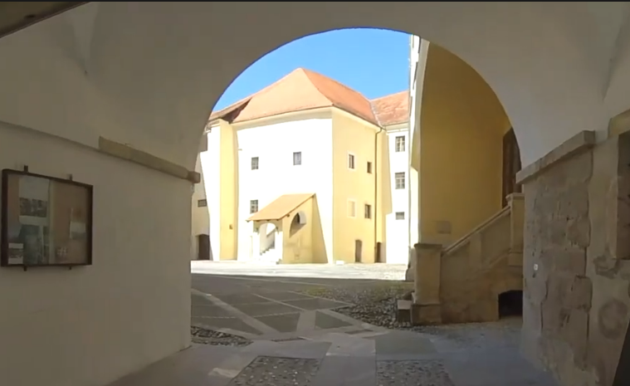
Creating the ITE content
Content of 4 different types has been made!
360-degree video of a family visiting some interesting places at each of the seven castles was made, for “placing” the visitor to the remote castles, Watch a video explaining the basic work process here How to Make 360° Videos
digital content of the local tourist offer was also planned to be created and presented, but due to COVID-19 it could not be made, so only already existing photos and videos were available for promotion purpose,

Slide 61
Creating the ITE content
Content of 4 different types has been made!
digital content for a mobile app that works as tour guide with elements of gamification was also made.
The interactive app follows an immersive story that puts a user in the role of an alchemist and accompanies him on his trip to the castles.

Slide 62
Choosing most suitable technologies for content presentation
3 types of digital technologies were chosen to present the content
Holographic projectors
Reason: attractive, new to most of the visitors, enable viewing of 3D content in detail, offer controlled degree of interactivity so the content could be made interactive – one can choose a castle to view with information about interesting architectural and historical facts added to the model
LCD screens and touchscreens
Reason: showcasing more existing information through digital content of tourist programmes at the castles (photos of events, gastronomic offer …)
VR glasses
Reason: very attractive to young visitors, new to most of the visitors, offer individual ways of experiencing 360° video content

Slide 63
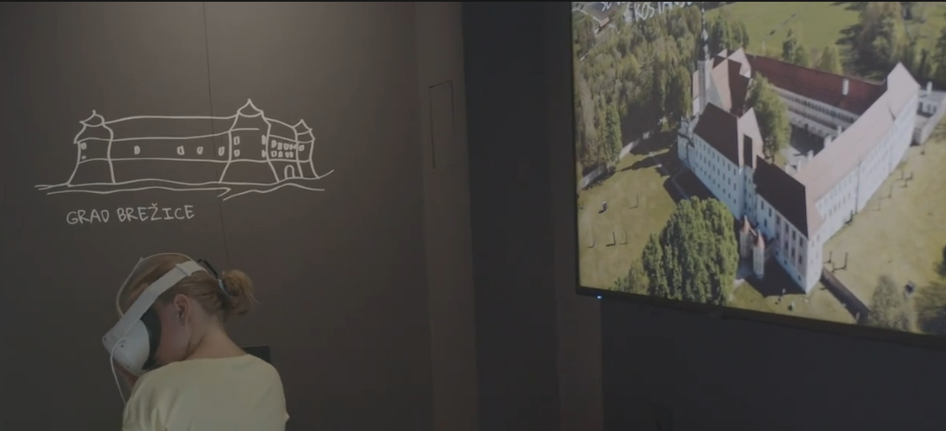
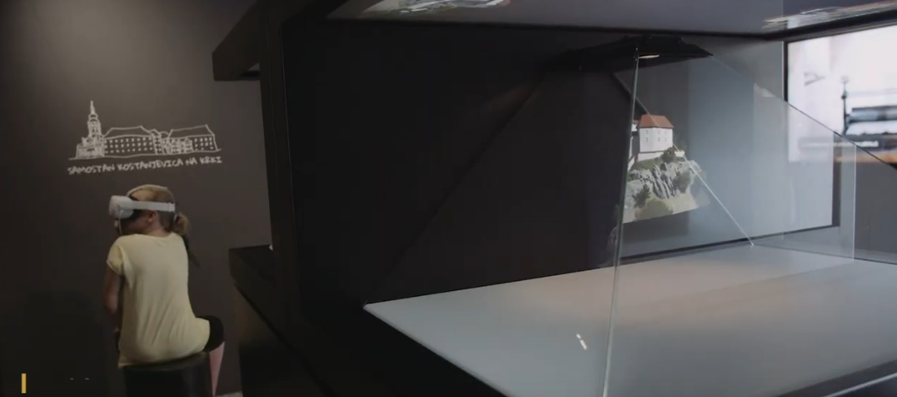
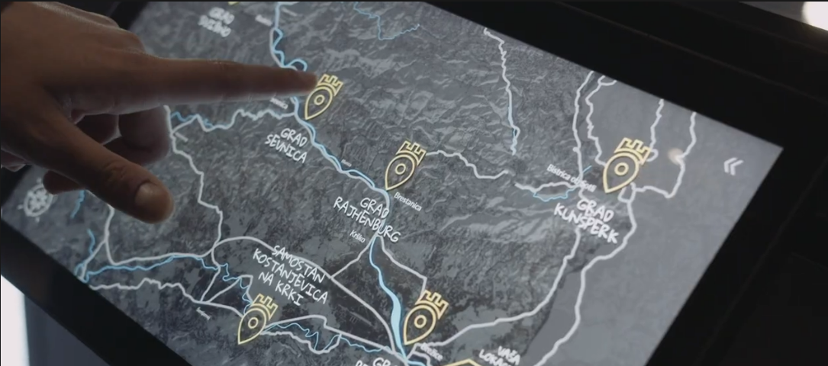
Choosing the most suitable technologies for content presentation
Using a holistic approach!
To present the visual content, the developer designed “Digital immersion room” inspired by the dark cellars of castles but interpreted in a modern way.
Inside this room the designers mounted all of the chosen digital technologies used for the presentation of the created visual content.
View a trailer for the final product: Trailer.

Slide 64
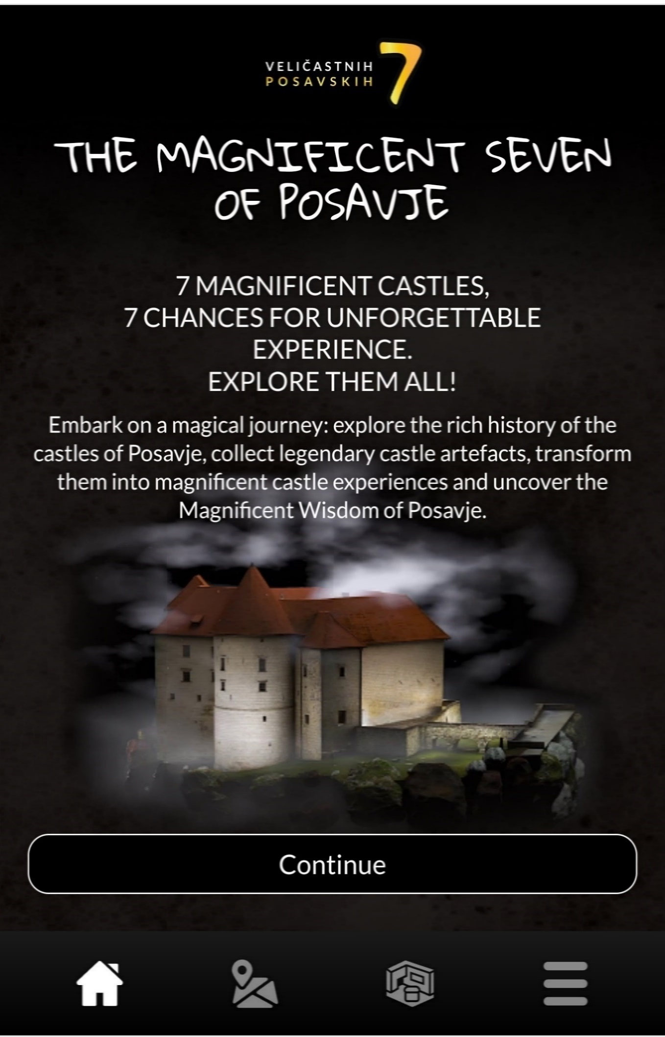
Choosing most suitable tech. for content presentation
The content created for the interactive tour guide was used in a mobile web-app
The App was developed to be web-based, so it can be run in a browser - this makes it independent of mobile platforms and thus available to anyone who owns a smartphone and has the access to internet through Wi-fi or mobile data transfer.
The mobile web-app was called “Magnificent 7”.
Mobile phone link: Magnificent 7

Slide 65
Spicing things up with WOW moments!
The Wow effect for the digital immersion room comes from the unexpected contrasts:
entering a dark , medieval-ish room from the bright outside world,
seeing mostly unknown digital technologies presenting medieval world of castles,
hearing a modern interpretation of medieval music playing in the background.
For the Mobile web-app the wow is achieved by:
turning the castle visit into a true adventure - incorporating the elements of gamification the visitor has a game goal of collecting legendary artefacts
participating in a Grand Prize draw for completing all the castle visits – the user also gets to obtain small prizes when visiting the castles.

Slide 66
Results of the final ITE product
Visitors have been impressed by the projections of 3D models and VR 360º video. They appreciate the possibility of exploring seven castles of Posavje in one place.
The investor was very pleased with the final results and with the number of visitors’ that showed an unexpectedly high interest in the attraction.
So far, no significant problems or downsides in designed ITE were identified, only some minor issues turned up because of poor planning for the possibility of inappropriate use of VR devices by children, that leads to hardware malfunctions.

Slide 67
5. International Case studies of innovative Immersive Experiences in the culture and heritage sectors

Slide 68
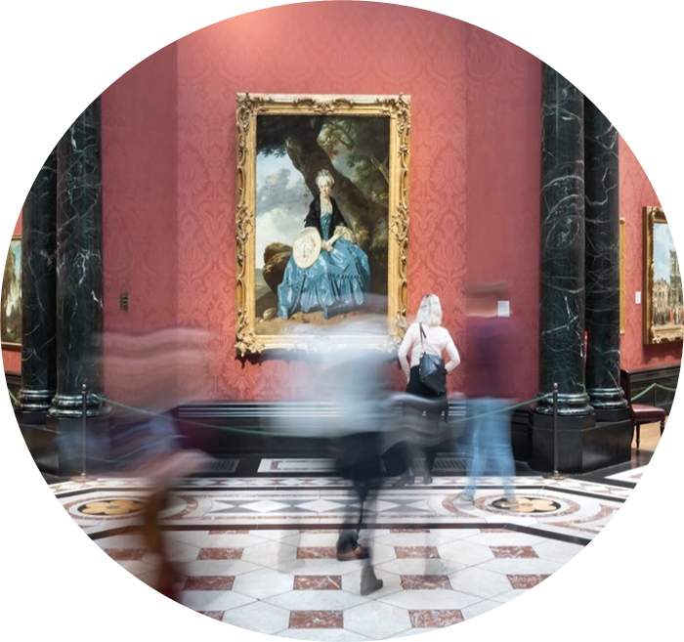
Get inspired…
The National Gallery, United Kingdom
The National Gallery in London is one of the world’s best examples when it comes to immersive cultural experiences. It offers several free virtual tours that can be enjoyed home. From Google tour to tours dedicated to the Renaissance or particular artistic selections Google Tour
The most innovative example is the "Sensing the Unseen" tour Sensing the Unseen. The experience is designed to be enjoyed on smartphones and it visits six scenes from Gossaert's "Adoration of the Kings," zooming in on details and actually entering the artwork accompanied by interactive sounds.
Credits National Gallery

Slide 69
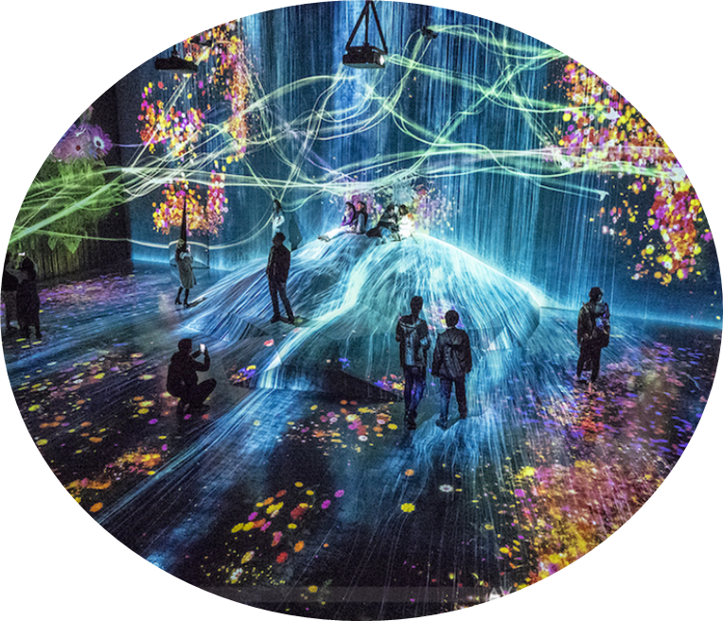
Get inspired…
teamLab Borderless of Shanghai, China
Is it possible to break the boundary of the frame to allow art roaming freely in space?
Yes, and that's what they did in Shanghai!
Shanghai Immersive Experience
Through the use of technology, art has been transported into a new dimension, immersive and experiential, where the visitor is enveloped by the work, actively participating and feeling part of the artistic concept.
teamLab Borderless shows how cultural and artistic heritage is transformed and enjoyed in a new way , becoming a real, shared experience.
Credits Travel Gaijinpot

Slide 70
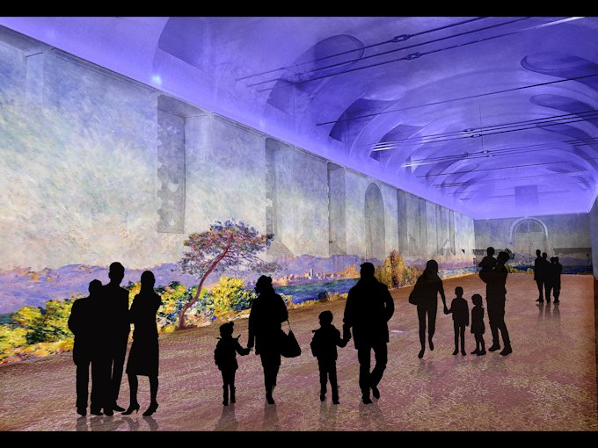
Get inspired…
Arcimboldi Museum, Italy
"Claude Monet - The Immersive Experience", is an excellent example of a highly successful immersive cultural experience. It uses both non-technological building blocks, such as furniture, and technological ones such as video panels and sounds. These combined allow the visitor to enter - literally - inside an impressionist painting.
The exhibition has allowed the museum to increase visits and raise its profile and offer an innovative way to experience fully the world of one of the greatest Impressionist artists of all time.
Credits Ticketone
Notes:
LINK

Slide 71
References
🕮 WWW sites and blogs:
Wikipedia: https://en.wikipedia.org/wiki/Main_Page
Why immersion matters: https://www.cladglobal.com/architecture-design-features?codeid=31267&ref=n
Humans have more than 5 senses: https://www.weforum.org/agenda/2017/01/humans-have-more-than-5-senses/
Usability, Design and Content Issues of Mobile Apps for Cultural Heritage Promotion: “The Malta Culture Guide Experience“: https://arxiv.org/ftp/arxiv/papers/1207/1207.3422.pdf
How to Use Augmented Reality in Museums: “Examples and Use Cases:“ https://jasoren.com/how-to-use-augmented-reality-in-museums-examples-and-use-cases/
Louvre Museum Official Website (virtual tours): https://www.louvre.fr/en/online-tours#virtual-tours
Anne Frank House (virtual tour): https://www.annefrank.org/en/anne-frank/secret-annex/landing/
Ullastret3D. Walking through an Iberian town from 2.200 years ago: https://heritageinmotion.eu/himentry/slug-7b0593e03133f6bba3b1245c16f4bde4
An overview of audience insights and perspectives on immersive art, culture, and entertainment: https://audienceofthefuture.live/wp-content/uploads/2020/07/Audience-of-the-Future_The-Immersive-Journey-Report_July-2020.pdf
Design methodology for 360° immersive video applications: the case study of a cultural heritage virtual tour: https://westminsterresearch.westminster.ac.uk/download/d990b2bc3d36de277362739f8a20d5ce3e2a0845be8f09631c6ddc1a87b8
Experience Machu Picchu in Virtual Reality. YouVisit: https://www.youvisit.com/tour/machupicchu
5 Ingredients for immersive storytelling with technology and space: https://medium.com/design-voices/5-ingredients-for-immersive-storytelling-with-technology-and-space-2a4c8f73bc83

Slide 72
References
🕮 WWW sites and blogs:
5 best storytelling Ted Talks: https://allgoodtales.com/5-best-storytelling-ted-talks/
Storytelling – How can we engage all the senses?: https://senseoflearning.com/2017/11/29/storytelling-how-can-we-engage-all-the-senses/
7 Of The Best Examples Of Digital Storytelling: https://thatsnovel.co.uk/2019/03/19/best-examples-digital-storytelling/
7 digital storytelling tips for the cultural heritage sector: https://medium.com/digital-storytelling-festival/7-digital-storytelling-tips-for-the-cultural-heritage-sector-8e701a439dd6
Link to “Regional development agency Posavje“ offcial web page: https://www.rra-posavje.si/
Link to a mobile web-app called “Magnificet 7“: http://www.egradovi-posavja.si/
Čatež in Posavje web page: https://posavje.com/en/the-royal-seven/
Link to the “Castles of Posavje“ official web page : https://gradoviposavja.si/
Virtual tours of the National Gallery: https://www.nationalgallery.org.uk/visiting/virtual-tours
Google virtual tour of the National Gallery: https://www.nationalgallery.org.uk/visiting/virtual-tours/google-virtual-tour
The National Gallery: “Sensing the Unseen“, At home, An experimental, interactive experience designed for mobiles (link to a mobile App): https://www.nationalgallery.org.uk/visiting/virtual-tours/sensing-the-unseen-at-home
Claude Monet - The Immersive Experience: https://monet-experience.it/
teamLab Borderless Shanghai: https://borderless.teamlab.art/shanghai/

Slide 73
References
⤤ Video:
Van Gogh Alive Wellington Exhibition: https://www.youtube.com/watch?v=0-ij1d8Lvbo
The Story of Senses Through Natural History: https://www.youtube.com/watch?v=5IOiKR3fvLs&t=60s
Bluecadet museum interactives for "Native American Voices" exhibition at the Penn Museum: https://vimeo.com/89925565/c61857150f
Bygone: Scents in Colors –Introduction: https://www.youtube.com/watch?v=3HaeVZCuMmQ&list=TLGGkXBzOrFbF8UxMjEyMjAyMQ
NAUSICAA - Immersive room about global warming: https://www.youtube.com/watch?v=rfq3aCInelU&t=11s
The starry night Stereo VR experience: https://www.youtube.com/watch?v=G7Dt9ziemYA
Barry C Smith: “We Have Far More Than Five Senses“: https://www.youtube.com/watch?v=zWdfpwCghIw
The differences between AR, VR & MR: https://www.youtube.com/watch?v=IFgGzOpjlUM
Chinese museums roll out VR, AR exhibitions: https://www.youtube.com/watch?v=-l_bsuTv0P8
What is a Web App? Web App vs. Native App: https://www.youtube.com/watch?v=qt6gSW-uYKI
Google Cultural Institute - Mobile Apps Demo: https://www.youtube.com/watch?v=hyOngqriHQI&t=2s
What is AR?: https://www.youtube.com/watch?v=1j9BY1tBmv8
Mobile Augmented Reality: Web vs App: https://www.youtube.com/watch?v=OgmUjDMpphc
Augmented Reality for Tourism, Titianic: https://creativeindustriesclusters.com/ar360-augmented-reality-for-tourism/
Augmented Reality (AR) Applications for Museums: https://www.youtube.com/watch?v=hDRVLYsCgxA
Exploring Cultural Heritage in Augmented Reality with GoFind!: https://www.youtube.com/watch?v=W14e8SRZGkA
What is VR?: https://www.youtube.com/watch?v=ULdt1rEgldc
Resonant: An Immersive Game for Connecting People to Cultural Heritage: https://www.youtube.com/watch?v=Q1kXcQMasEk

Slide 74
References
⤤ Video:
VR game Thermana Laško “Change the flow of the history“: https://www.youtube.com/watch?v=RjFoX0JQkmU&t=80s
Hold The World | Rift: https://www.youtube.com/watch?v=nr3l98Omm-0&t=47s
Pleito VR Concept: https://www.youtube.com/watch?v=PJRHUcC0xa8&t=122s
Interactive Table with Object Recognition: https://www.youtube.com/watch?v=ELlqqgKEy8M
Planes of Fame Air Museum Interactive Touch Table Exhibit: https://www.youtube.com/watch?v=0fU9Z6svUFA&t=16s
WildLife Interactive Exhibition 2017: https://www.youtube.com/watch?v=TdUo4yK8wj8
ARTLENS Gallery: Create, Engage, Connect | The Cleveland Museum of Art: https://www.youtube.com/watch?v=XYRjaZl08lQ&t=85s
Cleveland Museum of Art, Gallery One (12/12/12 – 6/21/17): https://www.youtube.com/watch?v=qWJqd6lyJ-E&t=55s
10 Most Advanced Holograms that are CRAZY!: https://www.youtube.com/watch?v=f7fffZ_k9ow
Build a 3D Hologram Projector: https://www.youtube.com/watch?v=z9OEpAsosFw
How to Make 3D Hologram Projector with Resin (Super Clear) - Resin DIY: https://www.youtube.com/watch?v=qNceVquu02o
Castle Rajhenburg - 3D model: https://www.youtube.com/watch?v=Y3LiqDvXcwE&t=64s
German Circus With Hologram Technology 2019: https://www.youtube.com/watch?v=bR_By2jEEcw
Da Vinci Museum Rome 3D Hologram: https://www.youtube.com/watch?v=BVym6-BJ78c
REAL holograms are finally here! (And they look very cool): https://www.youtube.com/watch?v=7oGtgbsmmg8&t=103s
Van Gogh, Atelier des Lumières, PARIS: https://www.youtube.com/watch?v=lNXzwzyo9xE
Da Vinci Experience Multimedia Room: https://www.youtube.com/watch?v=-UjF0QhiOMM
How to create immersive storytelling experiences - Gamification in Tourism Case Study: https://www.youtube.com/watch?v=CwLkqILkuSo

Slide 75
References
⤤ Video:
Getting to “Wow!” | John Nottingham | TEDxAsburyPark: https://www.youtube.com/watch?v=jupM4Nc0Y_k
5 best storytelling Ted Talks: https://allgoodtales.com/5-best-storytelling-ted-talks/
How to Make 360° Video (VR) : Basic Workflow Explained: https://www.youtube.com/watch?v=84a8dsQSGB4
e-Gradovi Posavja – trailer video: https://www.youtube.com/watch?v=KNC-Ohlmt3U
teamLab Borderless Shanghai, Digest Movie: https://www.youtube.com/watch?v=jRjLBK9-ZZ0
⤤ Audio:
TE MET, To See the King (audio): https://soundcloud.com/metmuseum/505-the-king?utm_source=clipboard&utm_campaign=wtshare&utm_medium=widget&utm_content=https%253A%252F%252Fsoundcloud.com%252Fmetmuseum%252F505-the-king
Inside the Circle of Fire: A Sheffield Sound Map by Chris Watson (2020 stereo version): https://www.youtube.com/watch?v=5hfoEDTn_fQ&t=434s
Canvas examples:
User Centered Design Canvas, accessible at: https://cutt.ly/jnTvcjG
Unique Selling Proposition Canvas, accessible at: https://cutt.ly/DnTvKTb
Persona Canvas, accessible at: https://cutt.ly/2nTbpgn
Storytelling Canvas, accessible at: https://cutt.ly/BnTbfPZ

