Slide 1
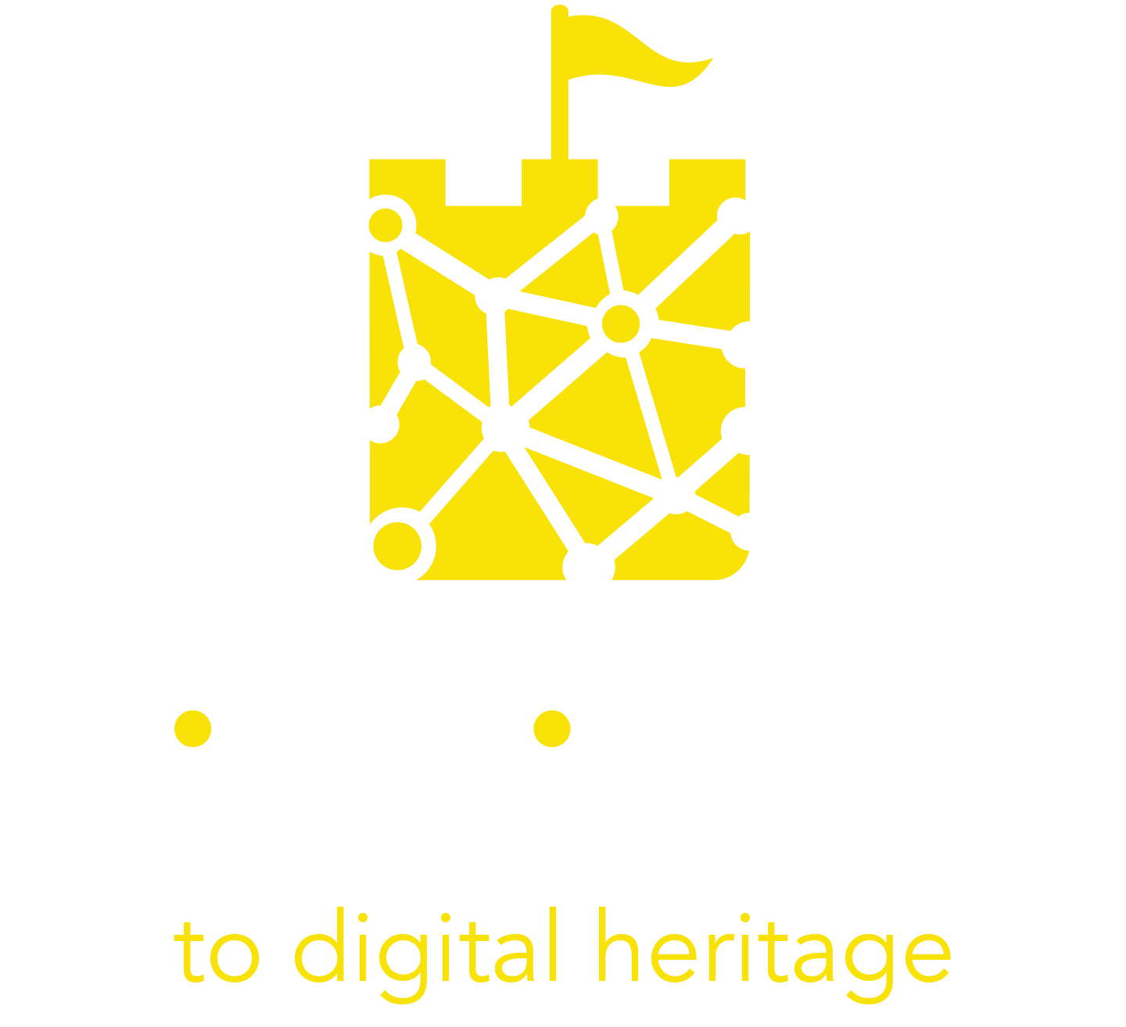
Module 2
Overcoming the Barriers to Digitisation of your Cultural Heritage Experience

Slide 2
TABLE OF CONTENTS
01
Overcoming the Barriers to Digitisation
02
Lack of inspiration
03
Lack of vision and strategy
04
Lack of confidence with the technology
05
Lack of skills
06
Lack of resources
07
Case studies and useful tools

Slide 3
“Inspiration comes from within yourself. One has to be positive. When you're positive, good things happen.“
Deep Roy

Slide 4
Overview
This module focuses on analysing the main barriers that cultural and tourism operators encounter in relation to the digitization of cultural heritage. It offers possible solutions for overcoming them.
Learning objectives:
Evaluate the most common barriers to digitization of cultural heritage
Explain some key strategies for dealing with the barriers:
Understand the basics of design thinking as a way to spark some inspiration

Slide 5
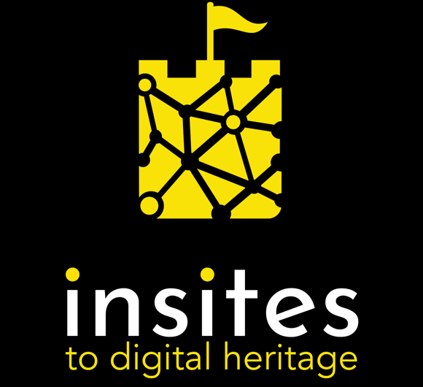
Introduction
Overcoming the Barriers to Digitisation

Slide 6
Overcoming the Barriers to Digitisation of Cultural Heritage Experiences
Digital innovations are reshaping the use of information and knowledge in society, but digitization of Cultural Heritage is not as simple as just using the latest technology available on the market.
There are numerous barriers that may challenge the digitization of the overall Cultural Heritage Experience. Paradoxically, most of the identified barriers are not of a technological kind. One of the biggest barriers is that digital strategies in most organizations are underdeveloped.
Digital transformation is only possible if all key stakeholders adopt it willingly. So what are the most common barriers in digitization and how can they be overcome?

Slide 7
Lack of inspiration

Slide 8
Lack of inspiration
Key stakeholders in the digitisation process often show a significant lack of inspiration to use advanced technology and to follow modern trends in cultural heritage.
This lack of inspiration may come from working in a closed group of experts without opportunities to share their own knowledge, to get to know best practices, practical use of the technologies, positive impacts on the users, etc.
The sharing of enthusiasm and knowledge brings inspiration and new creative ideas. Bringing experts from different environments, countries, and backgrounds together, provides a creative space for changing ideas. This innovation space and experience leads to making sustainable new plans and delivering them….

Slide 9
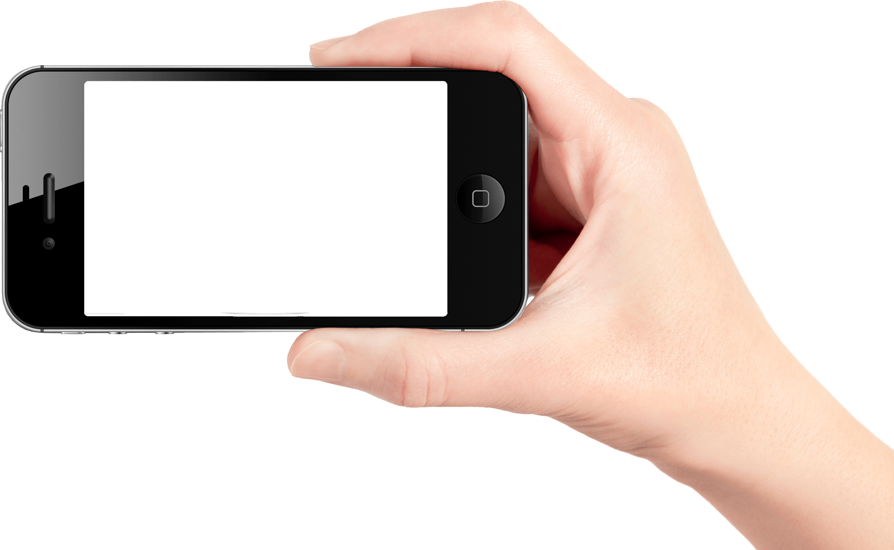
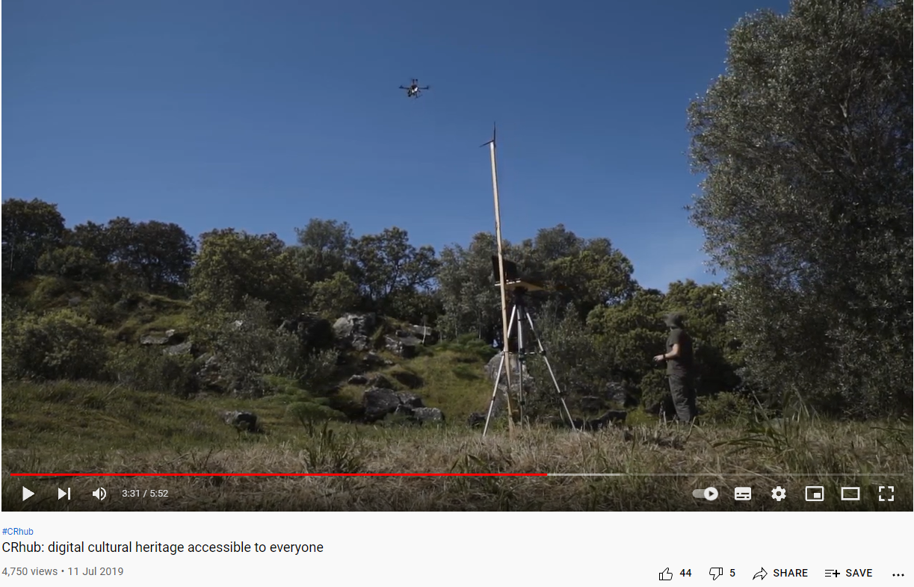
Lack of inspiration
All the cultural heritage that was digitised in the past, was based on inspiration as the first step.
Our INSITES platform hosts a MOOC with access to a private community of trainers in the digital education and marketing field, along with other cultural custodians.
Visit today to join the peer-to-peer learning network and be inspired by others!
Culture Hive is a free online resource hub for cultural professionals that brings the collective intelligence of the sector together in one place, by you, for you.
Click the link on the image to watch how other stakeholders are trying new digital software that makes cultural heritage accessible for all!

Slide 10
Watch and learn “How to uncross Directors arms”
What do a museum or cultural heritage directors want? And how can the people running their digital programmes help them get it?
Watch this concise, funny and insightful guide from the most digitally engaged of the current generation of museum directors- Maxwell L. Anderson “How to uncross Directors arms”. He outlines their perceptions and barriers to implementing a digital strategy.
*Only 5 minutes…click on the picture above!*

Slide 11
Lack of Vision and strategy

Slide 12
Lack of vision and Strategy
Without a strategy, cultural heritage organisations do not have the focus needed to achieve their goals and to develop future plans.
Managers of heritage institutions with a vision and a strategy are often lacking the resources to realize it. Through time the motivation to innovate can drain away and managers just follow a strategic plan that is unchanged for years.

Slide 13
Lack of vision and strategy continued….
Collaborating with world-renowned experts brings the energy and ideas for reshaping old strategies.
The pandemic has shown how different today's market is and how untraditional today's users are. Digitisation was the answer in lockdown.
The vision of digitising cultural heritage institutions needs to harness all the existing potential in and outside the institution.
Managers have to be able to set challenges, inspire their staff and engage them in the process of creating a shared vision.
Motivation is the key factor for changing mindsets and getting out of an institutional rut. It enables digital pathfinders to bring new technologies into the organization and offer the cultural heritage experts and the customers a unique, memorable experience………

Slide 14
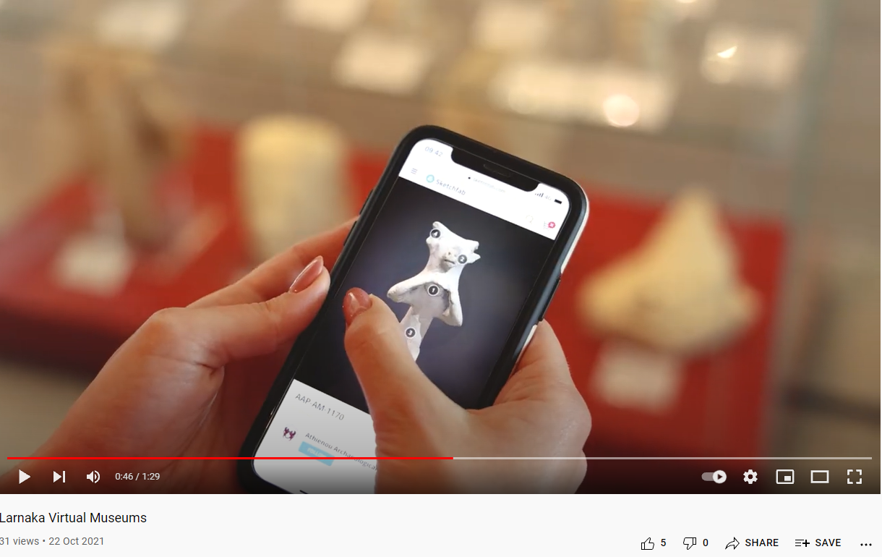
Lack of vision and strategy continued….
Click the link on the image to watch how “Larnaka Virtual Museums” has transformed their visiting offer with technology! Maybe some motivation/inspiration will be sparked!
Experience has shown that good local strategies are often based on good national strategies. National leadership can enable stakeholders to develop a new vision.

Slide 15
GUIDE to Digital Strategy for Museums
What is a digital strategy?
Do you need a digital strategy?
What would it take to create a good one?
Download this practical guide for museums (and other organisations) that want to do more with their digital programmes
Simply follow this link to download the Digital Strategy for Museum Guide PDF: https://www.cogapp.com/digital-strategy

Slide 16
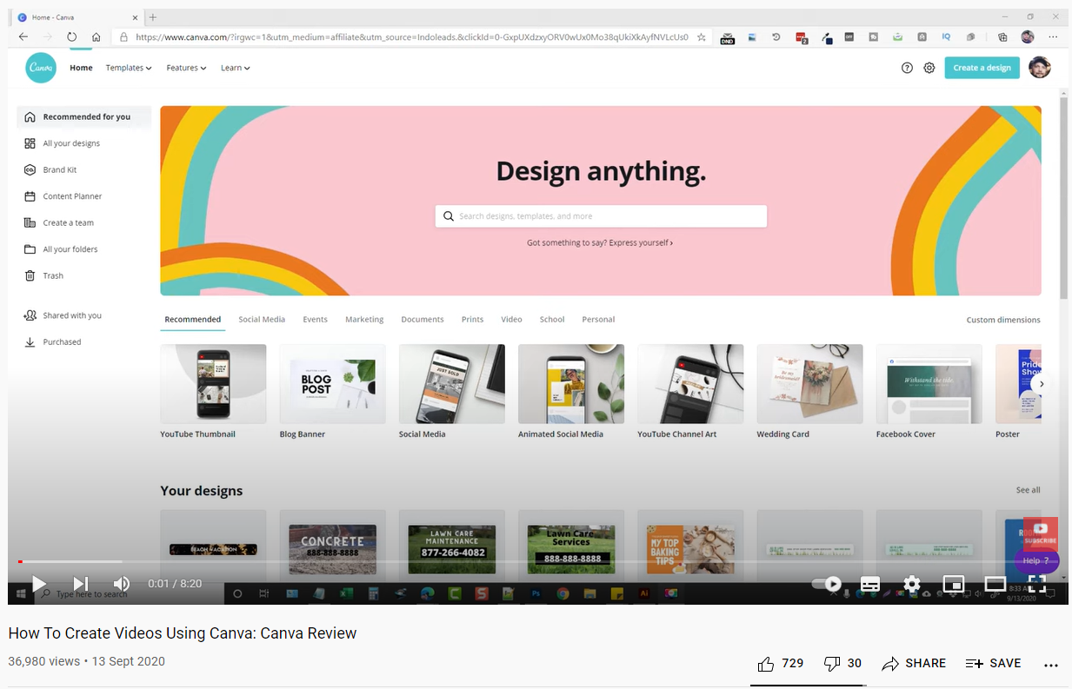
Click on a picture to watch the video below on how to create videos with ease using Canva
10 minutes Digital takeover-Canva!
Approaching the world of digitisation is daunting, and knowing where to start is not easy!
In order for you to gain confidence in the digital world and to see the vast benefits that digital tools and solutions hold, you must try it for yourself.
One of the BEST digital content tool is Canva, which is only growing in popularity!
Have a go at making a promotional video for your cultural heritage site. This is a small digital task, but it stands to inspire you onto greater things!
LEARN MORE

Slide 17
Lack of confidence

Slide 18
Lack of confidence
with the technology
People are generally afraid of new, innovative approaches and products, especially of new technologies.
Many of the staff of cultural heritage organisations have not grown up with the levels of technology we have in every facet of life today. Their lack of confidence in modern technology is understandable.
But when technology becomes accessible it gives people of all ages the opportunities and techniques. It enables them to learn, try new things and build their confidence.
“Don't be afraid! I had no idea what I was doing at the start, but through Emma’s help I learned a lot and I’ve ended up with a permanent memorial for my time in lockdown.” Oonagh Gay

Slide 19
Lack of confidence with the technology
Seeing good practice examples from the field is an excellent way of removing barriers.
Take a look at the Insites Case Studies and Digital Toolkit for a confidence boost; https://www.insitesproject.eu/
With projects involving heritage experts from a nontechnological background, it is important to put extra effort into explaining and involving them in the digitisation process, showing the added value for their users and for enriching their cultural heritage offer.
Ongoing consultancy support for training and handling newly digitised assets is also important.

Slide 20
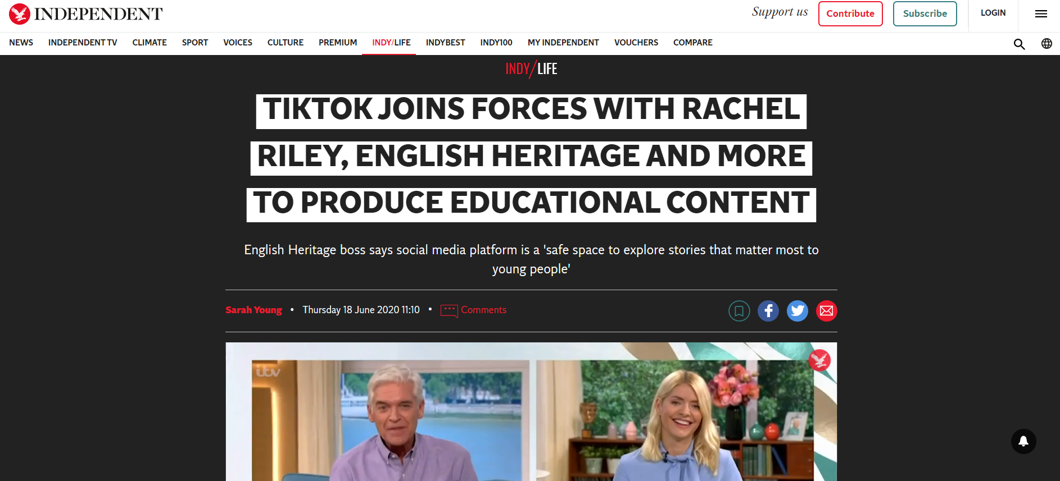
How are Museums using TikTok?
TikTok has enlisted the help of hundreds of experts and institutions to produce educational content for the platform.
The social media giant announced the launch of its #LearnOnTikTok initiative, which is part of an £11.5 million investment to be shared across Europe.
Find out how Museums in England are using TikTok to reach a wider audience! This could be a small step in building your digital confidence…imagine mastering one of the top trending digital/social media tools in the world!

Slide 21
Challenge…Create a TikTok account and video for your cultural heritage site!
EXERCISE
To Create an account:
1. Download TikTok from Google Play or the App Store.
2. Open the app.
3. Tap Profile in the bottom right.
4. Choose a method to sign up – you will need an email or phone number to sign up
To Create a video:
1. Tap + at bottom of the screen.
2. Upload content from your device Library or use the TikTok camera.
3. Add Sounds, Effects, Filters, or other camera tools.
4. Start your video by pressing the Record button.
5. Record your content.
6. Tap the check mark.
7. Make additional edits on the post page.
8. Post your video!

Slide 22
Lack of skills

Slide 23
Key Skills gaps
The majority of heritage organizations lack dedicated or general staff skilled in technology and digital project management. This is one of the biggest barriers to growth in audiences and revenue.
Cultural heritage organizations and businesses will need skills in digital curation and creating content for their users. Digitally skilled, talented people are now an essential asset for your organization and their knowledge is every bit as important to your success as the heritage expertise you value and accumulate
The three most common skills gaps are:
Experience Design
Project Management
Applying Digital Technology

Slide 24
Every cultural heritage institution has its own internal culture. Often this is not aligned with the tourist offer that exists in the local community.
The overall goal of every successful tourist product is to bring a high-value experience to the visitor, and this includes cultural heritage visitors.
Today’s visitors are comfortable with using modern technologies (e.g. VR headsets, apps) and demand a memorable experience. Experience design is a new approach that provides products and services with a focus on the quality of the user experience.
Key stakeholders in a location/destination need to connect and collaborate in the design process. Bringing different skills and talents together – Who can you work with to strengthen your idea?
Experience
Design

Slide 25
Project Management
Most financial resources for R&D activities are provided by national and EU project funding. This makes professional digital project management one of the basic requirements that every cultural heritage institution should have.
The well skilled and experienced project manager will overlook every step of the digitisation process including:
empowering in-house human resources
managing external experts
monitoring spending
buying and embedding new equipment
creating a path to sustainability
There are two routes to improving project management skills, provide additional training for the in-house staff or employ an experienced project manager in house or externally. These options have their pluses and minuses which need to be factored into your planning process.

Slide 26
Applying Digital Technology
The pandemic has confirmed that legacy ways of working are outdated, and that digital transformation speeds up and spreads the growth of the organization.
With technology skills being scarce in most heritage organisations it will be necessary to open and connect with IT experts with knowledge and experience in the advanced equipment that can make the most of your visitor’s offer.
Technology is constantly adapting to become more accessible to the non-expert and the knowledge of experts can easily be transferred to cultural heritage staff with limited previous experience.
Modern technology is just at the beginning of its path to transform society and change the way we live, think and experience things. With some confidence and enthusiasm to learn anyone can join in!!

Slide 27
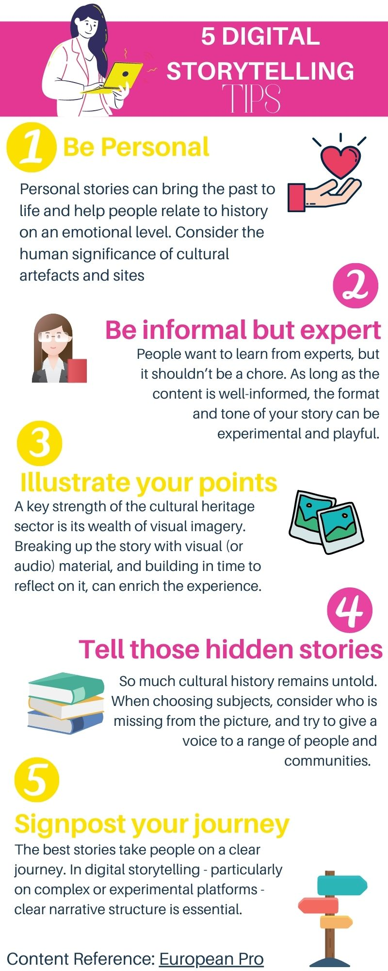
Digital Storytelling in the cultural heritage
sector….
This could be a way to test the “digital” waters and to gain some confidence in your digital skills!
Audiences want to feel informed by digital stories, but also curious, immersed, inspired and connected by them.
It is this that sets storytelling apart from other content types; and it is this that gives storytelling such a role to play in engagement and community-building across the cultural heritage sector.
For Tips on Digital Storytelling in the cultural heritage sector download the “Digital Storytelling Tips” Infographic or visit Europeana Pro’s blog for more in-depth reading on the subject!

Slide 28
2.6 Lack of resources

Slide 29
Technology
Two most common gaps in resources inhibit the development of Digital experiences of Cultural Heritage.
Lack of financial resources
Lack of human resources.
Some heritage organisations have in the past had substantial income from tickets, merchandising or event rentals. Post Covid, even those fortunate enough to continue to generate substantial income have severe financial challenges and many others have simply not had the funding to allow them to carry out research and development outside of their conservation and preservation roles.
Many heritage institutions relying on limited public funding also have limited human resources that are currently focused on the specialized heritage knowledge and skills their institution needs...
Lack
Of
Resources

Slide 30
Technology
Extra resources for digitization may come from different National and EU open calls, such as CINEA, which demands an excellent project idea and an active collaboration with international partner organisations.
Creating a chicken and egg scenario where it takes skills and investment to get skills and investment.
Investing some time to evaluate and learn digitization skills can break this cycle. Insites modules can get you started on your digitization journey.
Lack
Of
Resources

Slide 31
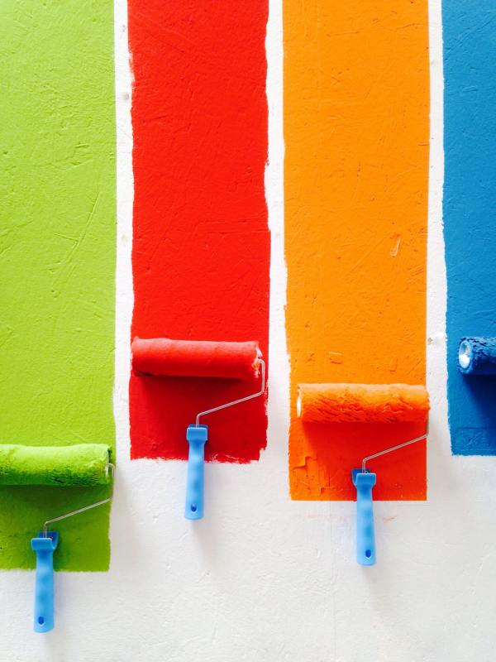
Introduction to DESIGN THINKING
Introduction to Design Thinking
If you are time and resource poor, with limited finances, design thinking could be the option for you!
For any business owner, it’s vital to develop user experience design skills. The costs and risks involved for any business on developing a new product or service are high. Applying design thinking can help save money right away because it directs attention to the specific solutions people need. (1)
It can be a great way to tackle ill-defined or unknown problems because they can reframe these in human-centred ways and focus on what’s most important for users.
(1) https://www.toptal.com/designers/product-design/design-thinking-business-value

Slide 32
Design Thinking training module!
What you will learn:
• Define what design thinking is and understand the main skills associated with design thinking
• Know the importance of design thinking in relation to your own business development
• Gain insight into how companies such as AirBnB and Uber have used design thinking to drive their business growth
• Have a clear understanding of the key elements and purpose of design thinking after watching the short YouTube video
• List the different stages that make up design thinking
(It will take less than 10 minutes to complete each sub topic…a lean approach)
This module was made by partners EUEI and BDEL in the E+ Lean Innovation Project!

Slide 33
Case studies and Useful tools

Slide 34
Get Inspired…
Digitization of Slovenian cultural heritage
Slovenia is famous for its castles. Many of them falling into ruins through time. But many did get completely restored and renovated. The Slovenian Ministry of Economic Development and Technology saw a potential in digitising some of them and published an open call for tourism destinations.
As a pilot project, there was also a hurdle to jump in engaging key stakeholders in a project with unfamiliar outcomes. Co-operation between museum staff and the technical experts needed to be established. Challenges were solved by building up trust and partnership with numerous meetings, simple explanations and demonstrations to involve heritage staff in the process, etc. After the first 10 digitisations cooperation became easier as everyone could visualize and understand the value of the results.

Slide 35
Get Inspired…
Acropolis, Athens, Greece
An interesting example of the effective use of a multidisciplinary advisory body, skills building support via specialized training and educational programs and the engagement of stakeholder groups such as the Friends of the Acropolis.
They established YSMA, a new special service, provided a radical overhaul and permitted the recruitment of highly qualified technical and scientific personnel. They ran an extensive research programme on the conservation and restoration of the site. This research enriched the heritage knowledge on the site and helped to make the appropriate decisions.

Slide 36
Get Inspired…
Škocjan Caves, Slovenia
Škocjan Caves is interesting for its holistic approach, local community representation, public awareness, international cooperation and school network.
To exchange know-how between the sites, the Škocjanske jame combined the school network, young people, local communities and local people in the management of the protected area (i.e. WH property). Fifteen years of the protected area in this area has significantly contributed to local development and the park is still considered the main tourist attraction providing for sustainable development of the area.

Slide 37
Get into Action
First Steps….
The first steps you could take to overcome barriers to digitizing culture are:
engaging with the external experts, coaches
joining national/international networks
participating in study visits
finding new financial sources/open calls
think about your skills mix and create a staff training plan for digital skills, particularly Experience Design, Heritage Technology, Project Management, Digital Communication.

Slide 38
Get into Action
Useful Links…
MOOC Cultural heritage free courses https://www.mooc-list.com/tags/cultural-heritage
Cultural Heritage Research Projects
Find projects in Europe and across the globe!
https://www.heritageresearch-hub.eu/homepage/heritage-projects/
Tourism 4.0 partnership - innovative digital tools & services, projects, etc. https://tourism4-0.org/
Game of TraCEs - gamification for cultural tourism experiences https://www.gameoftraces.com/

Slide 39
References
Cultural Hive: https://www.culturehive.co.uk/
Crhub - digital cultural heritage accessible to everyone: https://www.youtube.com/watch?v=UOD9NsUVJX0
MCN2014 - Ignite by Maxwell Anderson: https://www.youtube.com/watch?v=xoEXeNnusFE
Larnaka Virtual Museums: https://www.youtube.com/watch?v=BcZmlh_hTN0
Cogapp, Digital Strategy for Museum Guide: https://www.cogapp.com/digital-strategy
How To Create Videos Using Canva: https://www.youtube.com/watch?v=9mMidy_oC5o
The Indipendent (2020) Tiktok joins forces with rachel riley, english heritage and more to produce educational content: https://www.independent.co.uk/life-style/tiktok-learn-on-educational-initiative-rachel-riley-english-heritage-maths-health-a9572696.html
Europeana pro (2021) Seven tips for digital storytelling with cultural heritage: https://pro.europeana.eu/post/seven-tips-for-digital-storytelling-with-cultural-heritage
The Value of Design Thinking in Business: https://www.toptal.com/designers/product-design/design-thinking-business-value

