Slide 1
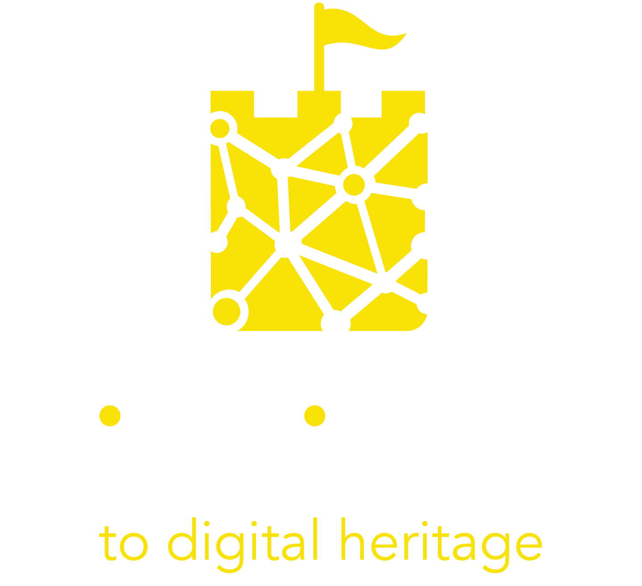
Module 1
Introduction to Digital Cultural Heritage

Slide 2
TABLE OF CONTENTS
01
Foreword
02
Experiential and Cultural Tourism
03
What is Digital Cultural Heritage
04
Digitizing Cultural Heritage
05
Audiences evolution after the pandemic
06
The extended cultural experience
07
Case studies and useful tools

Slide 3
“In times of change, learners inherit the earth.”
Eric Hoffer

Slide 4
Learning Objectives
When you have completed this module you will be able to:
Define experiential and cultural tourism.
Describe the potential of digitisation to transform the cultural heritage and tourism sectors.
Describe how audience behaviours have changed and the implications for traditional cultural heritage businesses
Explain the extended experience
Evaluate your readiness for digitisation

Slide 5
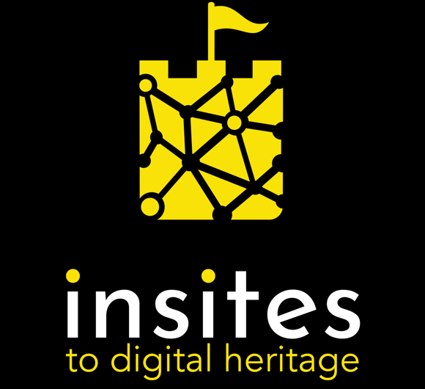
Foreword
The INSITES project and the aim of this guide

Slide 6
INSITES to digital heritage is an Erasmus+ funded project with an international partnership from seven countries: Banbridge District Enterprises (United Kingdom), Momentum (Ireland), European E-learning Institute (Denmark), Trabzon Ortahisar Belediyesi (Turkey), Akmi (Greece), Arctur (Slovenia), Destination Makers (Italy).
The aim of this project is to support innovation in the cultural tourism sector by improving the digital and experiential skills of cultural and tourism professionals, leading to the creation of new digital cultural heritage tourism experiences and new audiences for cultural heritage.

Slide 7
The present guide is the first step in this journey of reimaging how we create, protect and consume digital cultural heritage. It offers free educational resources with ideas, opportunities, tools, and case studies that will inspire you to plug into the powerful potential of digital technology to rejuvenate, preserve and grow cultural heritage tourism in Europe.

Slide 8
There are 3 other key resources offered by Insites:
An Active Peer Learning Guide that captures inspirational case studies and best practice examples of digital cultural and heritage tourism experiences across Europe.
A MOOC, a digital training point where cultural heritage professionals can access up-to-date information, guidance, and training from European digital cultural heritage experts.
A Digital Cultural Heritage Technology Toolkit with low/no-cost digital tools to make digital cultural heritage accessible and achievable for smaller tourism providers.

Slide 9
The first approach to digital may sound “scary” for many cultural and tourism operators that had not yet started a digital transformation journey in their organizations. The present project aims to start filling this existing gap between people and technology and to offer practical guidance to embrace a digital approach to the promotion of cultural heritage.
Join us in this path to explore the power of technology to increase your ability to deliver future-focused digital and immersive cultural tourism experiences to your audiences.

Slide 10
Experiential and Cultural Tourism

Slide 11
Cultural Tourism
Is when travellers actively seek out heritage attractions as a focus for a visit, giving the cultural tourism custodian a significant market advantage with this kind of customer.
Experiential Tourism
The experiential tourist focuses on getting actively involved in a destination's activities, heritage and culture, rather than simply visiting the place.
Immersive Tourism
The immersive tourist, like the previous two, is increasingly looking for more engaging and enriching holiday experiences than before.

Slide 12
Culturally Immersive Experiences
Cultural Immersive Experiences are the inner voice of a cultural heritage site. They must be able to:
Create a real competitive advantage for the site;
Focus on what is truly unique, memorable, and engaging in the area;
Meet the needs of the target audience.
In later modules, we'll look in more detail at how to design immersive tourism experiences for your visitors.

Slide 13
An opening group exercise:
Brainstorm about your motivation for travelling
You can write ideas in general or be very specific:
Some hints:
Food
Natural heritage (watch an example of natural heritage )
Cultural heritage (watch an example)
Popular places (watch an example)
Sports activities (skiing, surfing, etc.) (watch a video about sports tourism)
Weather
Events (Olympic games, UEFA Champions League, Expo, etc.)

Slide 14
What is Digital Cultural Heritage

Slide 15
Digital: not a tool, a horizon
Nowadays, digital cannot be considered as something apart from reality, rather it is a framework through which we interact with the world around us.
Cultural and heritage organizations and businesses have been faced more than ever with the importance of having a digital strategy not only to preserve but also to promote cultural heritage.

Slide 16
Digital: not a tool, a horizon
In general terms, the digitisation of cultural heritage refers to the use of digital technologies to make heritage objects and services available in a digital form. This approach can be applied to a variety of aspects of a cultural organization’s work such as:
communication
audience engagement
cataloging
conservation
education
research

Slide 17
Digital: not a tool, a horizon
Making a transition into the digital world is not only about moving existing experiences into a new digital format or medium, but more importantly, it is about re-imaging those experiences to create new immersive ways to interact with and experience culture. Breaking the boundaries between new technologies and culture makes fertile ground for the development of the sector on many levels.
Digital technology makes heritage accessible to broader audiences from researchers to the general public. It increases our ability to understand our cultures and to share that understanding. It fosters new connections that open up positive conversations, and it encourages us to look at old things through new eyes.

Slide 18
Digitization is a fundamental shift for the cultural sector that involves a whole new set of skills. But skills that can be learned and managed.
Cultural and tourism organizations need to look at technology as a real boost to their work that can generate greater value and impact.
Digitization is a long-term process that can start with small and no/low budget changes to support what you are doing and spark innovative thinking. Once technologies are embedded in your thinking and development processes digital can become a strategic lever that brings added value to your cultural organization and your audience.

Slide 19
Exercise: digital cultural heritage in your organisation
Group discussions,
Personal experience
Discuss in groups the current state of knowledge in your organization of experiences and practices related to digital cultural heritage

Slide 20
Digitizing cultural heritage

Slide 21
Digitizing cultural heritage
The powerful potential of digital technology to rejuvenate, grow and preserve cultural heritage
After the forced closures that cultural organizations and businesses had to face due to the Covid pandemic, it became of fundamental importance for all of them, from the smaller to the bigger ones, to adopt a digital strategy for their development.
This shock to the system has been looked at by many as a chance to be more strategic and to see technology as an opportunity that can bring a variety of benefits, including the creation of new revenue streams.

Slide 22
“Historically, many museums have seen digital as an isolated, compartmentalized operational need. But a modern museum now can look at digital as a platform for its operations, not just segmented operations in a department.”
David Lipsey, co-director of the Rutgers University’s Digital Asset Management Certificate Program
This integrated view is essential to cultural organisations on every level to create a strategy for digital transformation that moves you into the future with a rejuvenated offer for your visitors.

Slide 23
Opportunities for digital transformation
Preservation
Vibrant new digital tools for preserving, protecting, and restoring precious cultural artifacts.
Education
More interactive and hands-on approaches to involve a greater range of learners.
Data Collection and Analysis
Digital data can be used to gain unprecedented insights into your audience behaviors both online and onsite, making you much more likely to offer what they really want.

Slide 24
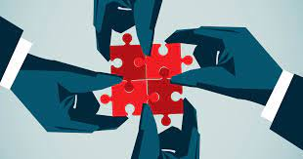
Opportunities for digital transformation
Powerful Collaborations
Digital shortens the distance between cultural, tourism, and creative businesses and offers fertile ground for the creation of new partnerships and all the strengths of a multidisciplinary approach.
Audience Development
A strong digital presence touches new audiences, including hard-to-reach younger generations, distant audiences, and people that cannot visit in person (e.g. the elderly, disabled people, people living in other cities). It lets you reach out to new types of travellers that do their research online and might never find you otherwise.

Slide 25
Audience evolution after the pandemic

Slide 26
Audience evolution
How a year of online activity has changed the ways
audiences experience the cultural heritage
The cultural (and especially the museums) sector has reached a “crucial turning point” in its digital transition where audiences are embracing and looking for a digital offering and museums are starting to create integrated online and offline content to show unseen materials from their collections and attract new visitors - According to the study Digital Responses of UK Museum Exhibition to the COVID-19 Crisis March-June 2020 conducted by researchers from the University of Warwick in collaboration with peers at the Oxford University Museum of Natural History.
To understand ongoing shifts in audience behaviors and plan new strategies accordingly, the Insights Alliance - a group of three leading UK consultancies, Indigo Ltd, Baker Richards, and One Further - has launched in 2020 the Culture Restart Toolkit, a program that collects and analyses data on UK audiences and visitors of theatres, museums, art centers, and other cultural organizations.

Slide 27
Audience evolution
Since October 2020, the program has collected data from nearly 50,000 respondents from the UK, and in its April's report, the analysis showed that 60% of respondents have engaged with culture online during the last year, and over half of those have done so four or more times, moreover 90% declared that they will continue to engage with events online or would consider online options for things they wouldn’t be able to see in person.
These results highlight a tendency towards digital culture consumption that will last beyond the end of the pandemic restrictions.
The future of cultural experiences seems to be characterized increasingly by a “digital hybridity” in which online experiences do not replace the physical one, rather it enhances it allowing cultural businesses and organisations to move beyond their doors and to offer a combination of real-life and virtual experiences to engage with their customers.

Slide 28
This shift parallels the growing appetite in younger generations who are increasingly looking for combinations of art and entertainment and immersive experiences enabled by digital technologies.
According to a recent Euromonitor analysis, Millennials and Gen Zs have high expectations for technology and innovation and increasingly value experience over things, 78% of them say they’d choose to spend money on an experience or event over buying something desirable.
These younger, less traditional consumers of new cultural experiences are a growing revenue stream

Slide 29
What’s the response from the cultural heritage sector?
According to the research conducted by the Observatory for Digital Innovation in Heritage & Culture, in Italy, 80% of museums nowadays offer at least one online content and 70% offer technological tools to enhance onsite visits.
A survey conducted by Cuseum on more than 500 culture professionals in the US highlighted that 92% of them are now running virtual programs in their institutions.

Slide 30
The extended cultural experience

Slide 31
The extended cultural experience
The new cultural experiences will start at home through online entertainment and educational contents and with the planning and preparation of the physical visit. They will continue onsite where the digital element will support and enhance the physical experience.
It is a “multi-platform approach”.
A key question to consider is how do you create experiences extended in time and space, no longer restricted to physical visits but accessible also before, after, and independently from the onsite experience.

Slide 32
Museums, libraries, and archives are expanding their digital offering making their collection available for consumption at home.
The broader tourism sector, including small businesses, local government and small towns are also getting in on the digital opportunity through formats such as immersive virtual tours and Augmented Reality (AR) applications*
.
*Find out more about the use of these technologies in module 3

Slide 33
The main digital solutions
Online:
Virtual guided tours
Online didactic programs
Online workshops and webinars
Virtual events and cultural happy hours
High-level training programs
Virtual art classes
Podcasts
Augmented reality experiences
Videogames
Bookshop e-commerce

Slide 34
The main digital solutions
Onsite:
QR code and beacon technology
Touch screens
Audioguides
Moreover, smartphone applications and chatbots often feature digital contents to be enjoyed, both online and onsite.
Find out more about some key low-cost tools in the Insites Digital Toolkit on the website: https://www.insitesproject.eu/

Slide 35
Case studies and useful tools

Slide 36
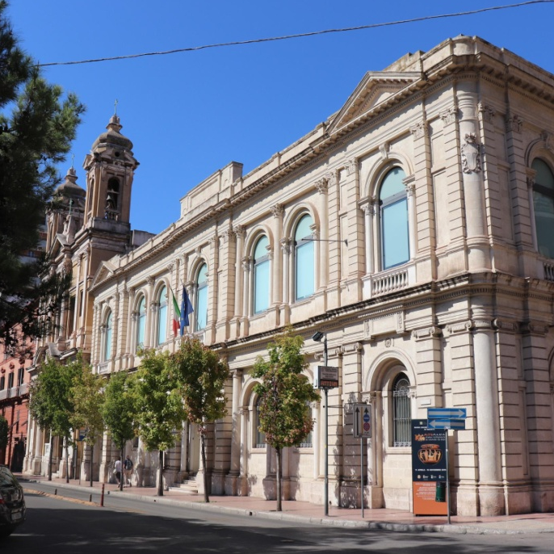
Get Inspired…
The National Archaeological Museum of Taranto, Italy
The National Archaeological Museum of Taranto (MArTA) exhibits one of the largest collections of artifacts from the Magna Graecia Era and constantly innovates its offering through new technologies. The MArTA has created in its spaces a fablab, a digital craftsmanship laboratory, it has launched Past for future, a 2D narrative videogame-related to the museum’s collection, it has launched a 3D Virtual, finally launched a project that uses Li-Fi technology and light waves to provide visitors with interactive multimedia contents during their visit. The museum also organizes a series of web meetings shared on the museum’s Youtube and Facebook accounts to reach a wider audience.

Slide 37
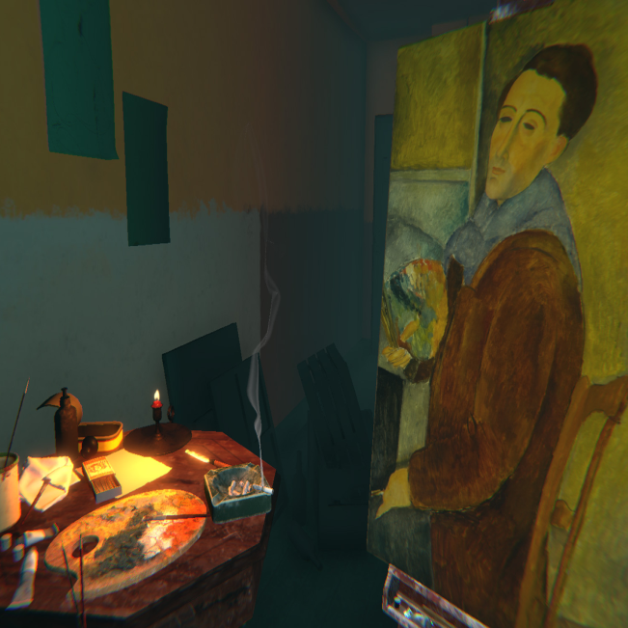
Get Inspired…
The Ochre Atelier at the Tate Modern, UK
As part of an exhibition on Modigliani, the Tate Modern created the Modigliani VR: The Ochre Atelier experience through which visitors can immerse themselves in a virtual reality recreation of Modigliani’s studio, a previously undocumented space that has been brought back to life through research and technology. The creation of this immersive experience was made possible by the collaboration of multiple teams at Tate (including AV, Conservation, Curatorial, and Digital), artists, designers, developers and producers at Preloaded, and researchers from the Museu de Arte Contemporanea de Universidade de São Paulo and The Metropolitan Museum of Art.
Credits Preloaded

Slide 38
Get Inspired…
The Baden State Museum at Karlsruhe Palace, Germany
The Baden State Museum is a major museum for cultural history in Germany that is reinventing itself by creating user-centered experiences that combine analog and digital elements to create a space for dialogue and debate. The museum is redefining its visitors as “active users” that can interact with the institution through an online account (paying a yearly subscription) and have access to extra content. Moreover, the museum has recently created an app to respond to the visitors’ need to engage with its collection that “matches” them with the museums’ artifacts through a swipe-right-or-left feature similar to one of the dating apps. Once matched, visitors can start a conversation with the objects (thanks to the use of chatbot technology) and organize a physical meet-up at the museum.
Credits Christiane Lindner,
© Badisches Landesmuseum

Slide 39
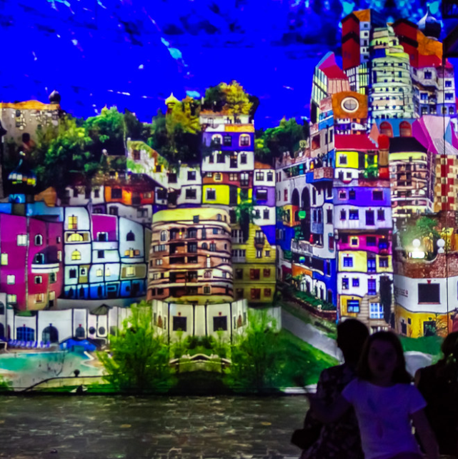
Get Inspired…
Atelier des Lumieres, Paris
After major renovations, the Atelier des Lumieres finally opened its doors to the public in 2018 and received 1.2 million visitors in the first year. Now each year, Culturespaces Foundation provides entertaining and interactive experiences to children with illnesses, disabilities, or social exclusion. The educational program entitled “Art en immersion” which is held in three immersive digital art centers (one of them is the Atelier des Lumieres in Paris) takes the children on an emotional and interactive journey with the help of Immersive digital technologies combined with the exceptional layout of each of the sites. This creates a highly unique experience of art discovery through digital media, which is suitable for younger audiences.

Slide 40
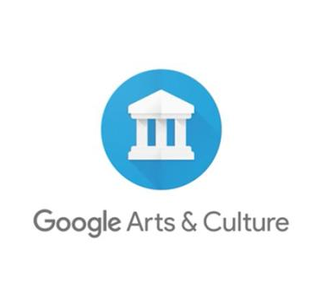
Get Inspired…
Google Arts and Culture
The online platform of high-resolution images and videos of artworks and cultural artifacts was developed at the Google Cultural Institute, Google Inc., in February of 2011. A small team of employees created the concept for the platform. The team leveraged existing technologies like Google Street View and built new tools specifically for the platform. The platform includes advanced search capabilities and engaging educational tools.

Slide 41
Get Inspired…
Engage and Create at the Cleveland Museum of Art
The Cleveland Museum of Art (CMA) gave to its audience the opportunity to develop their creative thinking skills with fun and playful activities-all from their home. Every other week the participants are challenged to create and reimagine a selected artwork from CMA’s collection using only one piece of household material or to sketch with a prompt something inspired by the CMA’s collection of art.
Credits The Cleveland Museum of Art website

Slide 42
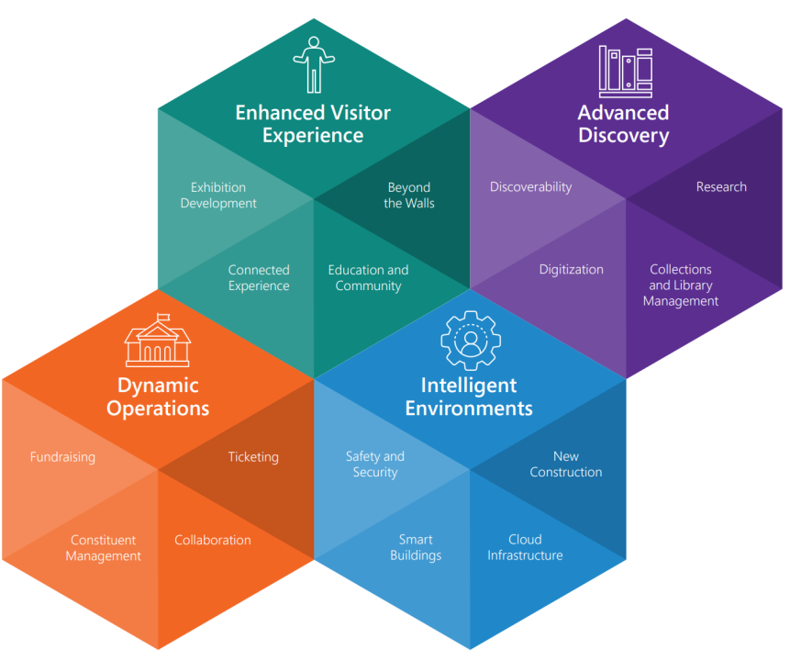
Get into action
Microsoft’s Libraries and Museums Education Transformation Framework
The Libraries and Museums Education Transformation Framework has been developed by Microsoft to support libraries and museums to express their full potential by inspiring change through a technology strategy for addressing critical areas and elements of digital transformation. The framework develops around four main areas: Enhanced Visitor Experience, Advanced Discovery, Dynamic Operations, and Intelligent Environments. The online platform allows institutions to fill an assessment and to indicate their target state and the related capabilities they would like to achieve. In the end, a report is generated that shows the difference between the current and target state and the recommended products or solutions to help fulfill the desired capabilities. (watch more)
LEARN MORE

Slide 43
References
World Tourism Organization: https://www.unwto.org/
Wonderful Copenhagen, Localhood for everyone marketing strategy 2020, accessible at: https://cutt.ly/knTzwmK
Artshub 2018, Feeling the impact of cultural tourism beyond the majors, accessible at: https://cutt.ly/3nTl7zr
Peak + Skift 2014, The Rise of Experiential Travel, accessible at: https://cutt.ly/WnTczBa
Tripadvisor, 2019 Experiential Travel Trends: New Skills, Health & Wellness, Family Activities Come Into Focus, accessible at: https://cutt.ly/4nTc8MU
Chen (2021), How Digital Asset Management Supports Museums’ Missions, accessible at: https://cutt.ly/EnTxXXB
King et al. (2021), Digital Responses of UK Museum Exhibitions to the COVID-19 Crisis, March – June 2020, accessible at: https://cutt.ly/xnTxBb9
Indigo (2021), Culture Restart Toolkit, accessible at: https://cutt.ly/rnTxNCC
KEA (2021), Market Analysis of the Cultural and Creative Sectors in Europe, accessible at: https://cutt.ly/fnTx1kC
Euromonitor (2021), New Strategies to Engage Millennials and Generation Z in Times of Uncertainty, accessible at: https://cutt.ly/1nTx20p
CCD x Smartify (2021), The multi–platform museum: A planning toolkit, accessible at: https://cutt.ly/unTx3r7
Observatory for Digital Innovation in Heritage & Culture (2021), Extended Experience: la sfida per l’ecosistema culturale, accessible at: https://cutt.ly/vnTx4OY
Cuseum (2021), The Impact of Virtual Programs on Revenue Generation for Cultural Organizations, accessible at: https://cutt.ly/XnTx7Mq
Microsoft, Libraries and Museums Education Transformation Framework: https://cutt.ly/cnTx6EI

